Slide 1

Lagoonapalooza
at Workshop Week
Train the Trainer
Lagoon Guidebook
Treatment Works 23-26 Area 5
10/21/2025
Notes:
Add regional logo in picture frame at lower left

Slide 2

Acknowledgement
This project has been funded wholly or in part by the United States Environmental Protection Agency (EPA) under a training and technical assistance agreement to Rural Community Assistance Partnership through a Treatment Works 5 grant. The contents of this document do not necessarily reflect the views and policies of the USEPA, nor does the USEPA endorse trade names or recommend the use of commercial products mentioned in this document.
This content does not necessarily reflect the views and policies of State Primacy, RCAP, or RCAP Regions.

Slide 3

Your Instructor Today…
Ty Leydig
Regional Field Manager ID & UT
ty.leydig@rcac.org
Background:
9 years with RCAC
6 years as Wastewater Operator and ORC
Class A Wastewater Treatment license in CO

Slide 4

Housekeeping
Cell phones = set to SILENT
Participation = encouraged
Restrooms
Breaks
Evaluations

Slide 5
Don’t Get Too Comfortable Yet!
Take a Post-it note from the table and write how many years of lagoon operations or wastewater operation experience you have.
  Less than 1 year
  1-3 years
  4-8 years
  Greater than 8 years
Let’s line up in these general groups.
Goal: Increase experience diversity at each table with the bonus of meeting someone new!

Slide 6


Slide 7


Slide 8
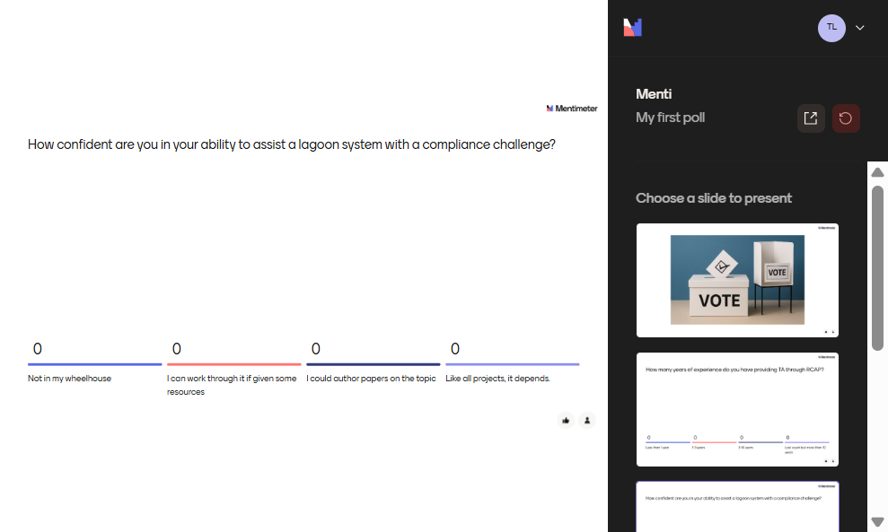

Slide 9
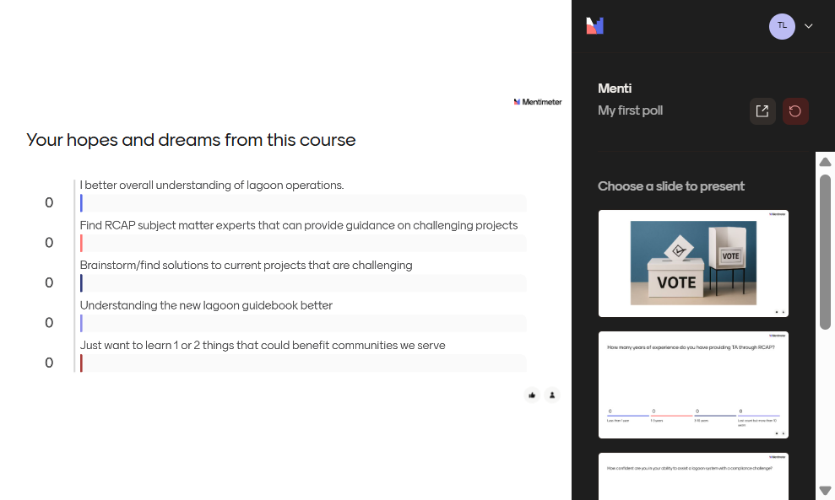

Slide 10
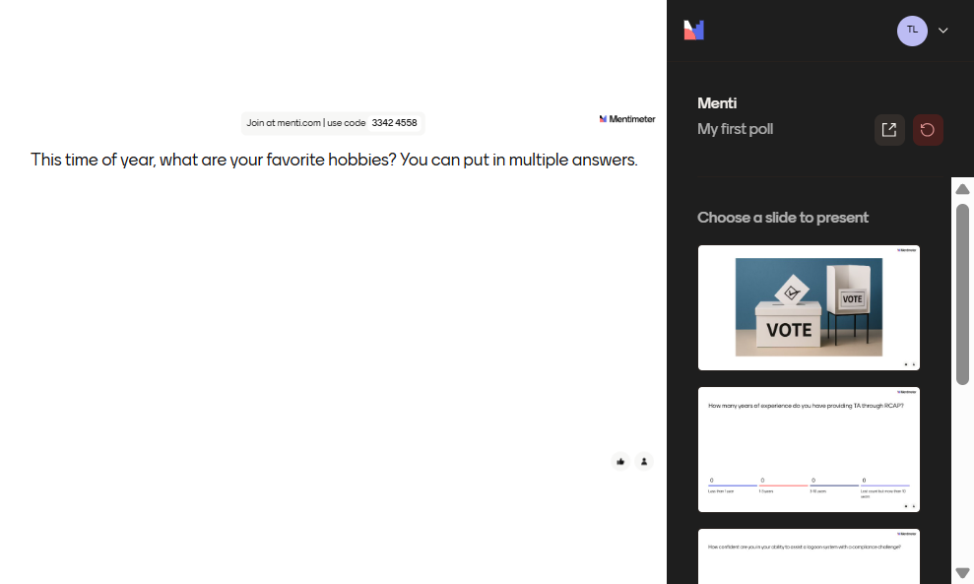

Slide 11
Today’s Agenda
Start Time | End Time | Duration | Description
1:30 PM | 1:50 PM | 20 | Introduction
1:50 PM | 2:20 PM | 30 | Lagoon Fundamentals
2:20 PM | 2:30 PM | 10 | Activity #1
2:30 PM | 3:00 PM | 30 | Lagoon Manual Table of Contents , O&M Essentials
3:00 PM | 3:30 PM | 30 | Break
3:30 PM | 4:00 PM | 30 | Sampling, Monitoring & Compliance Activity
4:00 PM | 5:00 PM | 60 | Financial Health Analysis Tool

Slide 12
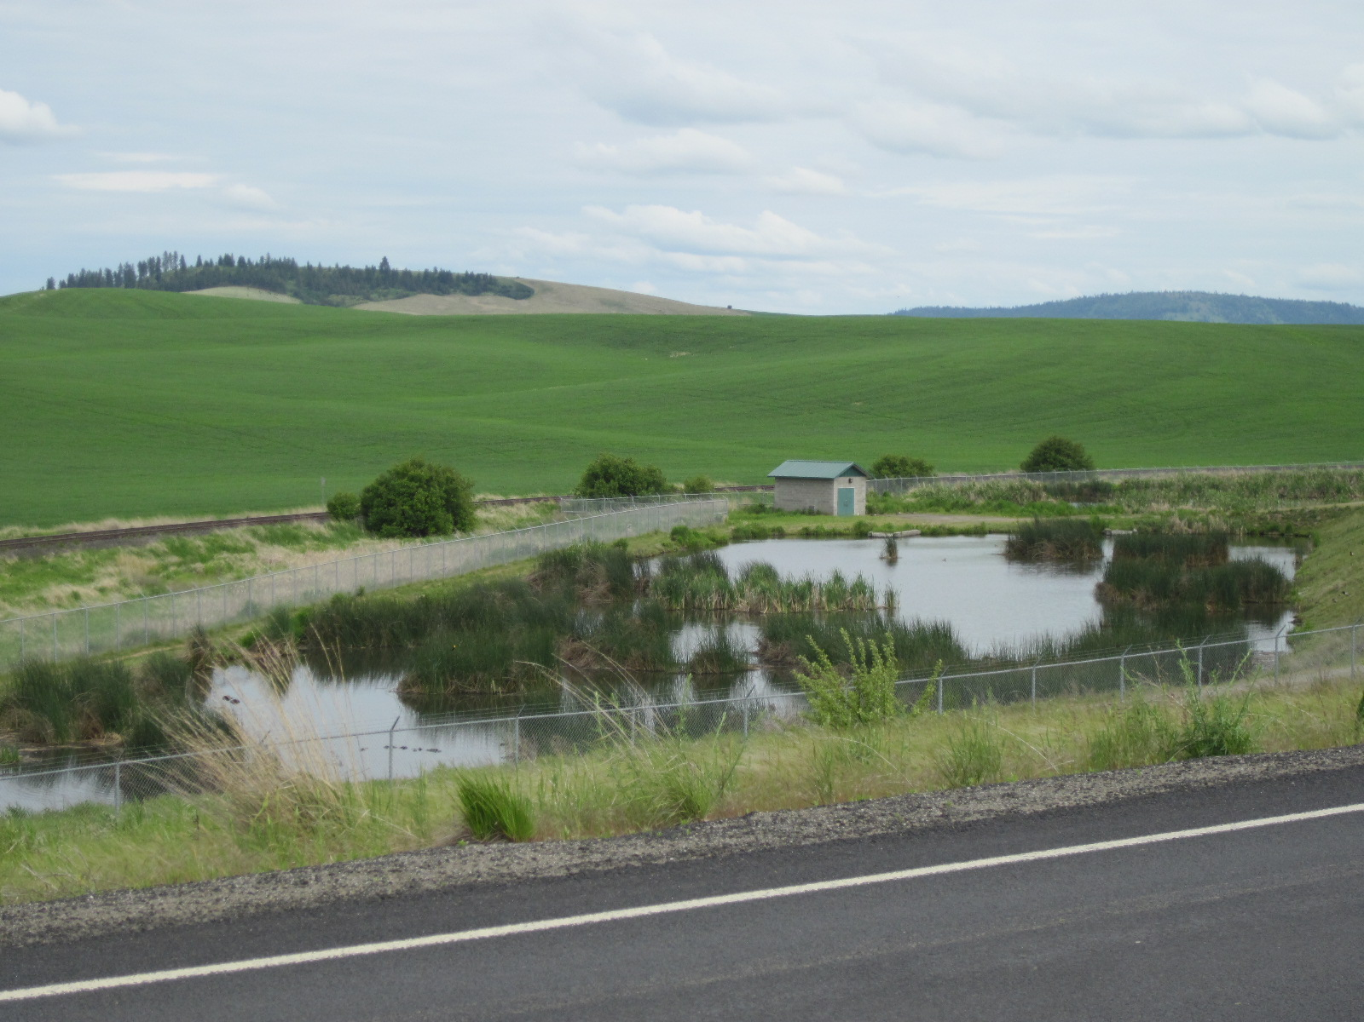
Lagoon Fundamentals
Rural Community Assistance Corporation. (n.d.). Wastewater Treatment Basics - Lagoons. [PowerPoint Slides]

Slide 14
Is it a Lagoon or a Stabilization Pond?
They are effectively equal and can be used interchangeably.
Stabilization pond is more descriptive
  Stabilized waste refers to waste that has been treated or decomposed to the extent that, if discharged its rate and state of decomposition would be such the waste would not cause a nuisance or odors in the receiving water. (Sacramento Manual, Chapter 9)
Lagoons
  Emphasizes the functionality of collecting and holding wastewater
Moving forward, we will use “lagoon”

Slide 15
What is a lagoon?
Lagoons are pond-like basins designed and created to treat wastewater through natural biological processes, where bacteria, sunlight, and wind breakdown waste material, resulting in treated effluent to protect human and environmental health.

Slide 16
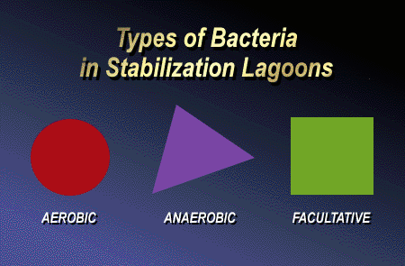
Types of Bacteria
Rural Community Assistance Corporation. (n.d.). Wastewater Treatment Basics - Lagoons. [PowerPoint Slides]

Slide 17
Types of Bacteria
Aerobic Bacteria
  Needs Dissolved Oxygen (DO) to live and grow
Anaerobic Bacteria
  Live only where there is no DO
Facultative Bacteria
  Can live with or without DO.

Slide 18
Types of Decomposition
Aerobic Decomposition
  Aerobic and facultative bacteria
Anaerobic Decomposition
  Anaerobic and facultative bacteria

Slide 19
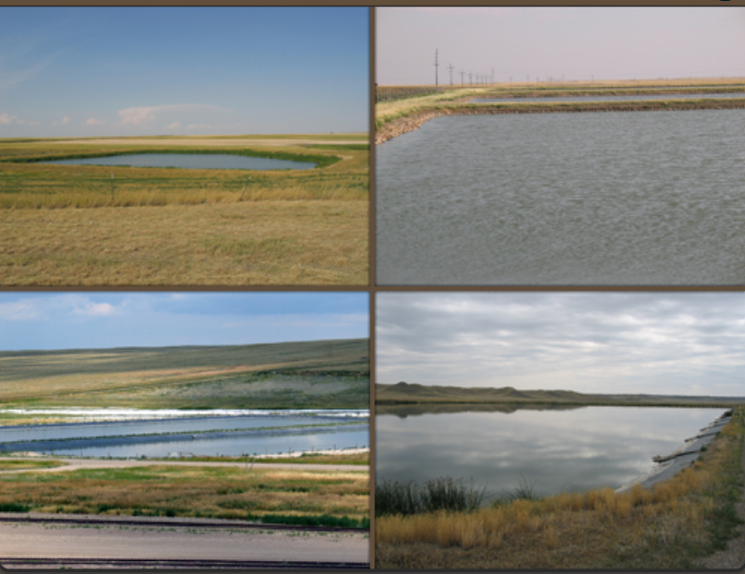
Lagoons Use Both Aerobic And/Or Anaerobic Decomposition
Rural Community Assistance Corporation. (n.d.). Wastewater Treatment Basics - Lagoons. [PowerPoint Slides]

Slide 20
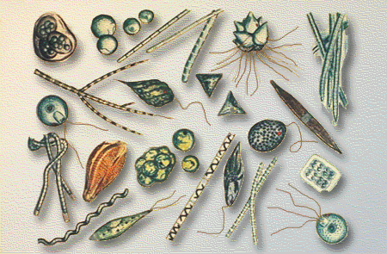
Algae
Single cell plants
Use sunlight and carbon dioxide to produce oxygen
Rural Community Assistance Corporation. (n.d.). Wastewater Treatment Basics - Lagoons. [PowerPoint Slides]

Slide 21
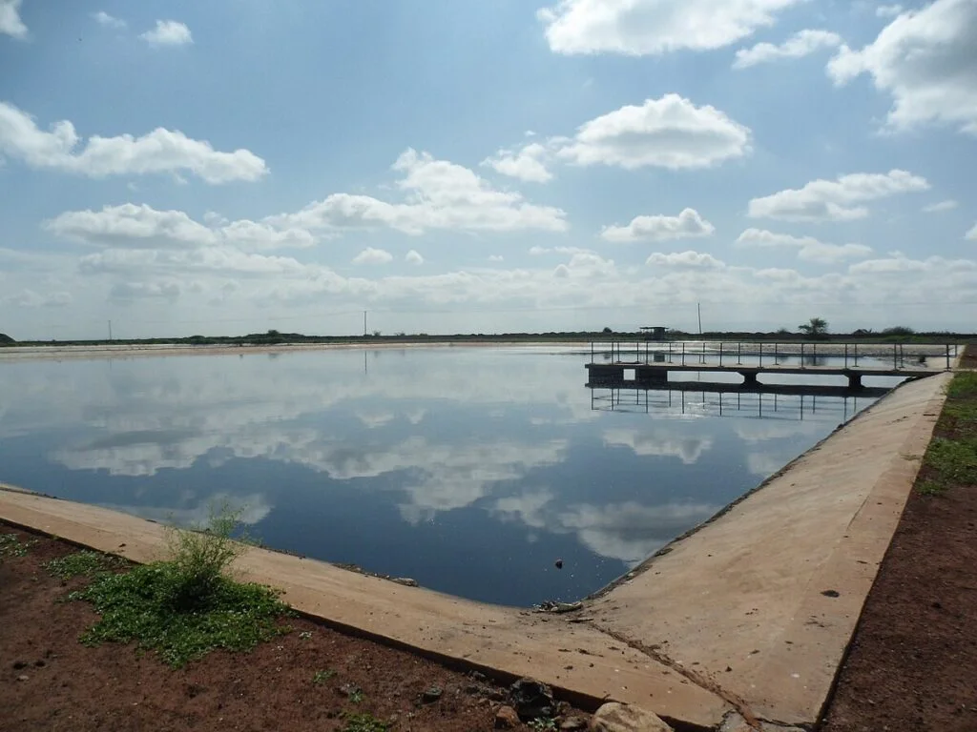
Sunlight Is An Important Part Of The Cycle
Water & Wastewater: Your Source for Water Clarity. (2024). Facultative Lagoons Wastewater Treatment. https://www.waterandwastewater.com/facultative-lagoons-wastewater-treatment/

Slide 22
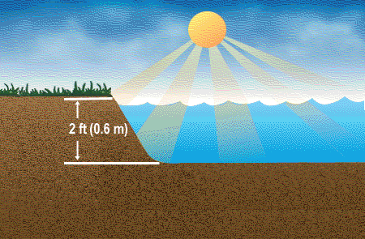
Sunlight Penetrates Entire Depth Of Shallow Lagoons
Rural Community Assistance Corporation. (n.d.). Wastewater Treatment Basics - Lagoons. [PowerPoint Slides]

Slide 23
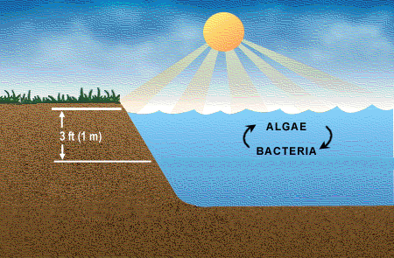
Algae Grow In The Top 3’ Of Lagoons
Rural Community Assistance Corporation. (n.d.). Wastewater Treatment Basics - Lagoons. [PowerPoint Slides]

Slide 24
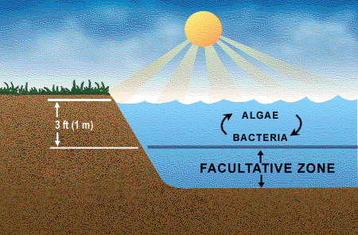
Aerobic Zone – top 3’
Rural Community Assistance Corporation. (n.d.). Wastewater Treatment Basics - Lagoons. [PowerPoint Slides]

Slide 25
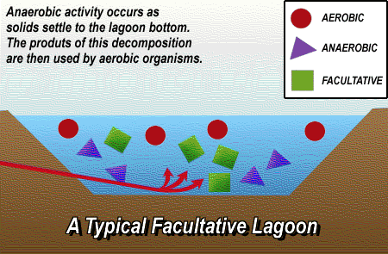
Typical Lagoon
Rural Community Assistance Corporation. (n.d.). Wastewater Treatment Basics - Lagoons. [PowerPoint Slides]

Slide 26
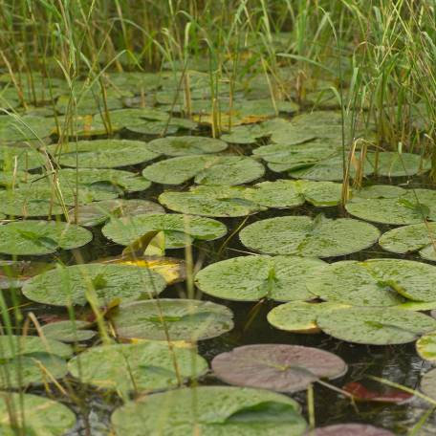
Lagoon Types
Named based on the type of bacteria it is designed to utilize.
Bacteria determine by DO.
DO determined by depth.
Aerobic
Anaerobic
Facultative
Washington State DOE. (Dec. 2006). 2006 TMDL Workload Assessment. chrome-extension://efaidnbmnnnibpcajpcglclefindmkaj/https://apps.ecology.wa.gov/publications/documents/0610092.pdf

Slide 27
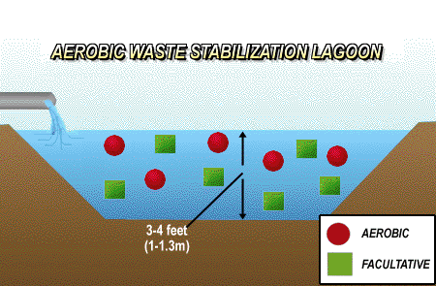
Aerobic Lagoon
Rural Community Assistance Corporation. (n.d.). Wastewater Treatment Basics - Lagoons. [PowerPoint Slides]

Slide 28
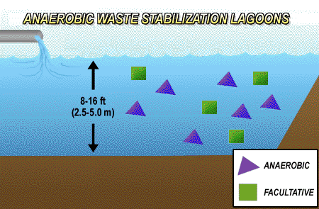
Anaerobic Lagoon
Rural Community Assistance Corporation. (n.d.). Wastewater Treatment Basics - Lagoons. [PowerPoint Slides]

Slide 29
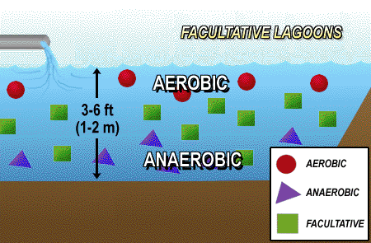
Facultative Lagoon
Rural Community Assistance Corporation. (n.d.). Wastewater Treatment Basics - Lagoons. [PowerPoint Slides]

Slide 30
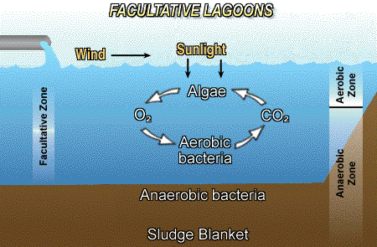
Facultative Lagoons

Slide 31
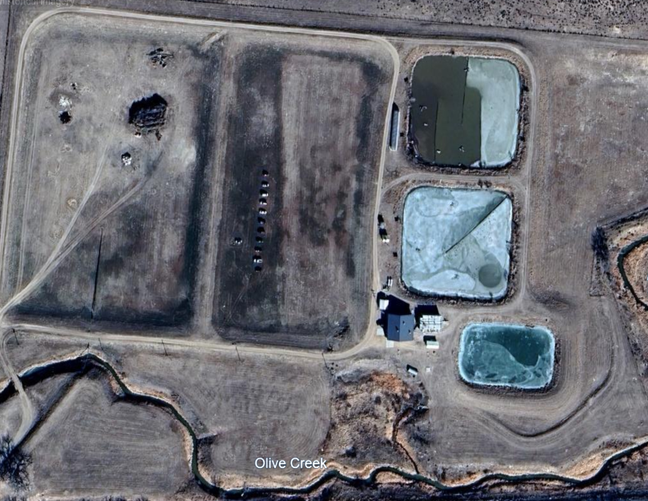

Label lagoon components and treatment areas
Components
Influent
Effluent
Headworks
Aerators
Anaerobic zone
Aerobic zone
Disinfection
Baffling
Flow Path
5.
6.
1.
3.
8.
8.
6.
4.
7.
6.
2.
Google Earth Pro. 2025. Overhead view of Wray, CO lagoons

Slide 32
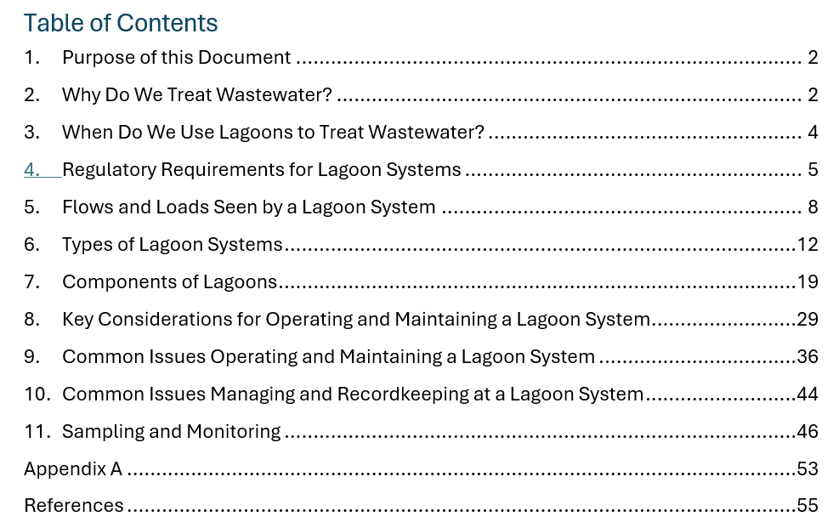
Let’s Start Reviewing the Guidebook

Slide 33
O&M Essentials
Design and Sizing
Influent Flows and Loading Control
Temperature and Climate Factors
Aeration Management
Sludge Management
Nutrient Removal
Effluent Quality Monitoring & Compliance
Odor Control
Health & Safety Considerations
Regulatory Compliance and Recordkeeping
Public and Environmental Impact

Slide 34
Design and Sizing
Capacity and Size: Ensure the lagoon is appropriately sized to handle the expected flow rates and pollutant loads. A lagoon that is too small may not provide adequate treatment, while one that is too large could lead to operational inefficiencies.
Retention Time: The lagoon’s hydraulic retention time (HRT) must be long enough to allow adequate treatment. The typical retention time ranges from 20 to 60 days, depending on the lagoon type and the wastewater strength.
Lagoon Depth: The depth of the lagoon is crucial in determining the balance between aerobic and anaerobic zones, especially in facultative lagoons. The shallow upper layers support aerobic activity, while deeper layers support anaerobic processes.

Slide 35
Influent Flows and Loading Control
Flow Variations: Wastewater flow can fluctuate due to seasonal changes, peak flows, or industrial cycles. Lagoons should be designed to handle peak flow conditions, and operational strategies should account for variations in flow.
Pollutant Load Monitoring: Regularly monitor influent water quality (BOD, TSS, nitrogen, phosphorus, and other parameters) to ensure that the lagoon is handling the expected load. Sudden increases in pollutant levels can overwhelm the lagoon's capacity.
Flow Distribution: Proper distribution of influent across the lagoon ensures even treatment. An ineffective inlet system can lead to short-circuiting or uneven treatment, resulting in untreated wastewater being discharged.

Slide 36
Temperature and Climate Factors
Impact of Temperature: Temperature plays a critical role in microbial activity. Warmer climates tend to accelerate treatment processes due to faster microbial activity. In colder climates, microbial activity slows down, requiring longer retention times or possibly supplemental aeration or heating.
Climate-Dependent Adjustments: Seasonal changes can impact lagoon performance, particularly with algae growth (which is critical in facultative lagoons). Cold temperatures can reduce algae growth and oxygen production, slowing down the treatment process. During winter months, it may be necessary to adjust the depth, add aeration or additional treatment steps.
Freeze Protection: In colder regions, lagoon systems may be at risk of freezing. Proper design and operational practices are needed to prevent ice formation, which could impair the lagoon’s function.

Slide 37

Aeration Management
Oxygenation in Aerobic Lagoons: Proper aeration is crucial to maintain aerobic conditions for microbial breakdown of organic matter. Aerators (mechanical or diffused air systems) should be maintained and adjusted to ensure they provide sufficient oxygen throughout the lagoon.
Algae Management in Facultative Lagoons: Algae are crucial in facultative lagoons for maintaining aerobic conditions in the upper layer. However, excessive algae growth can lead to problems such as odor (due to anaerobic conditions in deeper layers) and high nutrient concentrations. Algae blooms should be monitored and controlled if necessary.
Washington Stormwater Center. (2002). Washington Stormwater Center Updates. [PowerPoint Slides]

Slide 38
Sludge Management
Sludge Accumulation: Sludge builds up over time at the bottom of the lagoon. Regular monitoring and dredging of accumulated sludge are necessary to maintain effective treatment capacity. Without proper sludge removal, the lagoon’s treatment efficiency can degrade.
Sludge Stabilization: Sludge needs to be stabilized to prevent odors and pathogens. Anaerobic lagoons naturally stabilize sludge, but facultative and aerobic lagoons may require more frequent sludge management.
Sludge Disposal or Reuse: After stabilization, sludge can be land-applied, composted, or sent for further processing (e.g., dewatering, landfilling). Proper disposal or reuse methods should be in place to avoid environmental issues.

Slide 39
Nutrient Removal
Nitrogen Removal: Nitrification and denitrification processes occur naturally in lagoons but may require management to optimize nitrogen removal. Facultative lagoons typically perform better at removing nitrogen, especially under aerobic conditions in the upper layers.
Phosphorus Removal: While lagoons can absorb phosphorus, they are generally less effective at removing it than nitrogen. In cases where phosphorus removal is a concern, additional measures (e.g., chemical precipitation) may be needed.
Monitoring Nutrient Levels: Regular testing for nitrogen, phosphorus, and other nutrients is necessary to ensure that lagoon performance is adequate, especially if the effluent is discharged into sensitive receiving waters.

Slide 40
Effluent Quality Monitoring and Compliance
Effluent Quality Standards: Wastewater treatment lagoons must meet local, state, and federal effluent standards for parameters like BOD, TSS, fecal coliform, and nutrients (nitrogen, phosphorus). Regular monitoring is essential to ensure compliance with regulatory discharge limits.
Sampling and Analysis: Routine sampling of lagoon effluent for parameters such as BOD, TSS, ammonia, nitrates, pH, and pathogens helps ensure the system is functioning correctly and that the treated water meets discharge requirements.
Flow Monitoring: Monitoring the volume of effluent discharged from the lagoon helps ensure it matches the system's design and permits.

Slide 41
Odor Control
Algae and Sludge Management: Odor issues are common in wastewater treatment lagoons, especially if there is an imbalance between aerobic and anaerobic conditions. Excessive algae growth, inadequate aeration, or improper sludge management can result in the production of odors such as hydrogen sulfide.
Operational Adjustments: Managing the balance between the aerobic and anaerobic zones, controlling algae blooms, and timely sludge removal can help minimize odors. Regular aeration or chemical treatments may also be necessary.
Buffer Zones: For lagoons located near residential or recreational areas, establishing a buffer zone of vegetation around the lagoon can help mitigate odor by acting as a physical barrier.

Slide 42
Health and Safety Considerations
Public Health Risks: Lagoons often contain pathogens, especially in untreated or partially treated wastewater. Ensuring that safety barriers (e.g., fencing) are in place around the lagoon is essential to prevent accidental exposure to hazardous conditions.
Worker Safety: Workers involved in the operation and maintenance of lagoons should be trained to handle chemicals, manage sludge, and operate equipment safely. Proper personal protective equipment (PPE) should be provided, particularly when dealing with sludge or high-risk tasks.
Security: For facilities dealing with industrial or high-strength waste, proper security measures should be implemented to prevent unauthorized access to the lagoon and ensure the safety of workers and the surrounding community.

Slide 43
Regulatory Compliance and Recordkeeping
Permit Compliance: Lagoon systems are typically subject to environmental regulations and permitting requirements. Operators must ensure that the system operates within the bounds of its National Pollutant Discharge Elimination System (NPDES) permit or similar state-issued permits.
Record Keeping: Accurate records of maintenance activities, effluent quality monitoring, sludge management, and flow data must be kept for regulatory reporting purposes. These records also help in identifying trends or issues in lagoon performance.
Routine Inspections: Regular inspections of lagoon conditions, equipment, and operational logs are required to identify potential issues, such as excessive sludge buildup or inadequate treatment capacity.

Slide 44
Public and Environmental Impact
Discharge to Receiving Waters: The effluent from the lagoon, once treated, is usually discharged into a river, stream, or lake. Operators must ensure that the lagoon’s effluent meets water quality standards to prevent negative impacts on the receiving water body and the surrounding environment.
Ecological Considerations: Lagoons may also have ecological value, serving as habitats for birds or other wildlife. Operators should consider the environmental impact of the lagoon system on local ecosystems and avoid actions that might harm these environments.

Slide 45
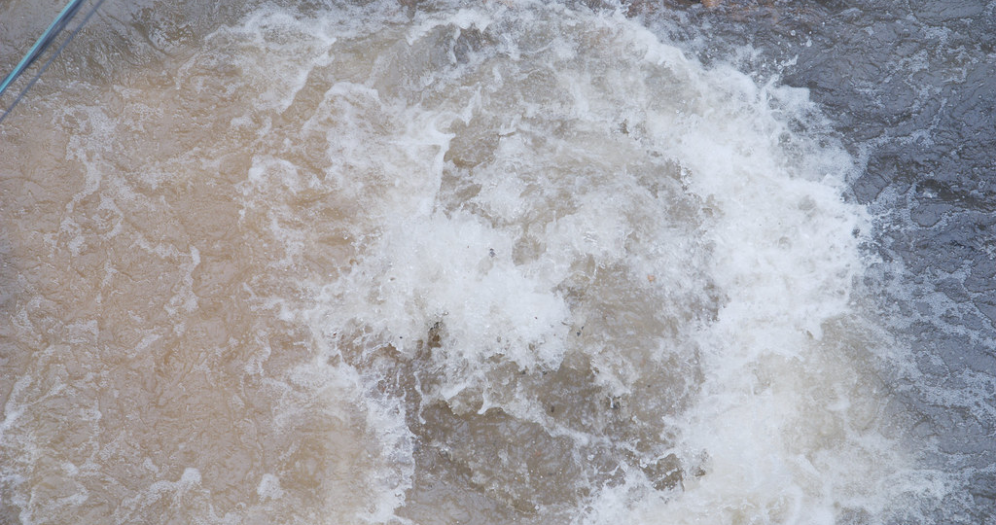
Break Time – 30 minutes
This Photo by Unknown Author is licensed under CC BY-SA

Slide 46
Activity #2
Review prompt

Slide 47

Sampling, Monitoring and Compliance
Influent Sampling and Monitoring
Effluent Sampling and Monitoring
Sludge Monitoring
Algae and Oxygen Levels
Temperature
Methane and Gas Monitoring (Anaerobic Lagoons)
Operations and Maintenance Monitoring
Regular Inspections
Compliance and Reporting

Slide 48
Influent Sampling and Monitoring
Flow Rate:
  Monitoring: Continuous or daily flow measurements to track influent volume and ensure the lagoon can handle the flow. This is often done using flow meters.
  Frequency: Typically, daily or as per permit conditions.
Key Parameters:
  BOD (Biochemical Oxygen Demand): Indicates the organic matter in the influent. Helps assess the lagoon’s loading capacity and treatment performance.
  TSS (Total Suspended Solids): Measures the solid particles in the wastewater.
  Ammonia (NH₃): Important for understanding nitrogen levels and for managing aeration needs.
  pH: Ensures the wastewater is within a pH range conducive to microbial activity.
  Nutrients (Nitrogen, Phosphorus): Monitoring nitrogen and phosphorus is crucial for nutrient management, especially to prevent eutrophication in receiving water bodies.
  Temperature: Affects microbial activity, especially in cold climates, which can slow down treatment processes.
  Fecal Coliform or Pathogen Levels: Key for determining the quality of effluent, especially for discharge to public waters or reuse.
Frequency:
  Typically, influent sampling is done weekly or as required by permits, but certain parameters like pH or temperature may be monitored more frequently.

Slide 49
Effluent Sampling and Monitoring
Flow Rate:
  Monitoring: Similar to influent, effluent flow should be measured continuously or periodically to verify the lagoon's treatment capacity.
  Frequency: Daily or per permit requirements.
Key Parameters:
  BOD: Effluent BOD is a key indicator of treatment performance and system effectiveness.
  TSS: Effluent TSS is important for meeting discharge standards.
  pH: The pH of the effluent should meet regulatory discharge limits.
  Ammonia (NH₃): Effluent ammonia is monitored to ensure nitrogen removal, especially in aerobic lagoons.
  Nitrate (NO₃): For systems designed to remove nitrogen, effluent nitrate levels are important.
  Total Phosphorus: To assess phosphorus removal efficiency.
  Fecal Coliform or E. Coli: Regulatory standards for pathogen removal must be met in effluent, especially for recreational or potable reuse waters.
  Chlorine Residual: If chlorine disinfection is used in the lagoon system, residual chlorine levels need to be measured to ensure effective disinfection.
Frequency:
  Effluent sampling is generally required on a daily to weekly basis, depending on the system and discharge permit.

Slide 50
Sludge Monitoring
Sludge Depth:
  Monitoring: The accumulation of sludge should be measured regularly to ensure that the lagoon is not overloaded. Sludge probes or manual methods can be used to determine the depth of sludge.
  Frequency: Monthly or quarterly, depending on the lagoon size and operational characteristics.
Sludge Volume and Composition:
  Monitoring: Sludge characteristics, such as its composition and methane production (for anaerobic lagoons), should be measured regularly. This helps to determine when dredging or further treatment of sludge is needed.
  Frequency: Periodically, typically quarterly or annually, depending on the lagoon’s operational conditions.
Sludge Age:
  Monitoring: Tracking the age of sludge helps assess whether it is adequately stabilized.
  Frequency: Annually or as required.

Slide 51
Algae and Oxygen Levels (for Facultative Lagoons)
Algae Growth:
  Monitoring: Algae growth is crucial for facultative lagoons as it supports aerobic processes. Monitoring algae blooms is important to avoid overgrowth that can cause odors or system imbalance.
  Frequency: Weekly or monthly, depending on the lagoon and weather conditions.
Dissolved Oxygen (DO):
  Monitoring: In aerobic and facultative lagoons, DO levels must be monitored to ensure adequate oxygen for microbial activity, especially in the upper layers.
  Frequency: Weekly or as needed in aerobic lagoons; may be less frequent in facultative lagoons unless aeration is used.

Slide 52
Temperature Monitoring
  Monitoring:
  Temperature impacts microbial activity and the overall treatment process. It's important to monitor the lagoon’s temperature to adjust operations (e.g., aeration, retention time) accordingly.
  Frequency:
  Daily or weekly, especially in seasonal climates where temperature variation is significant.

Slide 53
Methane and Gas Monitoring (for Anaerobic Lagoons)
Methane Production:
  Monitoring: Anaerobic lagoons produce methane as a byproduct. Monitoring methane levels helps determine the rate of sludge stabilization and ensures there is no dangerous gas buildup.
  Frequency: Monthly or as part of regular sludge management checks.
Gas Emissions:
  Monitoring: It may be important to monitor other gases, such as hydrogen sulfide, which can lead to odor problems and safety concerns.
  Frequency: Monthly or based on operational needs and safety protocols.

Slide 54
Operational and Maintenance Monitoring
Aeration System Performance:
  Monitoring: For aerobic lagoons, monitoring the aeration system’s performance (e.g., power consumption, dissolved oxygen levels, aerator function) is essential to ensure proper treatment.
  Frequency: Daily checks or automated monitoring for aerators.
Inlet and Outlet Structures:
  Monitoring: Regular inspection of inlet and outlet structures to ensure proper flow distribution and prevent short circuiting. Also, monitoring for clogging or damage.
  Frequency: Monthly inspections or as needed.

Slide 55
Regular Inspections
Lagoon Condition:
  Monitoring: Visual inspections of the lagoon for signs of erosion, excessive algae growth, short-circuiting, or other structural issues.
  Frequency: Monthly or quarterly.
Fence and Safety:
  Monitoring: Ensuring that safety barriers (such as fencing) are intact and that the lagoon does not pose a safety risk to the public.
  Frequency: Monthly or after significant weather events.

Slide 56
Compliance and Reporting
Regulatory Compliance:
  Monitoring: Sampling and testing must meet local, state, and federal requirements for discharge quality, pathogen levels, and nutrient content.
  Frequency: Regular reporting, often monthly or quarterly, to environmental agencies for compliance with permit conditions.
Reporting:
  Results from influent and effluent sampling, sludge management, and aeration data must be documented and submitted to the relevant authorities.
Frequency:
  Monthly, quarterly, or annually, depending on local regulations and permit requirements

Slide 57
Troubleshooting Common Issues
This section looks at
  Sludge Accumulation
  Algae Overgrowth (Excessive algae)
  Odor Issues
  Inefficient Treatment Due to Inadequate Aeration
  Nutrient Imbalances
  Short Circuiting and Uneven Flow Distribution
  Poor Sludge Stabilization and High Sludge Volume
  Seasonal Variability in Performance

Slide 58

Financial Health of a Lagoon System

Slide 59
Session Objectives
Principals of Cost-of-Service Analysis
Identifying Financial Needs
  Defining financial sustainability for your community.
Application to Achieve Financial Sustainability

Slide 60
Principles of Cost-of-Service Analysis
Rate analysis has negative connotations
  It implies rate increases
  Leads to immediate lack of community buy-in
It’s really a Cost-of-Service Analysis
  Evaluating costs whereby rates are justified by data
  Provides avenue to educate rate payers on how monies are being applied to service.

Slide 61
Principles of Cost-of-Service Analysis
Expenses = Revenue
  Seems simple and straight forward but this is often misunderstood by decision makers.
  What expenses do you budget for vs. what is the true cost of providing water

Slide 62
Budgeting
What is in your Budget
True Cost of Service
Annual operating costs
  Operation & Maintenance (O&M)
  Administrative
  Debt Service
Annual Operating costs
Reserves
  O&M reserve
  Emergency reserve
  Debt Service Reserve
  Short-Lived Asset reserve
  Capital Improvement Reserve
Does your budget reflect the true cost of service?

Slide 63
O&M Reserve
O&M Reserve
  1.5x billing cycle expenses held in highly liquid accounts.
  Pay staff and vendors on time because we know that not all customers pay on time
  Monthly operating expenses = $10,000
  O&M Reserve = $15,000
    Generally held in checking accounts

Slide 64
Emergency Reserve
Emergency Reserve
  Determined by either the cost of the most critical piece of equipment in your system or most expensive (Must include installation costs as well)
    Question to ask is “what piece of equipment, if fails, could significantly impact provide water service to our customers?”
    Should not be “storage tank, main line trunk, lagoon levy, etc. Those items are much bigger problems that should be accounted for in emergency response planning
  Operators can provide valuable input on this.
  May require 2-3 years to build reserve
  Held in liquid account
  Example could be well pump, chlorination system or lift station pump

Slide 65
Debt Service Reserve
Debt Service Reserve
  Requirement by funders to ensure if revenues drop, debt payments can be made
  Generally, need to be 1 annual payment worth of savings
  Systems may be given up to 10 years to build reserve
  Held in restrictive account and generally need funder permission to use.
If looking at a capitol project requiring funding recognize that this will need to be calculated into cost-of-service analysis.

Slide 66
Short- Lived Asset Reserve
Short-Lived Asset Reserve
  Reserve focused on replacement of equipment with a life cycle expectancy less than 15 years.
    Pumps & Motors
    Chemical feed systems
    Storage Tank maintenance
    Instrumentation
    Headworks equipment
    Other examples???
  Operator input is very valuable here.
  Generally, items costing less than $100,000 should be included.
  Held in an account earning interest!!!

Slide 67
Capitol Improvement Reserve
Capital Improvement Reserve
  Reserve focused on replacement of equipment with a life cycle expectancy greater than 15 years.
  Big ticket items
    Major treatment, distribution, storage upgrades
    Often driven by challenging compliance needs
  Many systems see this as depreciation.
    However, depreciation is generally calculated on a straight-line trajectory
    Fails to address inflation impacts.
    Example:
      An F-150 purchased in 2010 with a life cycle of 15 years cost $30,000. Depreciation would say you need set aside $2,000/year for replacement. However, we know that an F-150 purchased today will cost $60,000. Depreciation leaves a massive shortfall in replacing that item.
  Most small systems struggle to adequately fund the capital reserve.

Slide 68
So where do we go from here?
Evaluate your budget from a true cost-of-service.
  Are you considering the all the different types of reserves needed?
  If not, here are some resources.
  Let’s start with Short-Lived Assets

Slide 69
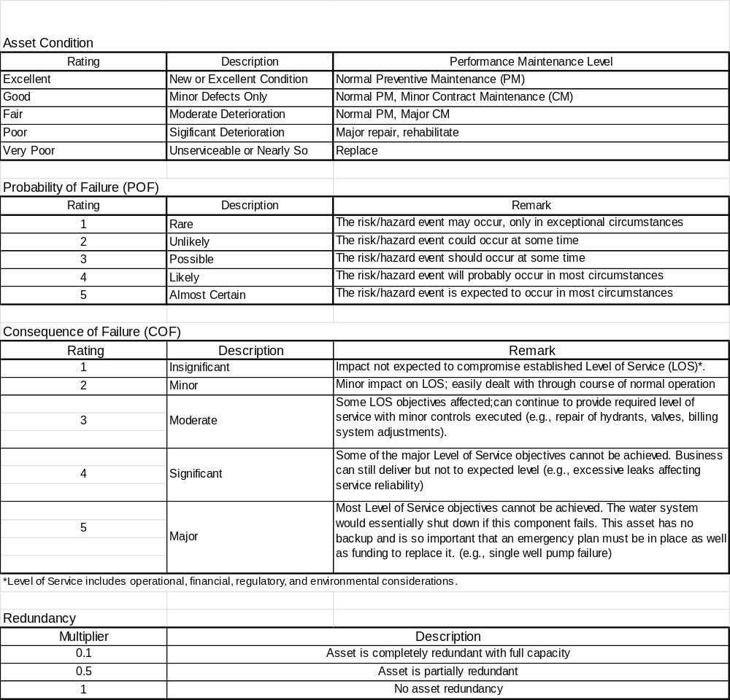
Prioritizing our equipment with life cycle of less than 15 years.
Three variables to consider
Probability of Failure (PoF)
Consequence of Failure (CoF)
Redundancy
PoF* CoF * Redundancy = Criticality
Higher criticality = Higher priority to replace
Let’s look at an example

Slide 70
Would need to set aside $7,553 annually in order to pay for this equipment at end-of-life cycle.
As you can imagine your system will have more than 3 items listed. There will likely be 20+ for small systems. But the priority list does give you an idea where to start with reserve building.
We have created a tutorial on using this spreadsheet.
Caveat: Cost does assume a constant inflation rate. I can’t predict inflation next month let alone 10 years from now.

Slide 71

Calculating Cost-of-Service

Slide 72
Total Expenses = Annual Operating Costs + Reserves
Annual Operating Costs
  Use actuals from recent budget
Reserves
  O&M Reserve = Annual Operating Costs/number of billing cycles *1.5
  Emergency Reserves = Identify most critical piece of equipment or most expensive/number of years to save
  Debt Service = 1-year of annual payment/required time to set aside funds
  Short-Lived Assets = Complete spreadsheet
  Capital Improvement = Can use short lived asset spreadsheet to generate cost. However, rarely it is fully funded due to affordability

Slide 73
Establishing Rates
This is a function of expenses.
Base rate = Price charged regardless of amount of water used
Variable rate = Price impacted by amount of water used. This is seen with Tiering Rate Structures
Fixed costs = Costs that don’t change based on water produced
Variable costs = Cost that do change with amount of water produced.

Slide 74
Fixed vs. Variable Costs
Fixed Costs
Variable Costs
Personnel (100%)
  Salary
  Benefits
Equipment (80%)
Administrative (100%)
Debt Service (100%)
Reserves (70%)
Electricity (70%)
Chemicals (90%)
Fuel (50%)

Slide 75
Establishing Rates
Theoretical
  Base Rate = Fixed Costs
  Variable Rate = Variable Costs
Our experience is that most small system costs are around 95% fixed costs.

Slide 76
Establishing Rates
Issue: True cost-of-service is expensive and often unaffordable.
Very difficult decision are being made throughout small communities in Idaho everyday.
  Rate increases are inevitable but balancing affordability with costs in the challenge.
We developed a Basic Financial Health model specifically for communities to use based on the principles in this presentation.

Slide 77
Thank you for attending!
Speaker name and contact information here

