Slide 1
Operation and Troubleshooting of Lagoons
Presented by

Slide 3

Pre Test

Slide 4
What are Lagoons?
Ponding of wastewater to:
  Stabilize the waste
  Cause die-away of pathogens
  Allow percolation, evaporation or controlled discharge, and land application
Stabilize: waste that has been treated or decomposed to the extent that if discharged or released, its rate and state of decomposition would be such that the waste would not cause a nuisance or odor.

Slide 5
Why use Lagoons?
Advantages:
  Reduced O&M
  Operator Certification Level
  Effluent limits
  No Discharge Possible (complete retention)
  Meet Fecal Limits
  Sludge disposal
  Changes in Temperature
  Load Fluctuations

Slide 6
Why Use Lagoons
Disadvantages:
  Rely on Light as Energy Source
  Space (requires large areas for retention and treatment.
  Banks subject to wind and animal erosion
  Sludge can be more difficult to get rid of

Slide 7
Operation and Troubleshooting of Lagoons
EPA Classifications: I, 2 and 3
Types: Aerobic, Anaerobic, Facultative
Types: Primary, Secondary, Tertiary
Design Parameters
Size & Depth
Biological Processes
Chemical Enhancements?

Slide 8
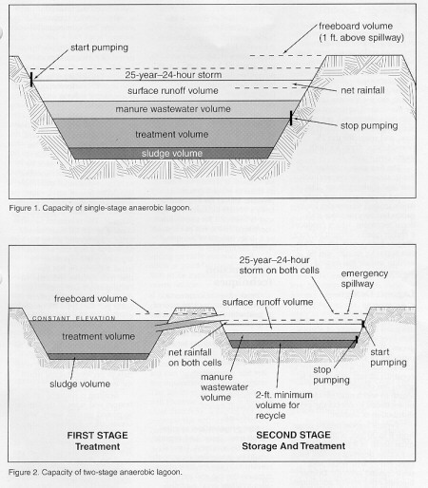

Slide 9
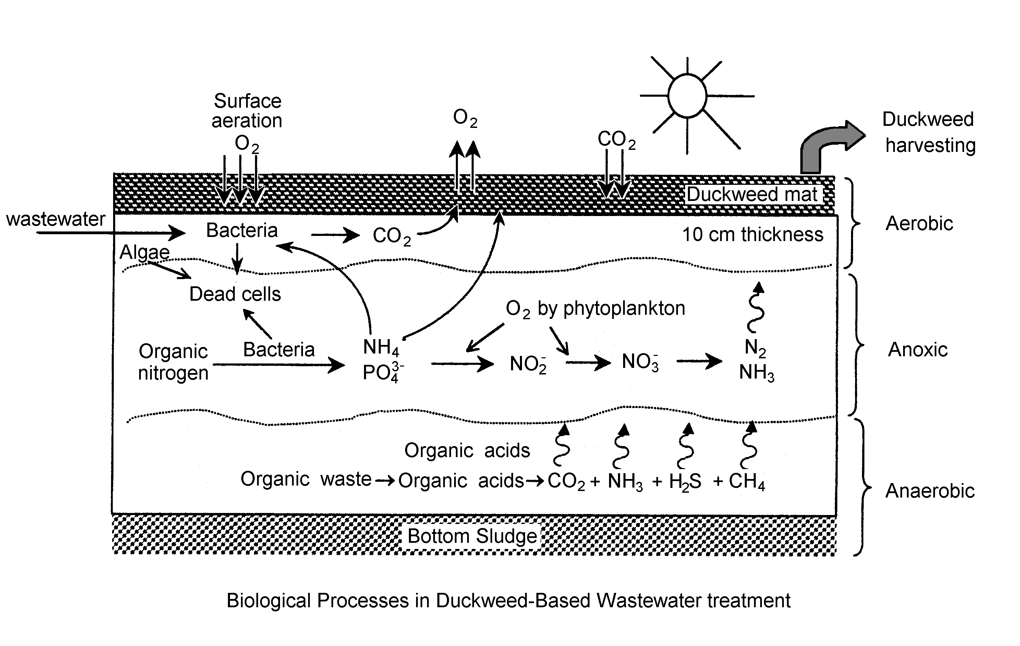

Slide 10
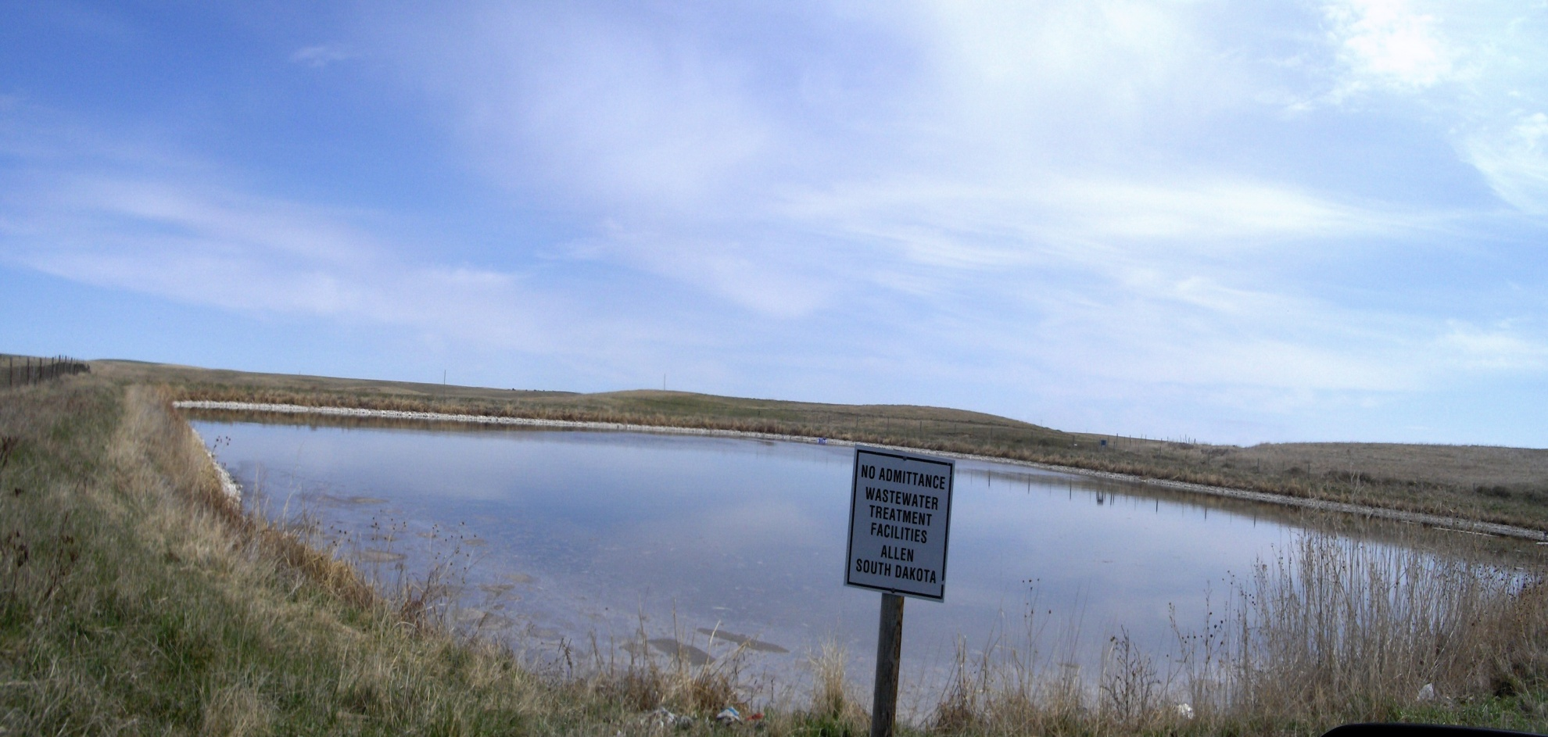
Most Lagoons are “Facultative”:
- 4 to 8 ft deep
- both aerobic & anaerobic digestion

Slide 11
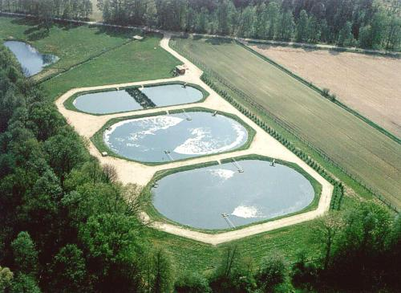
Aerated Lagoons

Slide 12
Anaerobic Lagoons
(without Oxygen)
Deep lagoon (> 8 ft. deep)
No dissolved oxygen
Not aerated, heated or mixed
Typically for pre-treatment and sedimentation of suspended solids
Can have odor problems
Long retention times, especially in cold climate (un-effective below 27 F)

Slide 13
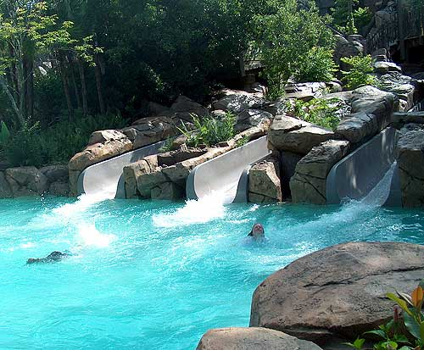
Other Lagoons: Fun Type

Slide 14
Lagoon operations
Health & Safety
Sampling & Monitoring (when?)
Controlling Flows & Levels
Chemical Addition?
Trouble Shooting Problems

Slide 15
Lagoon Maintenance
Inspections: Observations & Records
EPA Permit requirements
Sludge/Grit control & removal
Maintaining Dikes
Plant & Critter control
Mechanical systems
Schedule

Slide 16
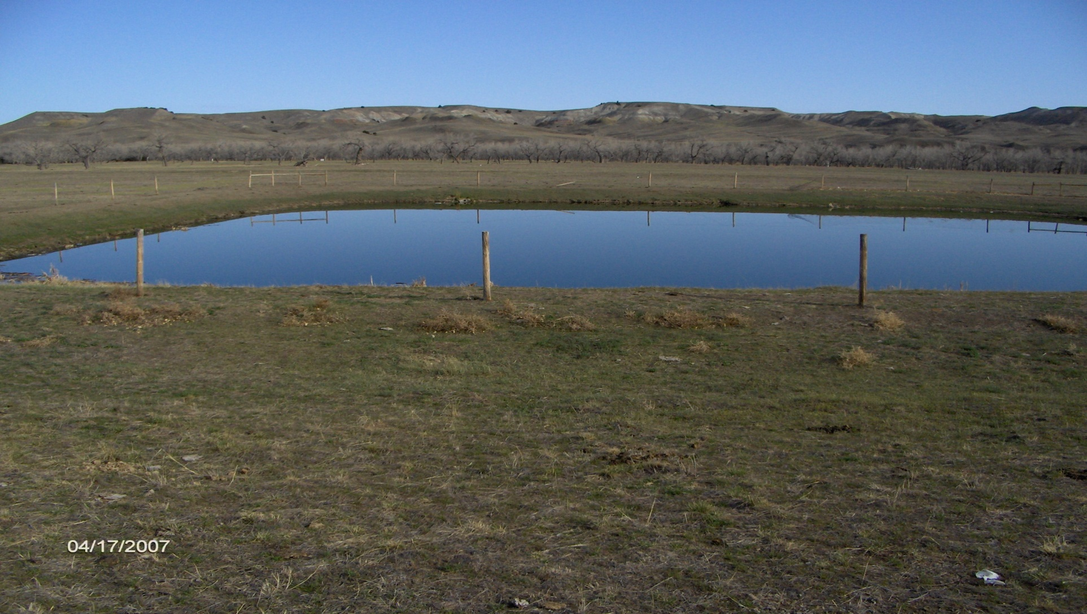
Typical Lagoon

Slide 17
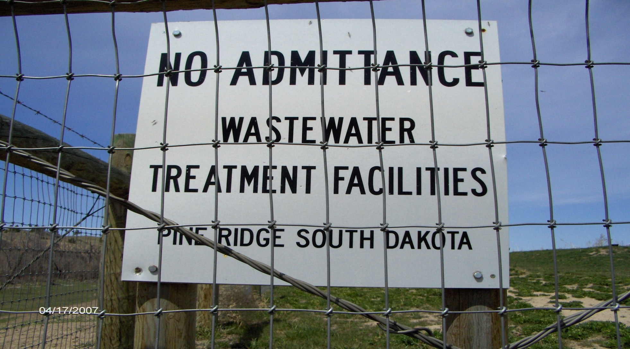
Good Signage

Slide 18
WW Lagoon Problems
Sign old or unreadable
Gates or sign or locks missing
Fences down or cut
Over grazing or erosion from livestock
Dry lagoons (size or flow issues)
Burrows
Inflow or Drain plugged
Cattails and/or trees

Slide 19
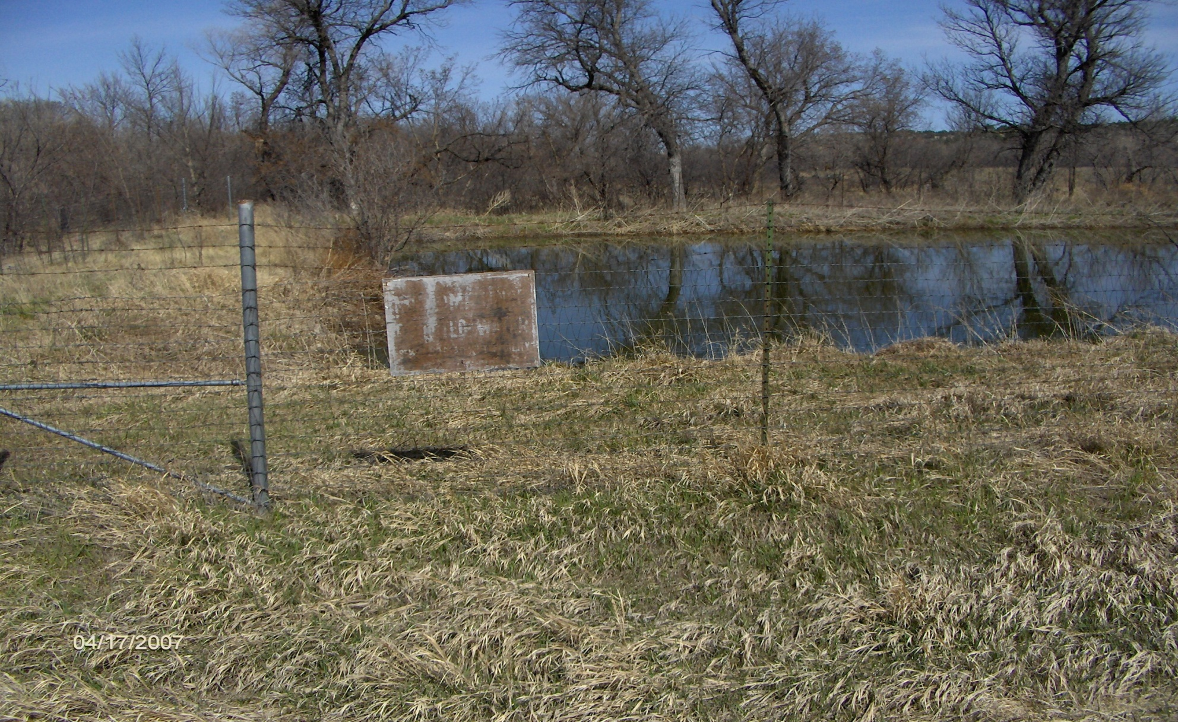
Old Sign

Slide 20
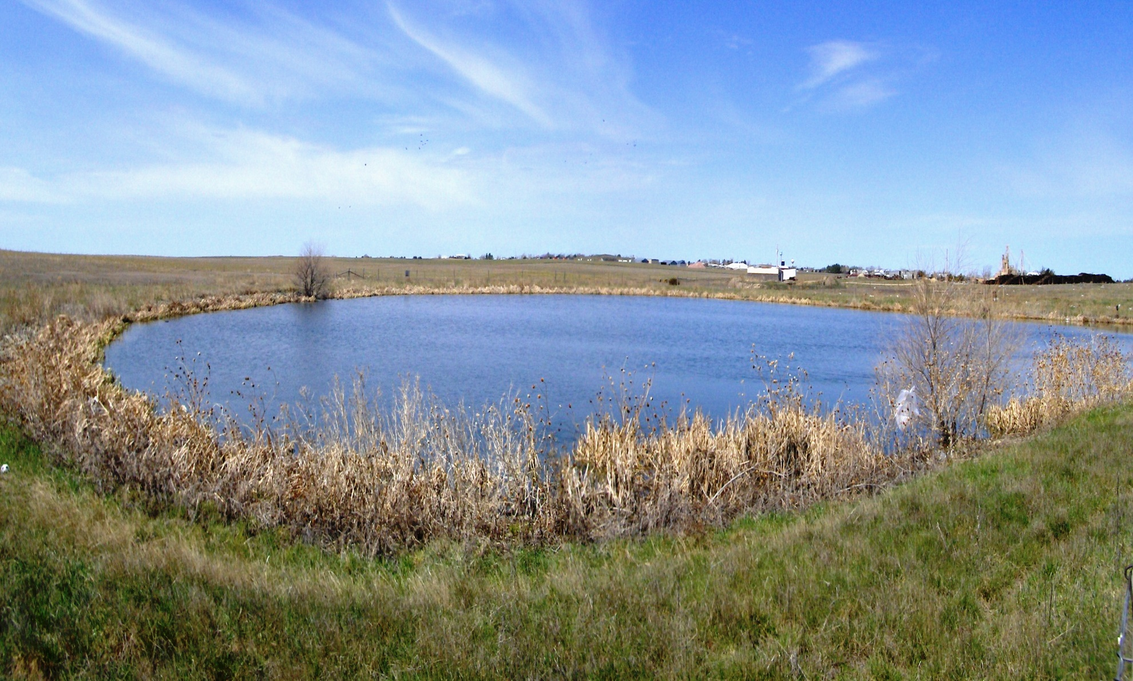
Plant Growth

Slide 21
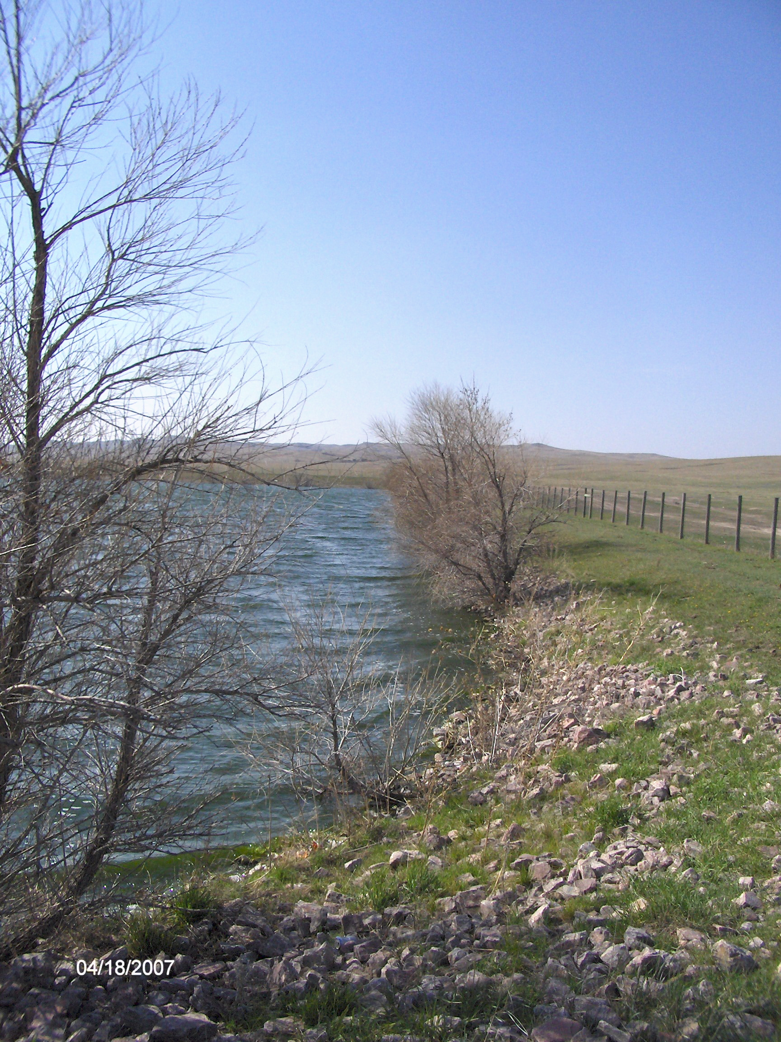
Trees & Brush

Slide 22
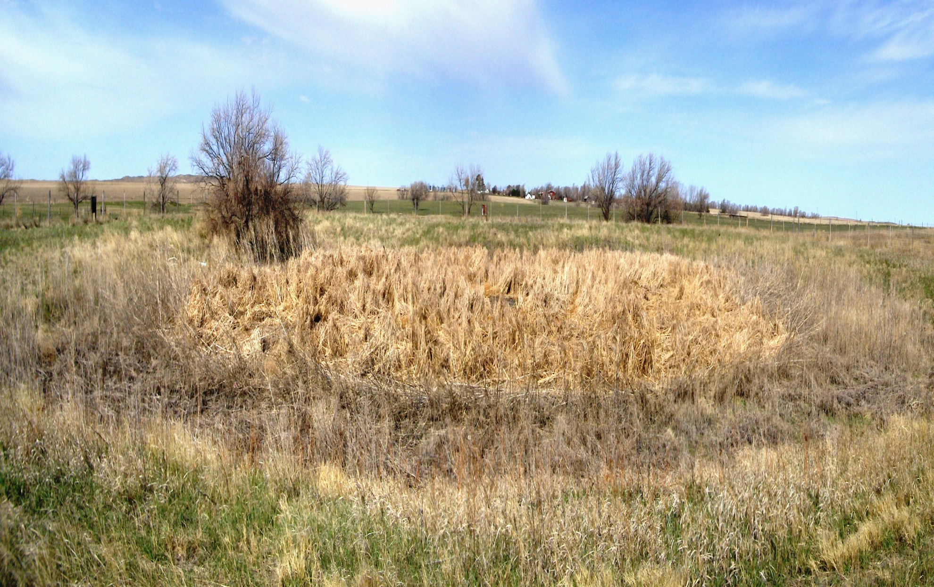
Overgrown Lagoon - Low Flow

Slide 23
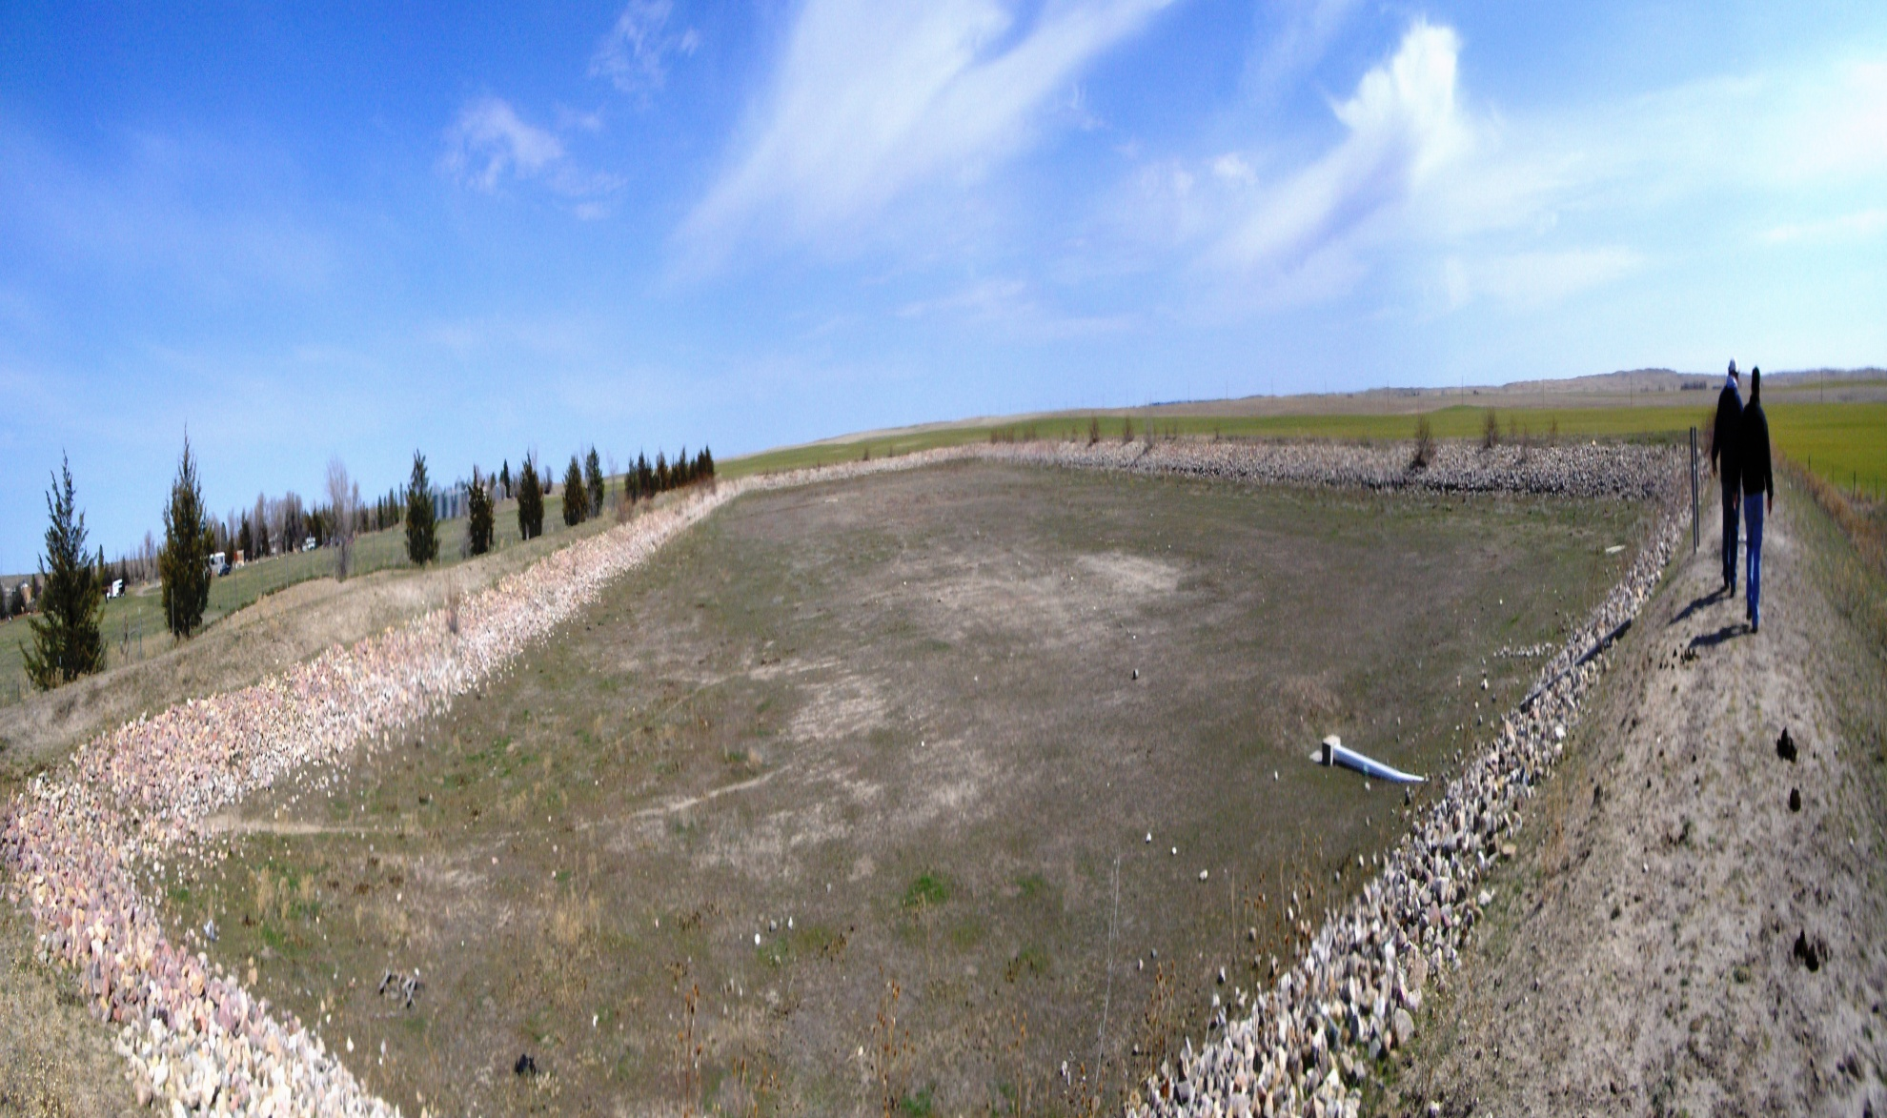
Over Grazing

Slide 24
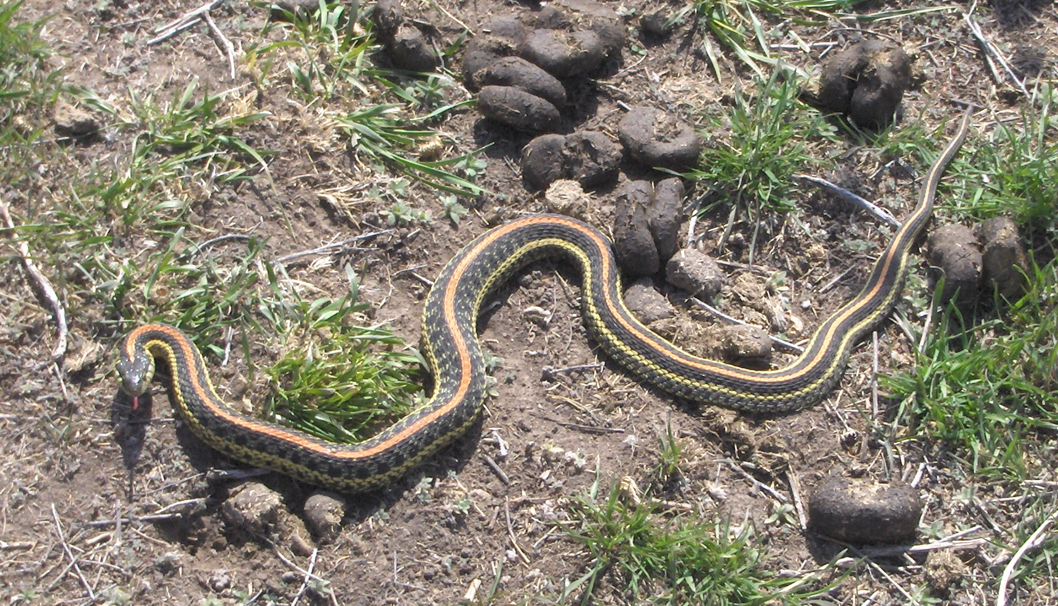
Lagoon Guard

Slide 25
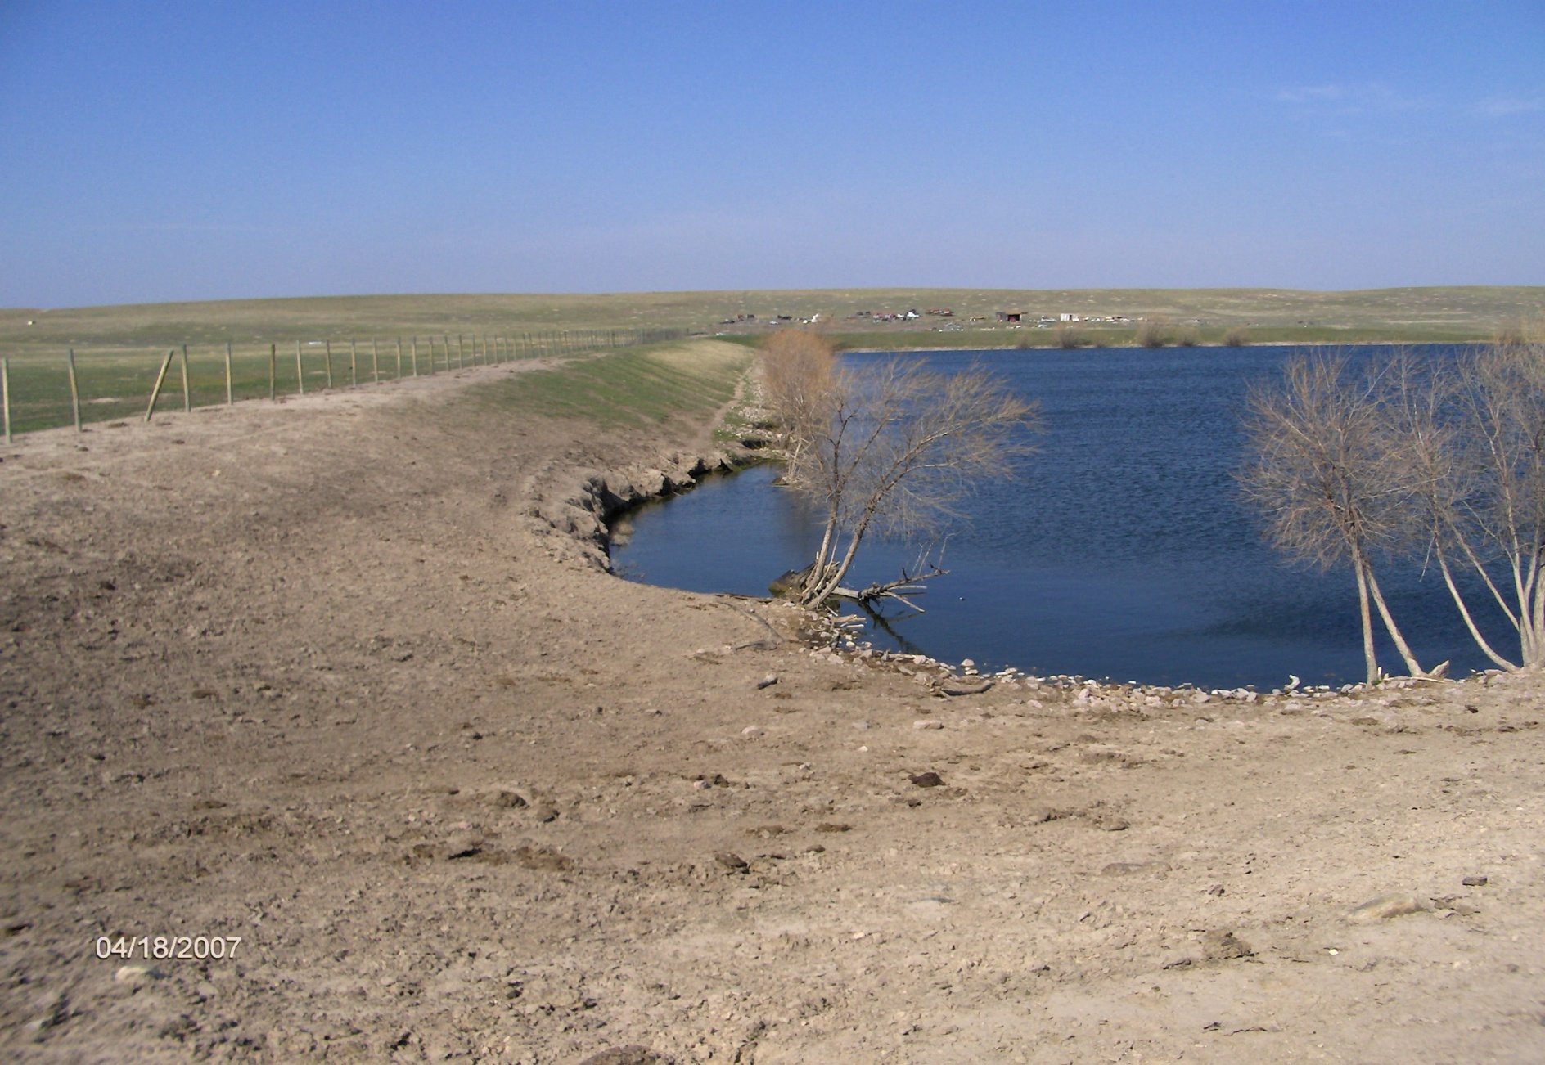
Erosion from Cattle

Slide 26
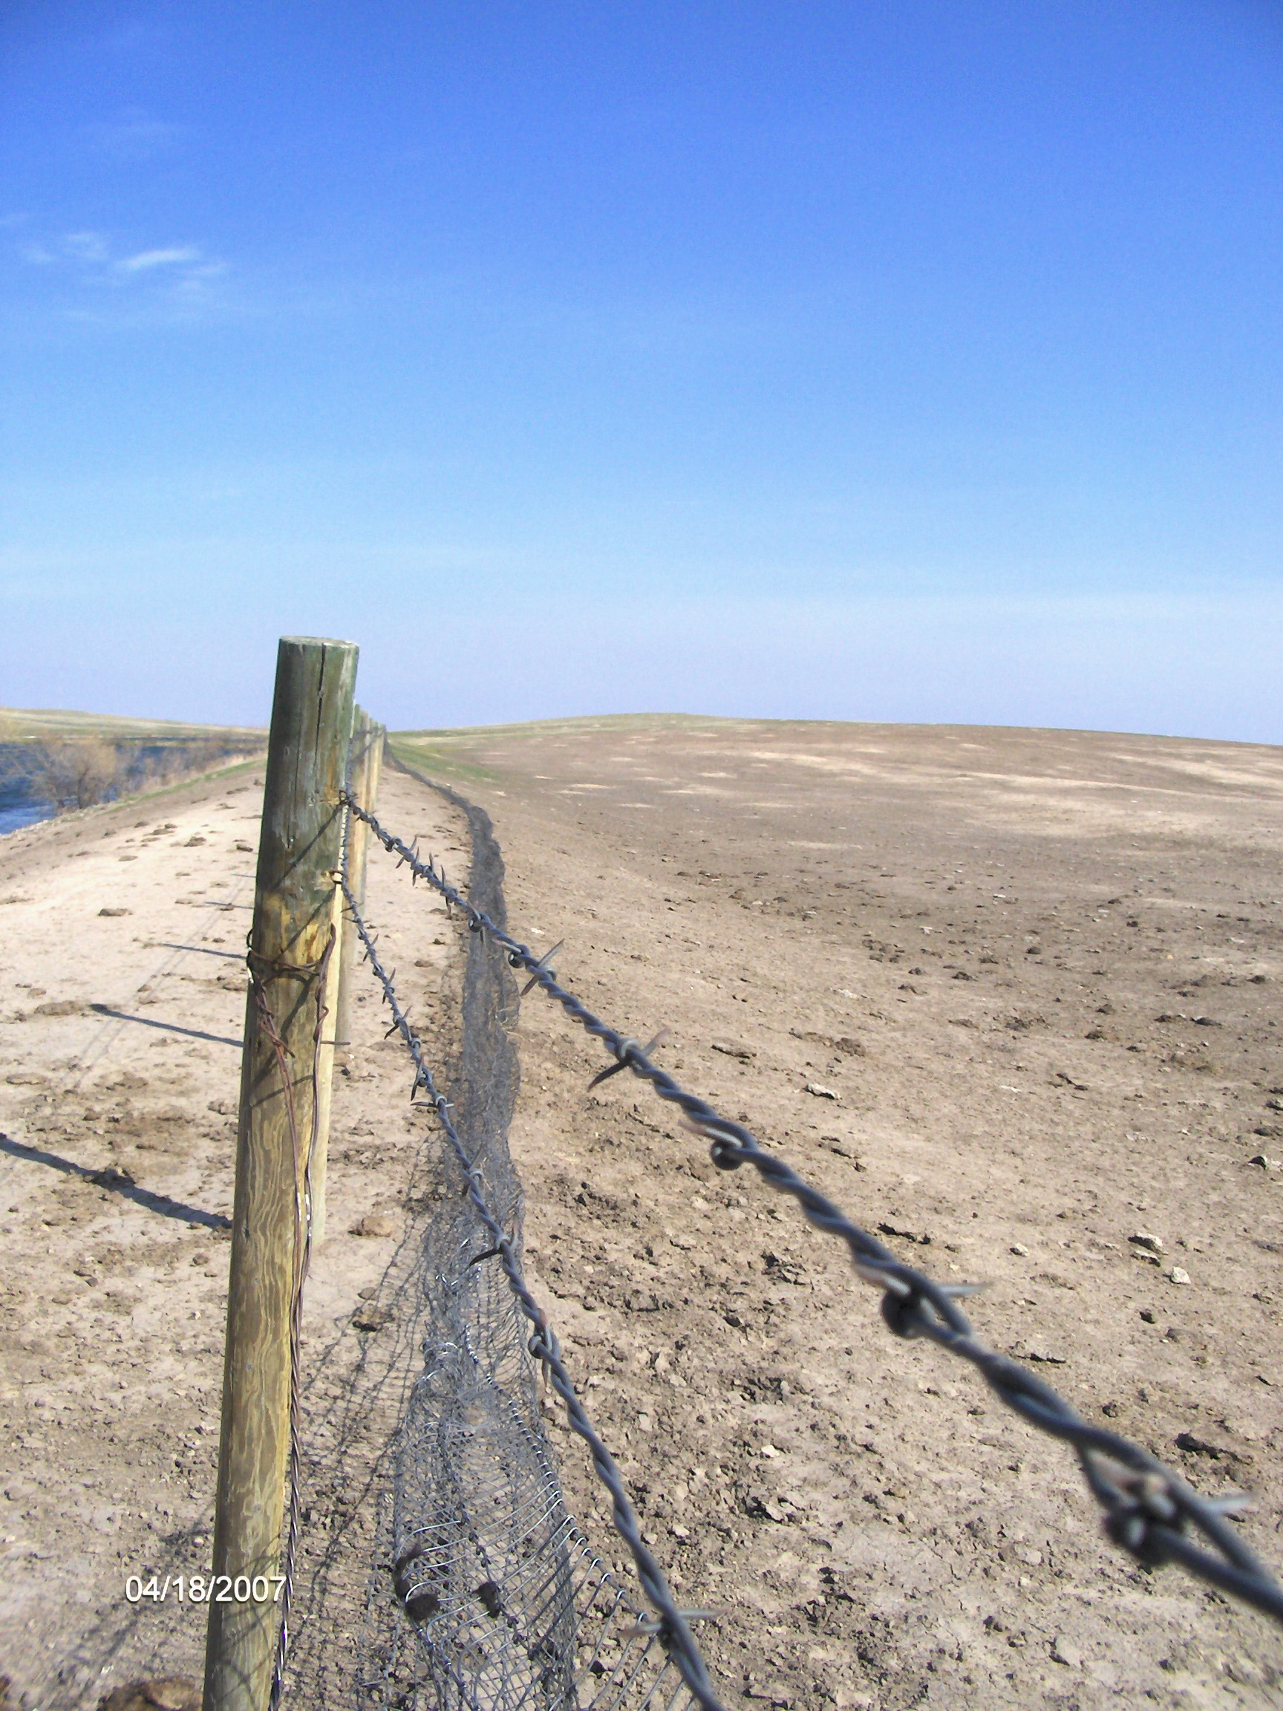
Fences Down

Slide 27
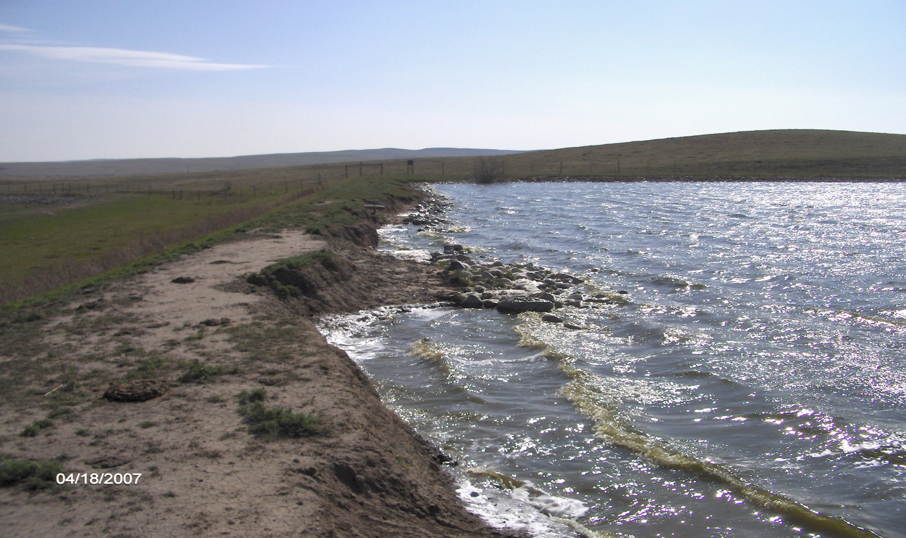
Wave Erosion

Slide 28
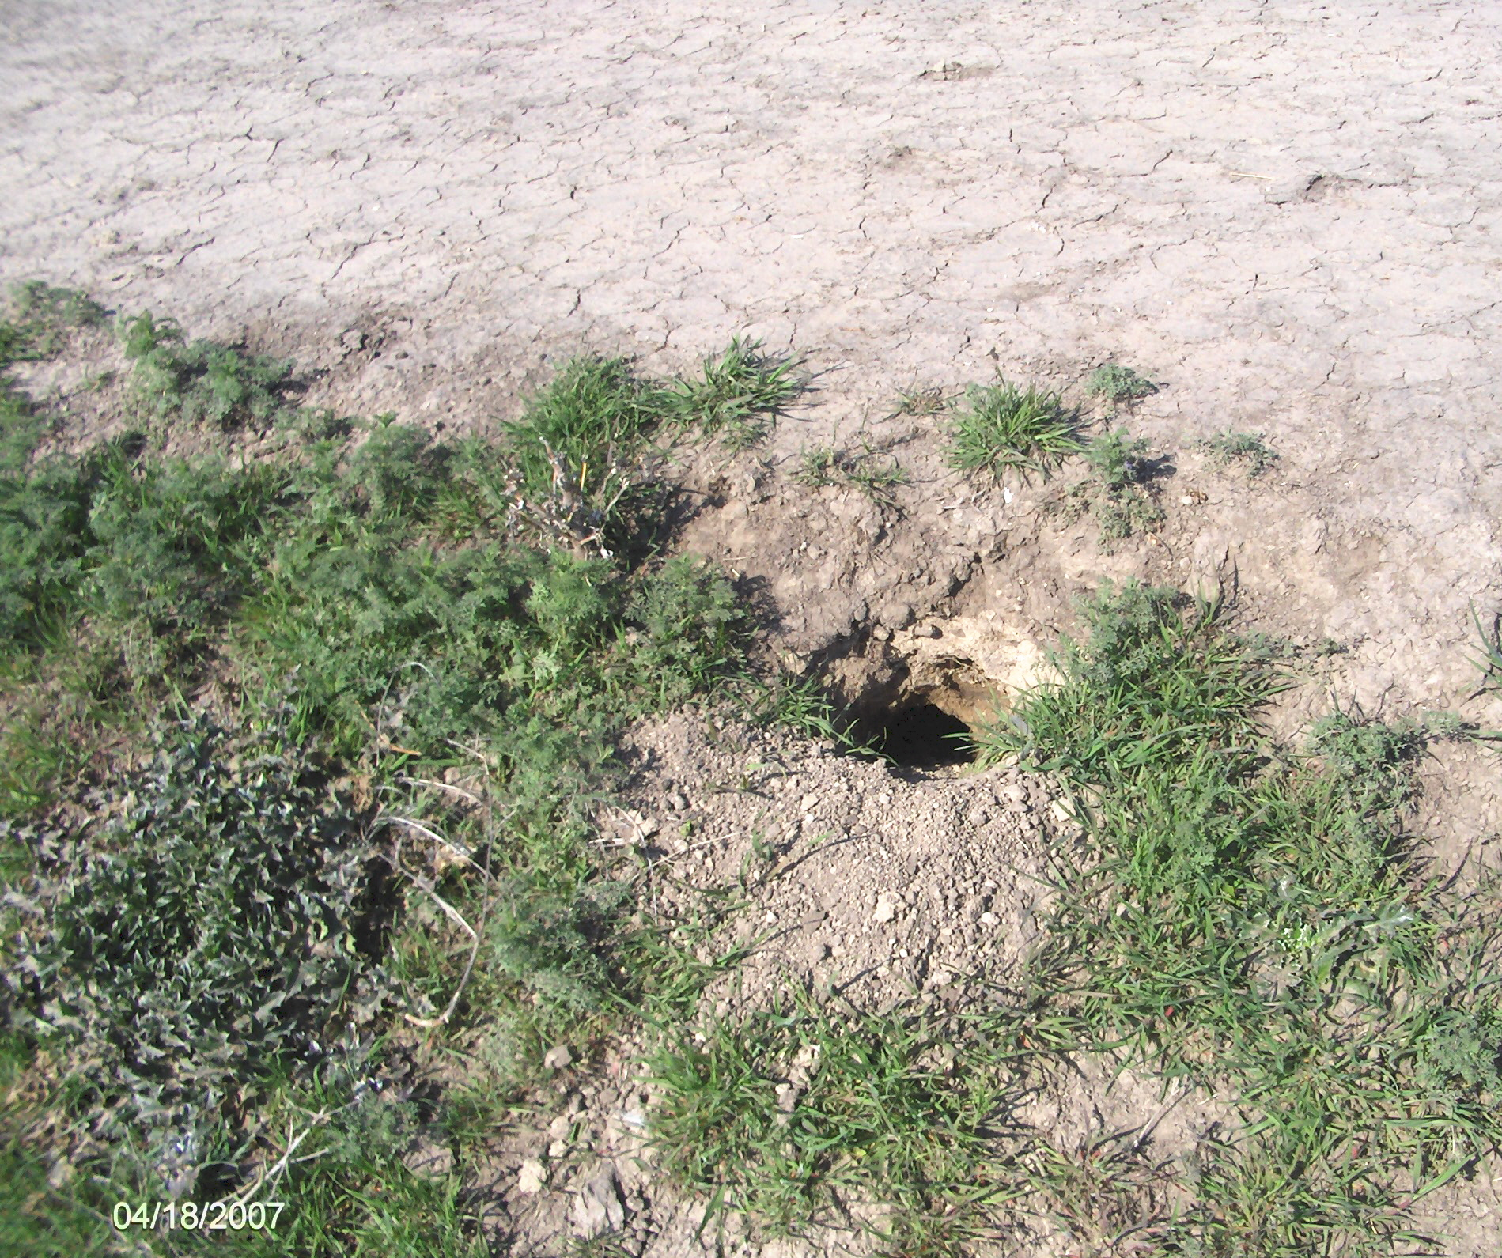
Critter Burrows

Slide 29
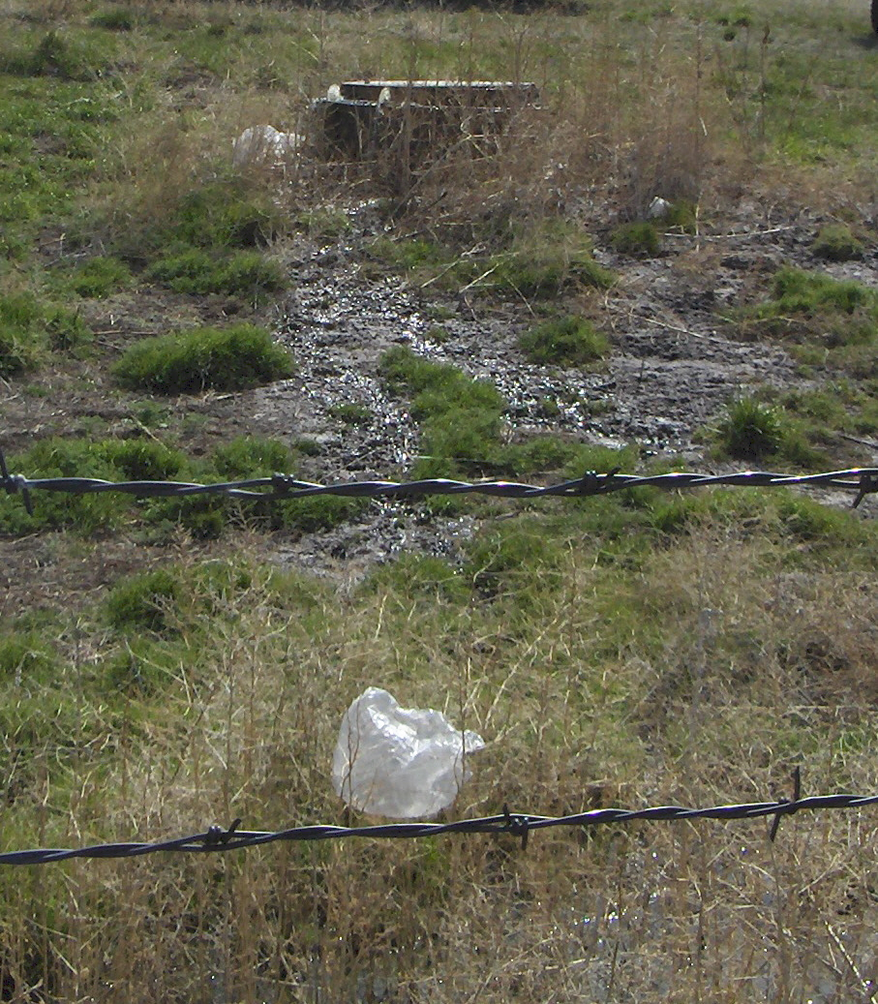
Inflow Blockage?

Slide 30
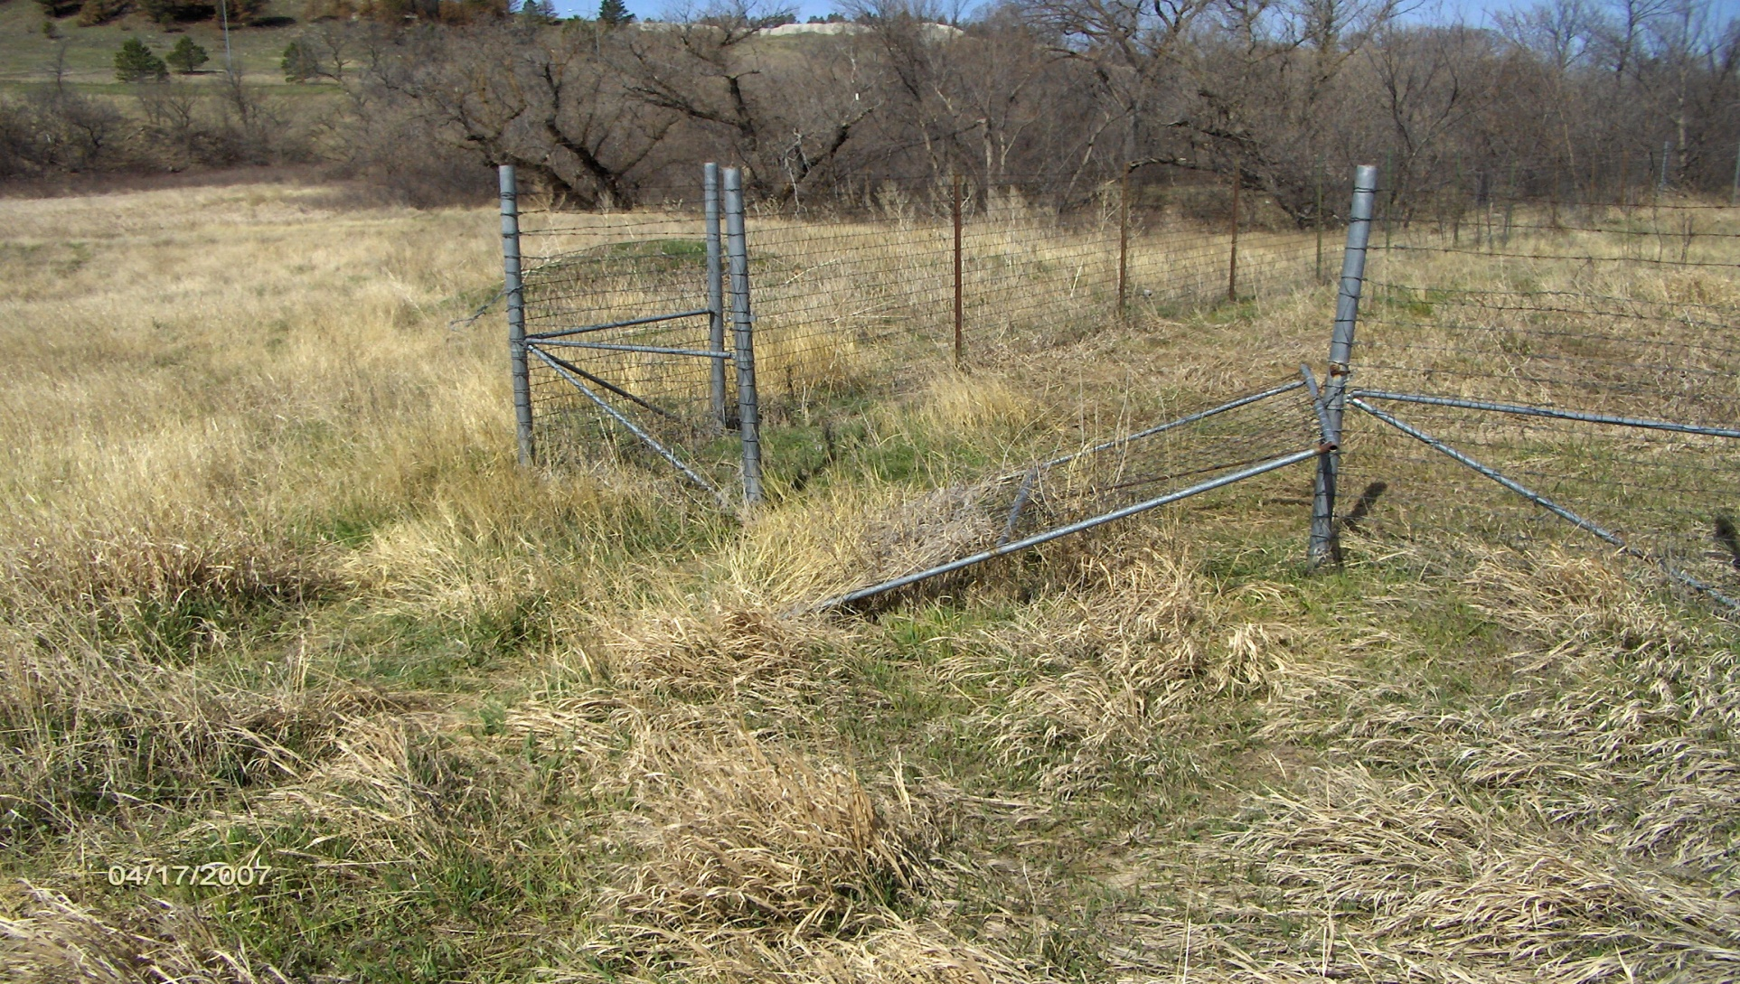
Security

Slide 31
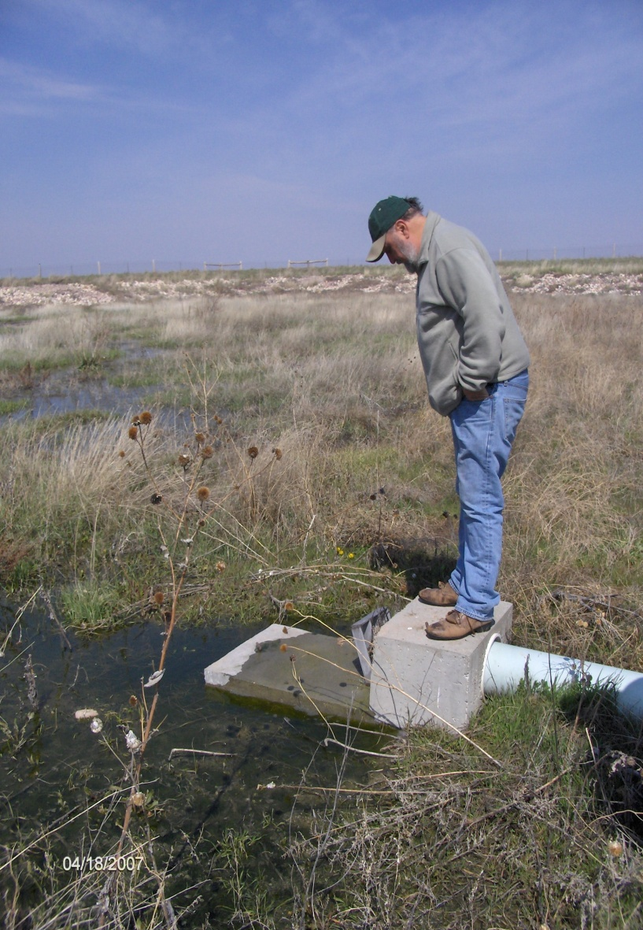
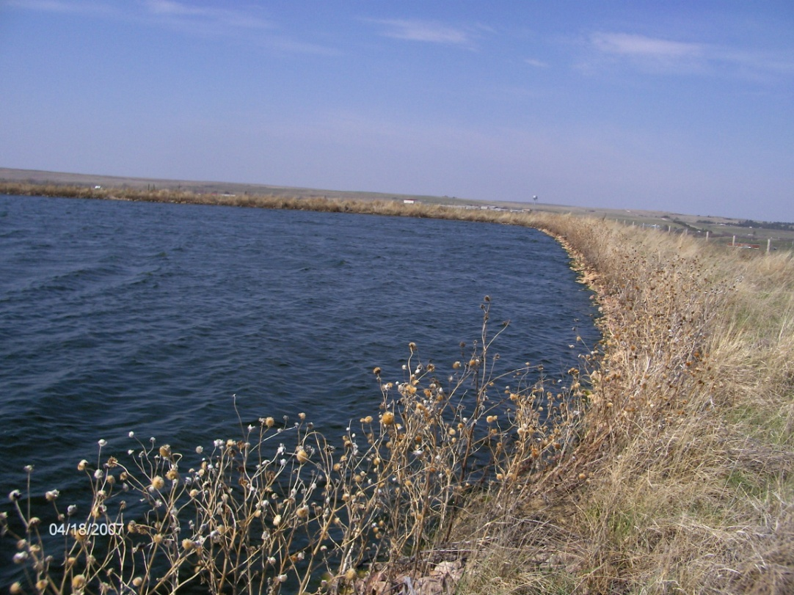
Flow: pond to pond

Slide 32
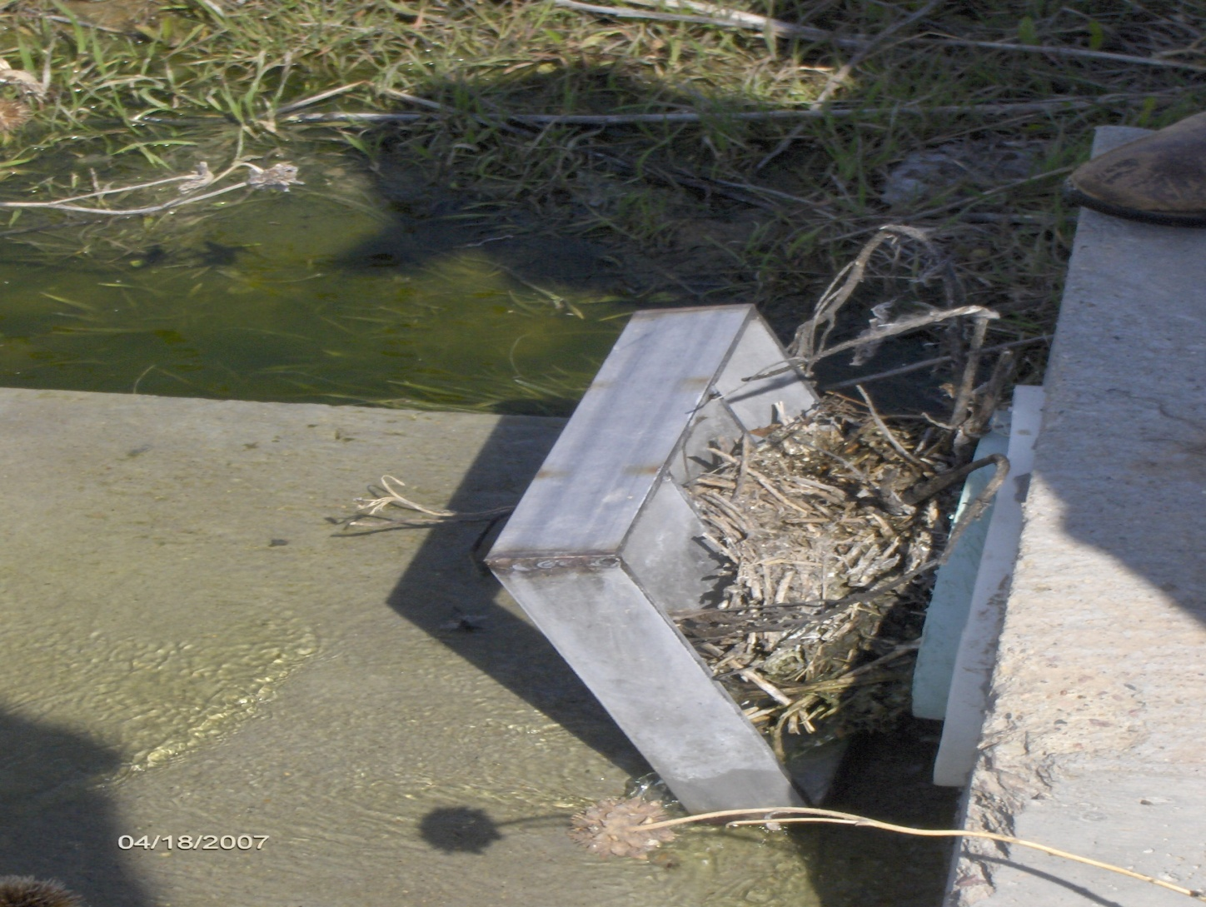
Blockage

Slide 33
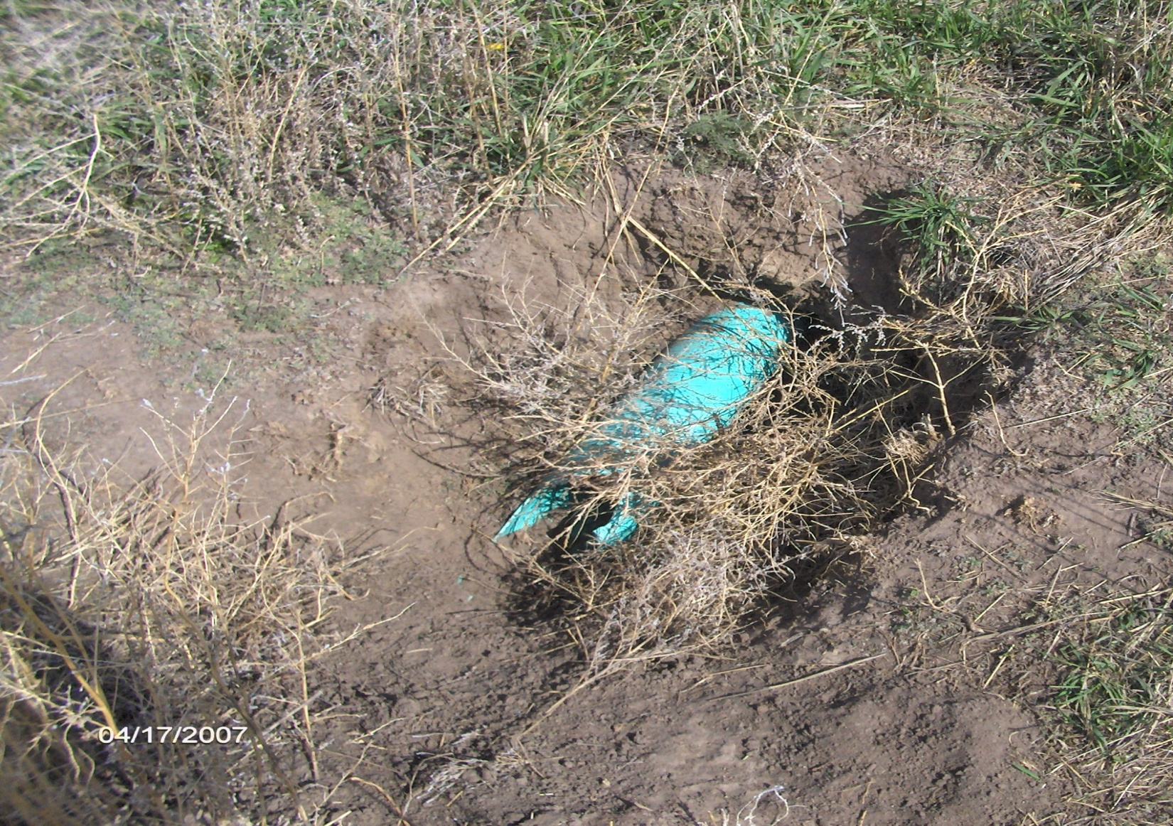
Outflow

Slide 34
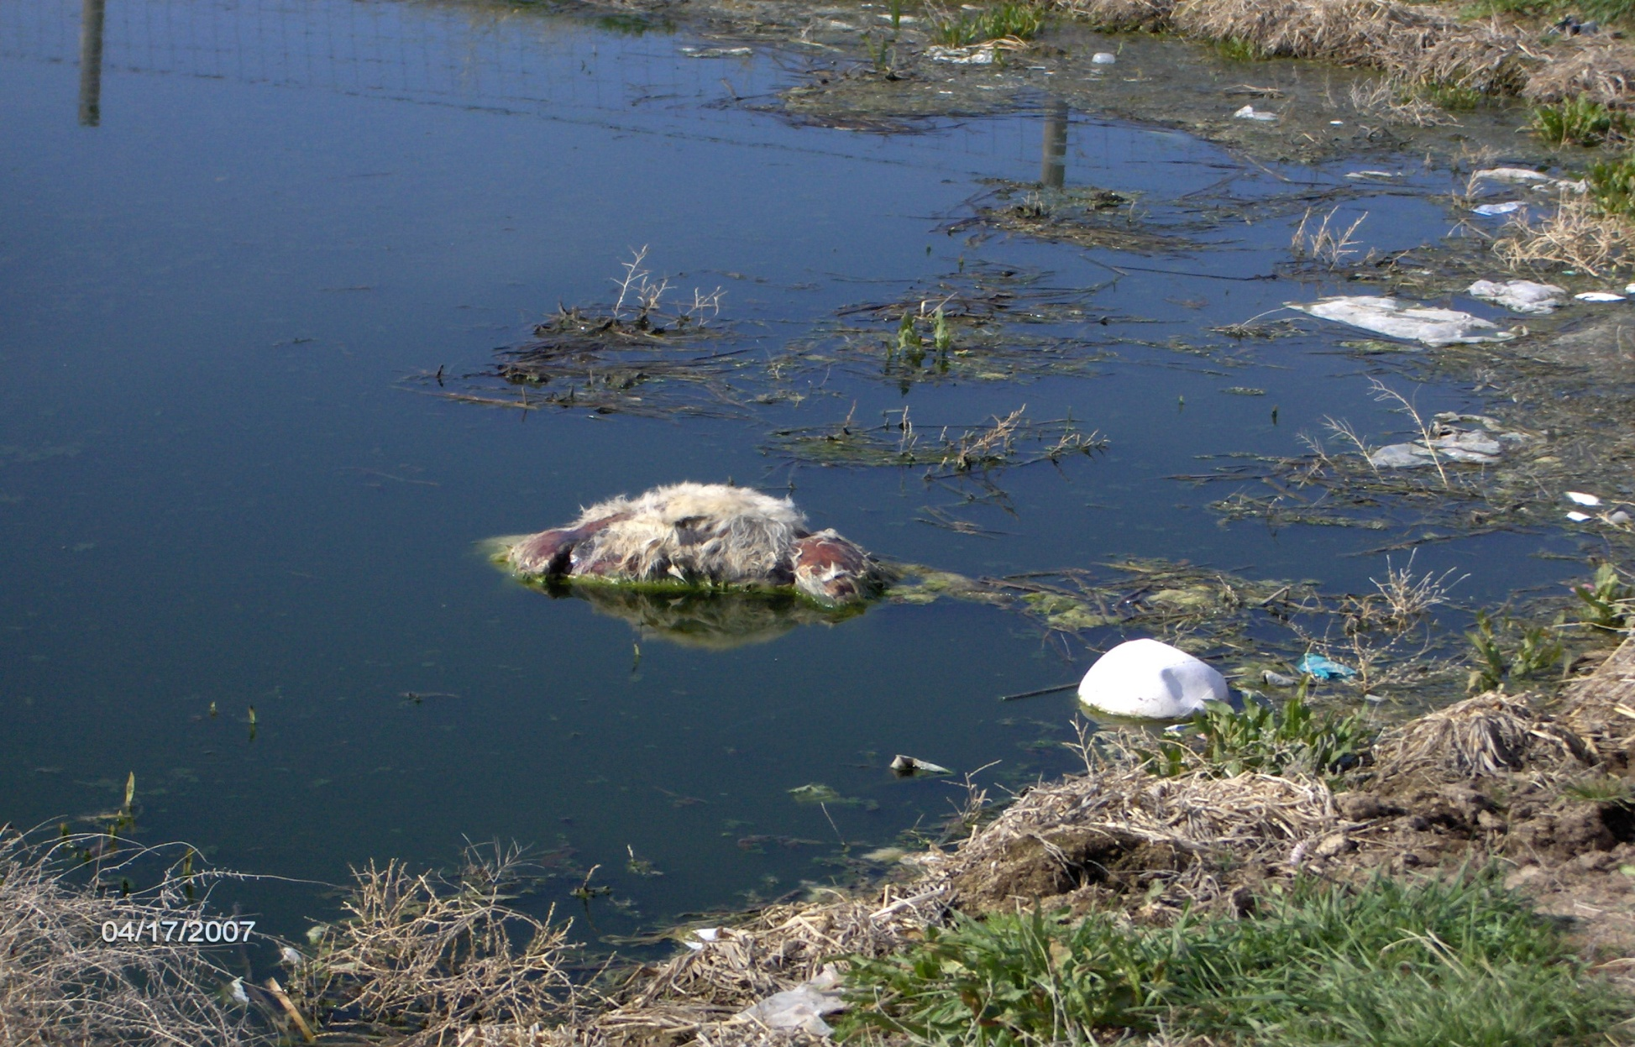
Debris in Lagoon

Slide 35
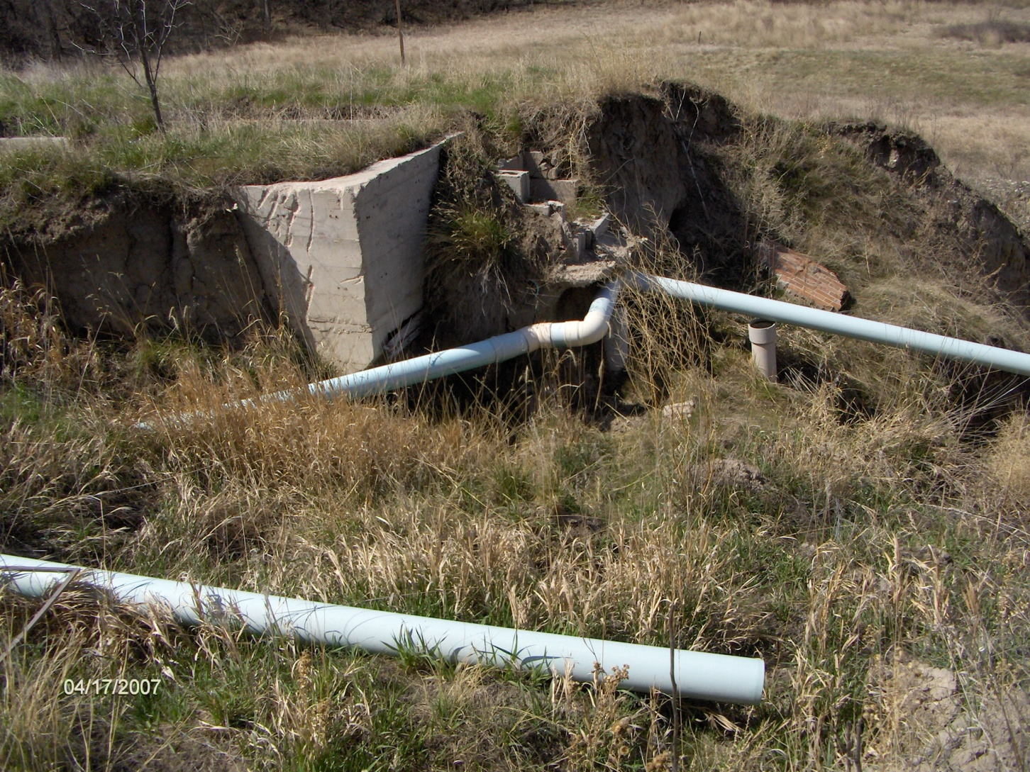
Piping

Slide 36
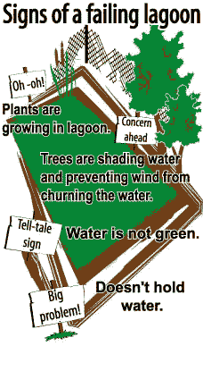

Slide 37
Observations and Record Keeping
Wastewater
  Color, Scum, Weeds, Algae, Odors, Ice
Dikes (Berm)
  Weeds, Holes, Erosion
Pond Structures
  Blockage, Grease, Corrosion, Erosion, Valves
Aeration System
  Operation, Patterns, Valves

Slide 38
Questions?
Contact information:
Gregg Hinrichsen
Midwest Assistance Program
308 – 528 - 1048
ghinrichsen@map-inc.org

