Slide 1
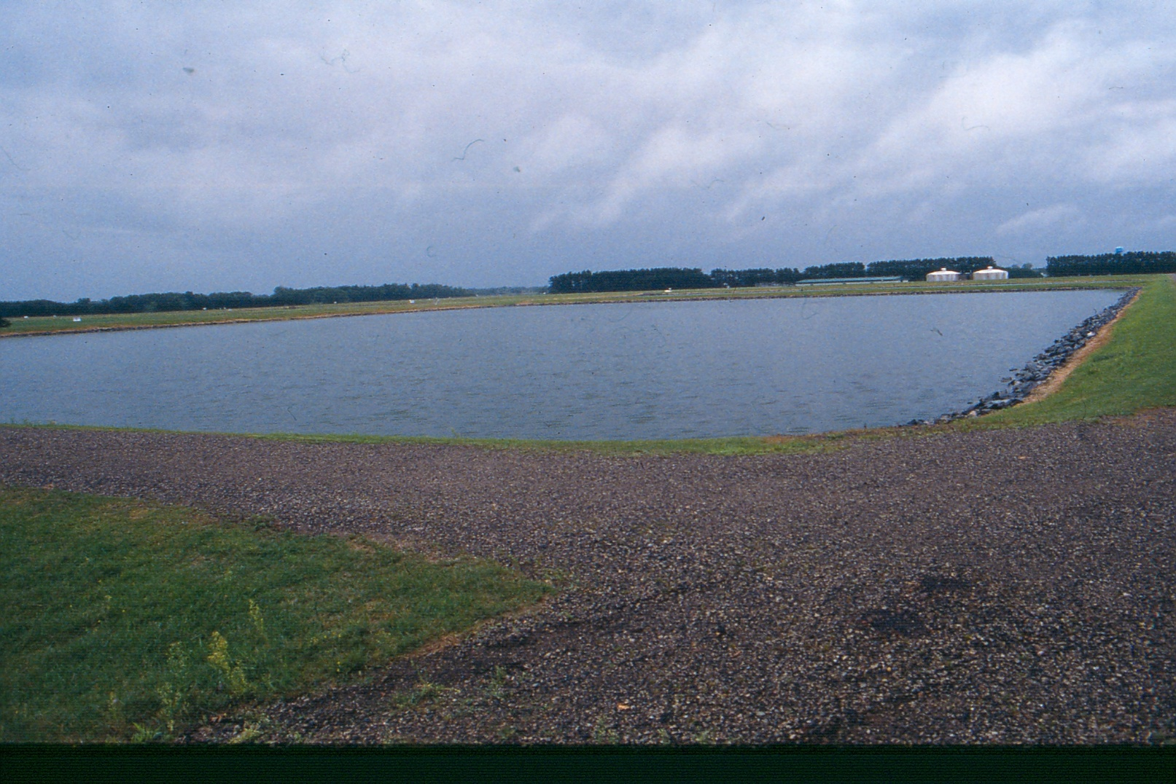

Operations and Maintenance of Wastewater Stabilization Ponds
North Dakota Operator Training
2021
Susan Hazelett, PE

Slide 2
Presentation Overview
Background
Operations
Algae
Phosphorus Removal
Maintenance
Troubleshooting
Questions

Slide 3
Background

Slide 4
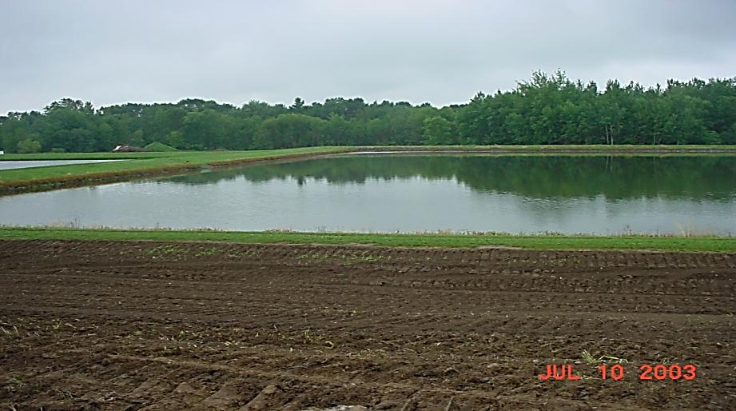
Definitions
Biological Oxygen Demand (BOD)
  The amount of oxygen consumed by bacteria while they decompose organic matter
Total Suspended Solids (TSS)
  The suspended particles that are NOT dissolved and can be removed via a filter
pH
  The acidity or basicity/alkalinity of a solution

Slide 5
Stabilization Ponds Basic Design
Minimum of 180 Days Storage
3’ freeboard
Operating Volume 3 feet
2’ sludge storage

Slide 6
Microbial Systems
Bacteria
  Decomposes organic matter (reduce BOD)
  Oxidize inorganic compounds (Ammonia, H2S,Nitrate)
  Feed other members of the food chain
Algae
  Supply oxygen to aerobic bacteria
  and other life forms
  Elevate pH during day– pathogen kill,
  precipitate metals, odor control,
  ammonia volatilization
  Can also cause TSS and pH violations
  Consume oxygen at night and lower pH

Slide 7
Microbial Systems
Protozoa
Control pathogens
Consume organic matter
Lower BOD and TSS
Higher Life Forms (Daphnia, rotifer, leeches, nematodes)
Digests organic matter
Consume algae, protozoa and nematodes
Clarify water

Slide 8
Symbiotic Cycle
Sunlight
Algae
Oxygen
Nutrients
Carbon Dioxide
Bacteria
Organic Matter

Slide 9
Yearly Variations
Month
J
F
M
A
M
J
J
A
S
O
N
D
Algae
Bacterial
Activity
pH
BOD
Storage
Storage
Discharge Windows

Slide 10
NDNPDES Permit Limits
Biochemical Oxygen Demand (BOD₅)
  25 mg/L
Total Suspended Solids (TSS)
  30-45 mg/L
Fecal Coliform (E. coli)
  200 colonies/100 mL (usually seasonal)
pH
  6(7)-9 SU
  Total Phosphorus
  None yet

Slide 11
Operations

Slide 12
Operational Steps
Use Fill and Draw Type Operation
  Isolate primary cell for raw influent
Make Old Water
  Hold in primary until full, then transfer from primary(s) to final cell
Isolate/Settle in Final Cell

Slide 13
Operational Steps
Spring
  Operator discharges enough high-quality effluent after solids settle and before algae develops
Fall
  Operator discharges enough high-quality effluent after solids settle and after algae die off
  OR
Summer
  Irrigate or spray site during growing season

Slide 14
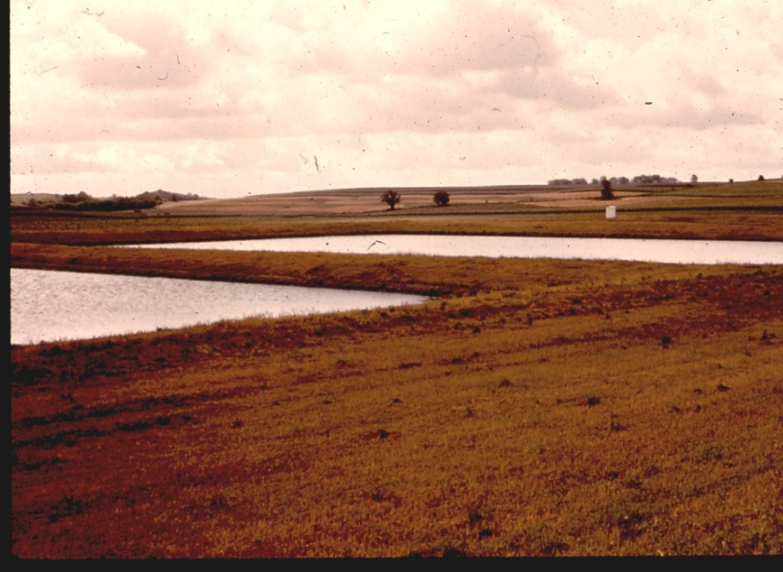
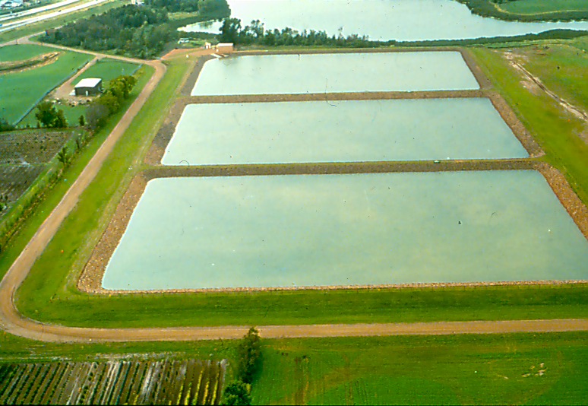
Method of Operation
Series Operation or Parallel Operation

Slide 15
Series Operation – Two Cell
Transfer
Primary Cell
Settle
Influent
Secondary
Cell
1) All Influent to Primary Cell – Closed Transfer Gates
2) Create Old Water
3) Transfer into Secondary

Slide 16
Series Operation – Three Cell
Transfer
Settle
Influent
1) Influent Into a Primary 4) Create Old Water
2) Create Old Water 5) Transfer to Secondary
3) Transfer to other Primary

Slide 17
Parallel Operation – Three Cell
Transfer
Influent
Settle
Influent
Transfer
1) Equal Split into both Primary A and Primary B
2) Create Old Water
3) Transfer into Secondary

Slide 18
Series vs. Parallel Operation
Series Operation
  Summer
  During discharge
Parallel Operation
  Winter
  High loading

Slide 19

Moving/Transferring Water

Slide 20
Guidelines for Transferring
Create Old Water
Six Inches Per Day
Fill Secondary to Max Operating (3’)
Isolate Secondary Before Discharge/Irrigation

Slide 21
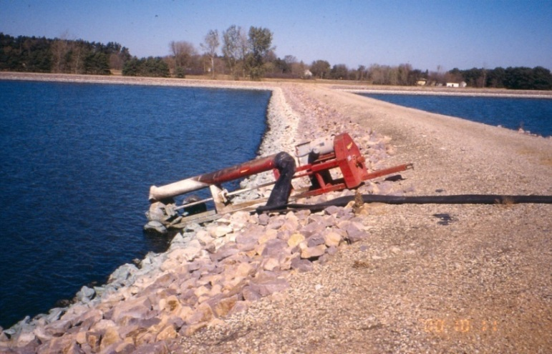
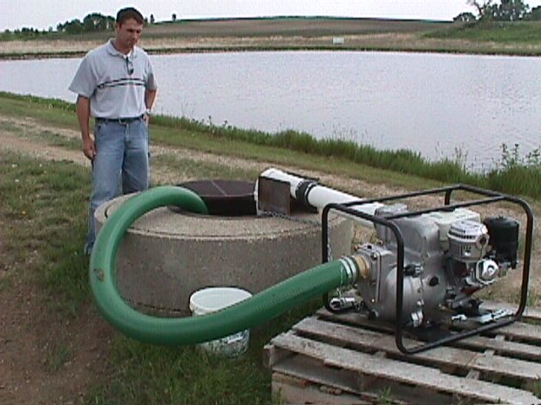
Adequate Elevation Difference
Can you Fill and Isolate the Secondary
HWL of Secondary = LWL of Primary
Transfer Pump Needed?
Pump Size?
  6 inches per day = 100 gpm per acre
Pump Through Control Structure

Slide 22
Discharging
Discharge Period
Generally:
Acceptable Discharge Periods
Spring | March 1 – June 30
Fall | September 1 – December 31
Problem Discharge Periods
Summer | July 1 – August 31
Winter | January 1 – February 28

Slide 23
Discharging
Ice-covered Receiving Water – 100 percent coverage from bank to bank, regardless of ice thickness
Facilities should avoid discharge to ice-covered receiving water regardless of acceptable/problem discharge period

Slide 24
Discharging
How much discharge is enough?
1) Calculate Storage Need
  Days (180) x Average Flow
  = Volume of Storage Needed
2) Calculate Storage Available
  Calculate Volume Available in All Ponds
3) Calculate Total Volume to Discharge
  Storage Need – Storage Available
  = Volume to Discharge
4) Calculate Total Feet to Discharge
  Volume to Discharge/Secondary Pond Size
  = Feet needed to discharge

Slide 25
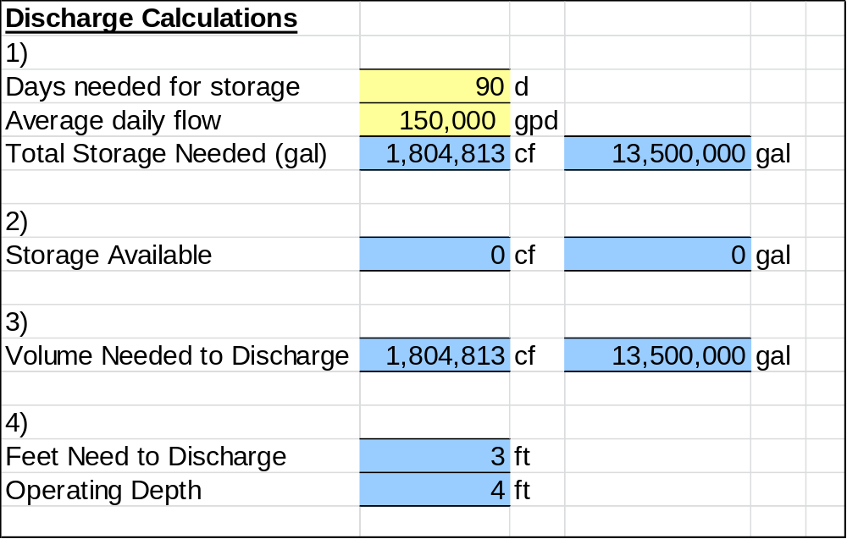
Discharge Calculations

Slide 26
Algae in Ponds

Slide 27
Algae in Ponds
Algae is an essential component in a healthy pond system
Algae provide needed oxygen to bacteria for waste stabilization
Algae can become problematic, cause high TSS and high pH
Old ponds with high sludge levels, excess nutrients in raw wastewater

Slide 28
Algae Removal
Natural Die Off
Daphnia
Aquatic Plants
Barley Straw
Chemicals – Call NDDEQ
  Copper Compounds – avoid due to toxicity concerns
  Hydrothol 191,Potassium Permanganate, Sodium Percarbonate

Slide 29
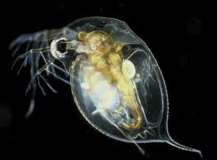
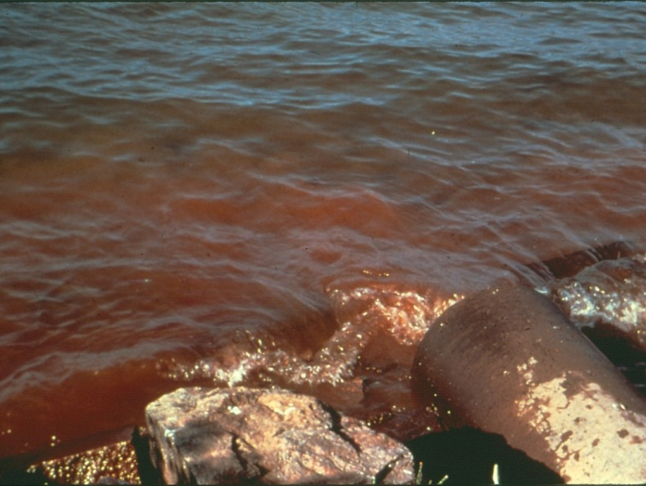
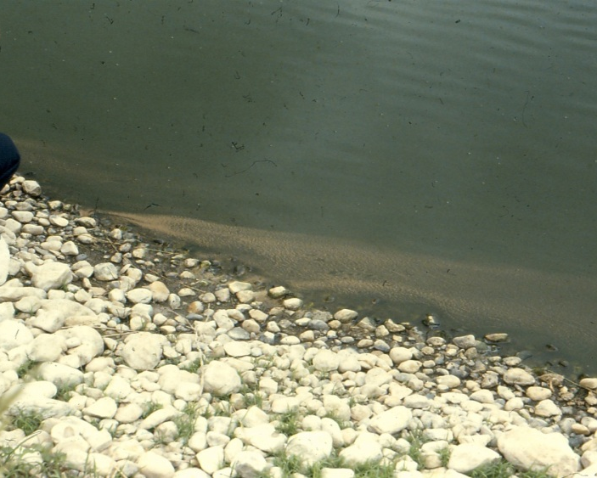
Daphnia
Pond Filter
Clarifies water, feeds on bacteria and algae

Slide 30
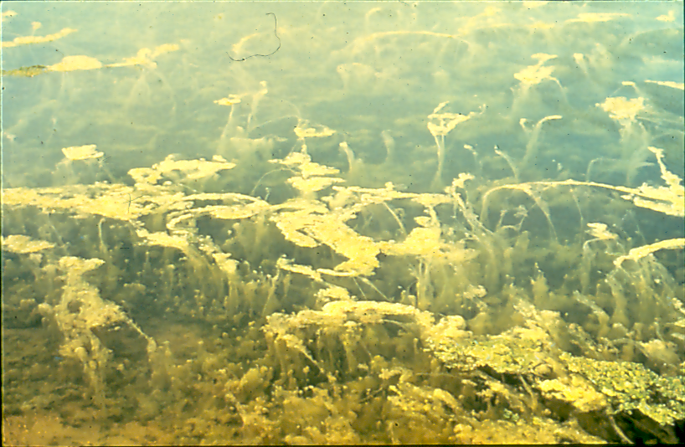
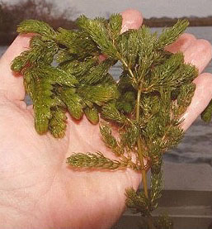
Aquatic Plants - Coontail
Submersed/Free Floating Plant with NO Roots
Absorbs Nutrients
Releases a Chemical that Inhibits Algae Growth

Slide 31
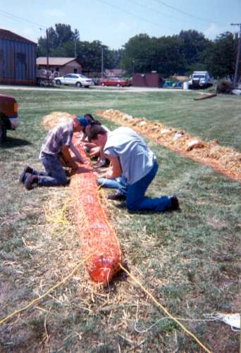
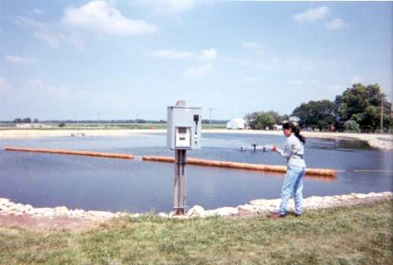
Barley Straw
Must be Added Prior to Algae Development
Releases Substance Toxic to Algae

Slide 32
Copper Compounds
Not recommended due to potential toxicity
Must meet both an effluent limit and receiving water quality limit for copper
Receiving water copper limit depends upon water hardness
Discuss with NDDEQ prior to use

Slide 33
Hydrothol 191
Approved aquatic algaecide/herbicide
Available as a liquid or granular
Toxic at 0.3 mg/L
Need at least 1.0 mg/L to reduce to less than 45 mg/L
Water temperature greater than 68°F
Pond must be aerobic
Wait at least 4 days before discharge or 7 days before spray

Slide 34
Potassium Permanganate
Typically used in water treatment for taste and odor
Typical dosage needed
  70 to 165 pounds per acre
Concerns
  Pink/Purple, then straw brown color
  Stain hands
  Safety
    Eye protection
    Reacts with other chemicals; explosive
  Can be toxic to aquatic life

Slide 35
Phosphorus Removal

Slide 36
Typical Pond Effluent Phosphorus Concentrations
Low range
  < 2.0 mg/L
Average
  2.0 – 3.0 mg/L
High range
  8 + mg/L
NPDES Permit (if required)
  - 1.0 mg/L

Slide 37
Typical Chemicals Used
Aluminum Sulfate (Alum)
Ferric Chloride

Slide 38
Application of Alum
Alum dispersed/mixed into pond contents
  With pontoon or fishing boat
  Piped to mixers in the ponds
Application equipment
  Injection equipment
  Possibly a loading dock
  Storage tanks (boat and land)
Some have applied via a fire hose from dike
Can be labor intensive

Slide 39
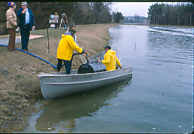
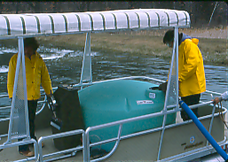
Application of Alum

Slide 40
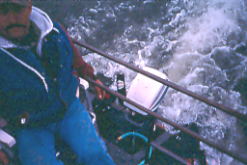
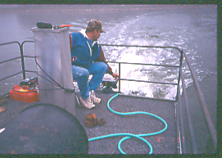
Application of Alum

Slide 41
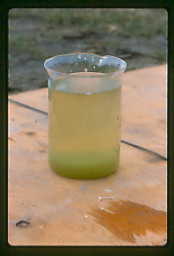
Chemical Reaction
Chemical reacts with phosphorus
A floc is formed
Settling occurs
Dosage depends on
phosphorus concentration
pH

Slide 42
Pond Systems Using Alum
To remove 2 mg/L
  Approximately 70 to 150 gallons of liquid alum per million gallons of water in your pond
Cost
  Approximately $2 per liquid gallon delivered but can vary depending on location

Slide 43
Maintenance

Slide 44
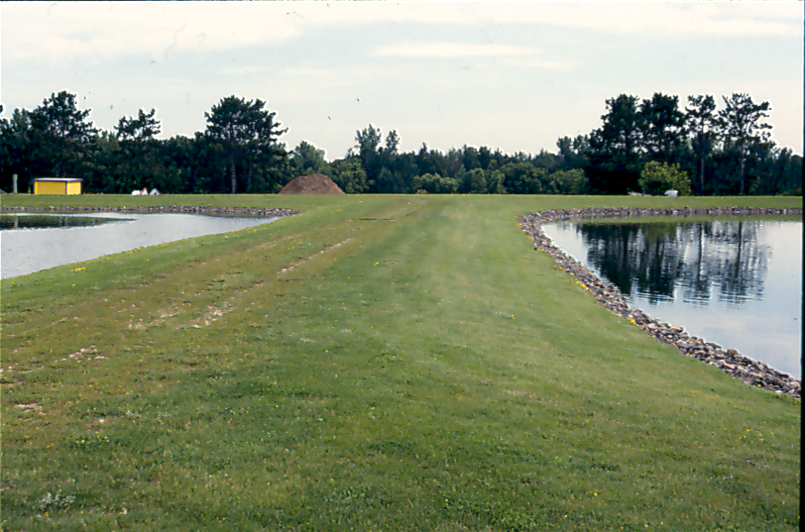
Maintenance
Extremely important
If neglected, will destroy pond system
Can result in very costly repairs

Slide 45
Necessary Maintenance
Vegetation
  Submerged
  Floating
Grass
Erosion
Rodents
Floating Mats
Control Structures
Seepage
Road/Fences/Gates/Signs

Slide 46
Proper Maintenance
Protect the Liner
Reduce Odor/Insect Problems
Prevent Short-Circuiting
Increase Sunlight Penetration
Can Save Costly Repairs in the Future

Slide 47
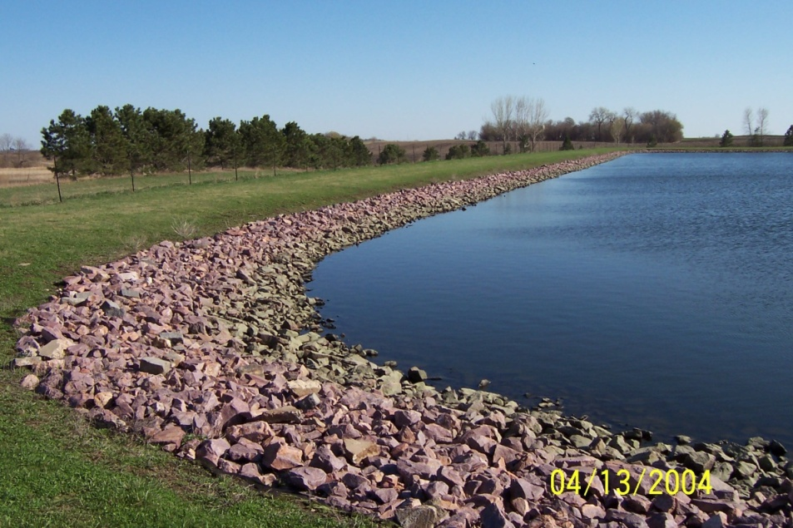
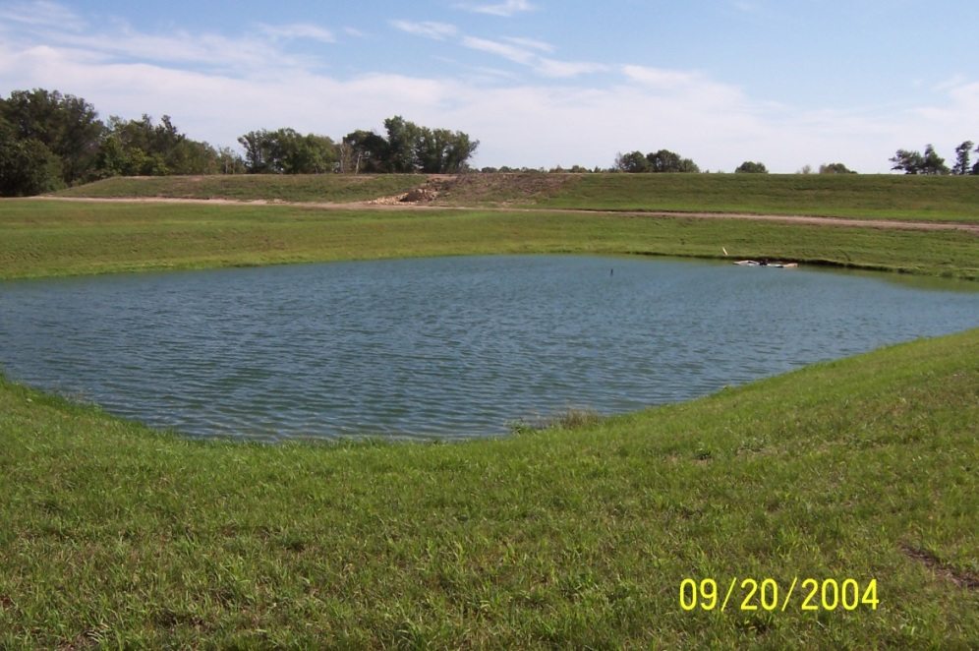
The Good

Slide 48
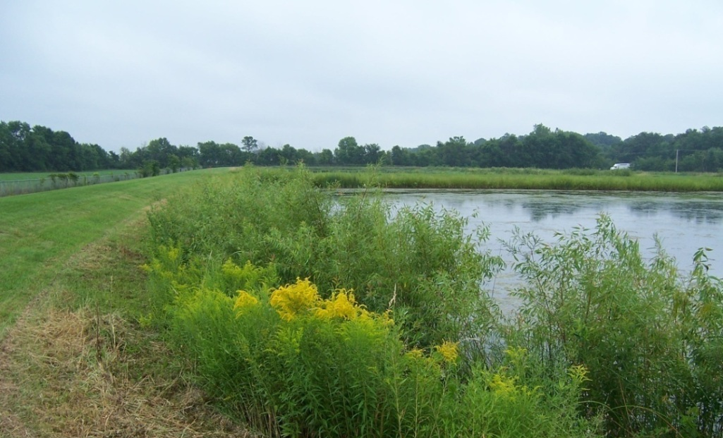
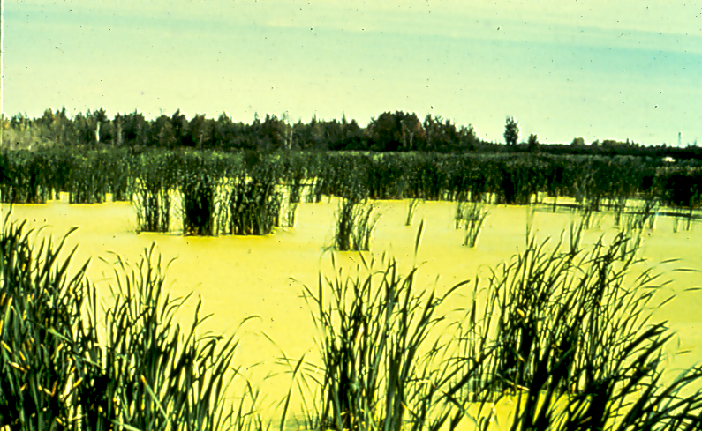
The Bad
…and the Ugly

Slide 49
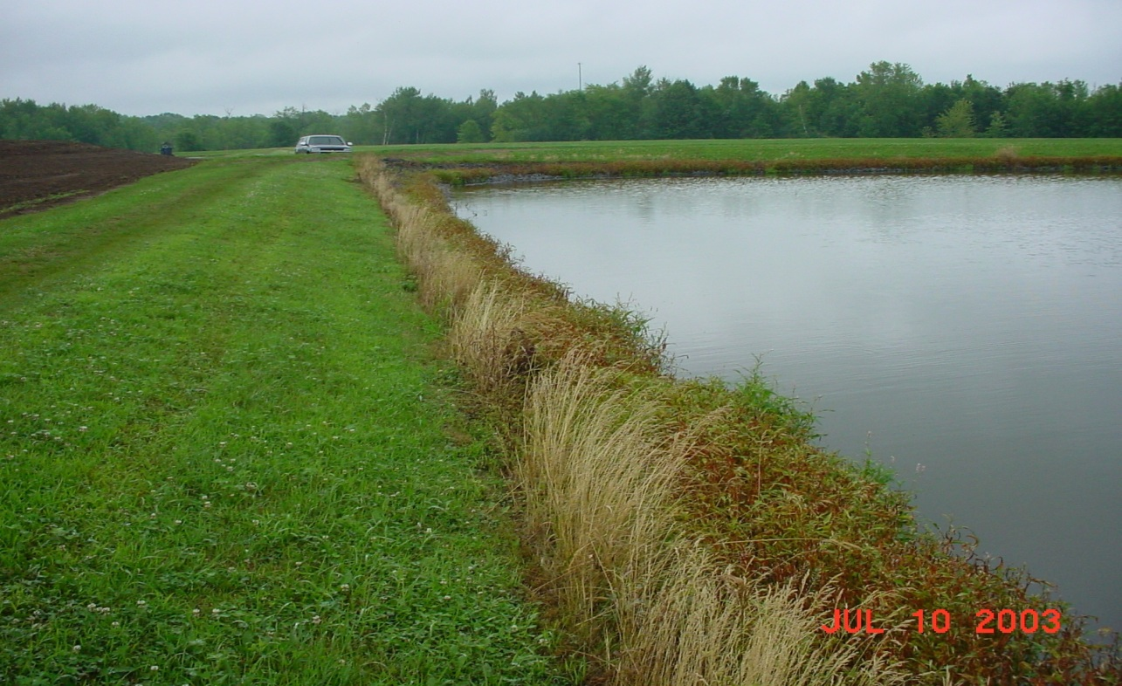
Vegetation Concerns
Is it Deep-Rooted?
Is it Affecting Your D.O. Level?

Slide 50
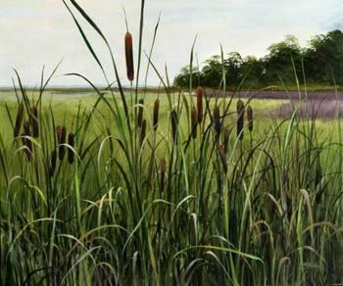
Cattails
Very Deep, Penetrating Root System

Slide 51
Removal of Cattails
Pulling Young Plants
Cut and “Drown” Method
  Lower water level and cut near bottom
  Raise water at least three feet above remaining plant
Chemicals
  Approved DEQ aquatic herbicide

Slide 52
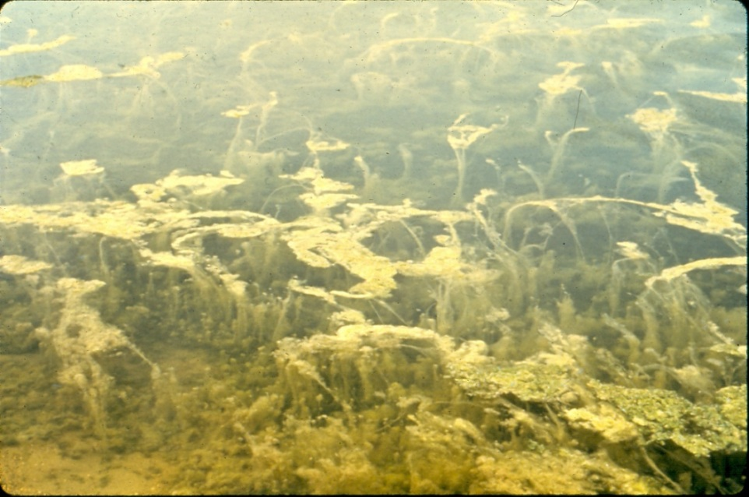
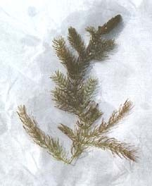
Coontail
Has been Shown to be Very Beneficial
Releases Toxins and Absorbs Nutrients
Not Deep Rooted

Slide 53
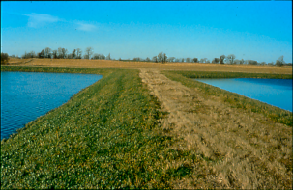
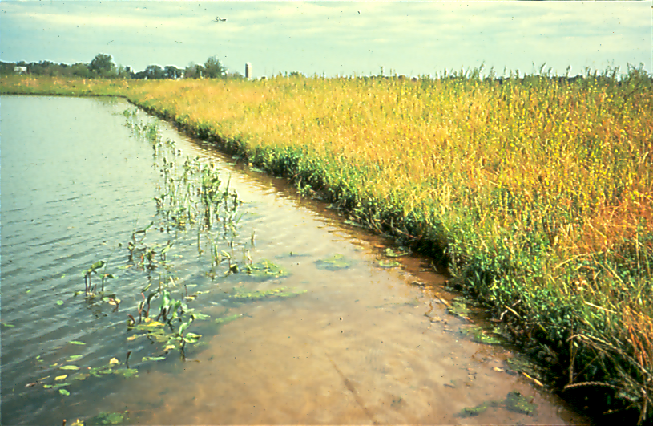
Grass Dikes
Need to be Mowed Frequently for Erosion Control
Recommended at Least Monthly
Good
Bad

Slide 54
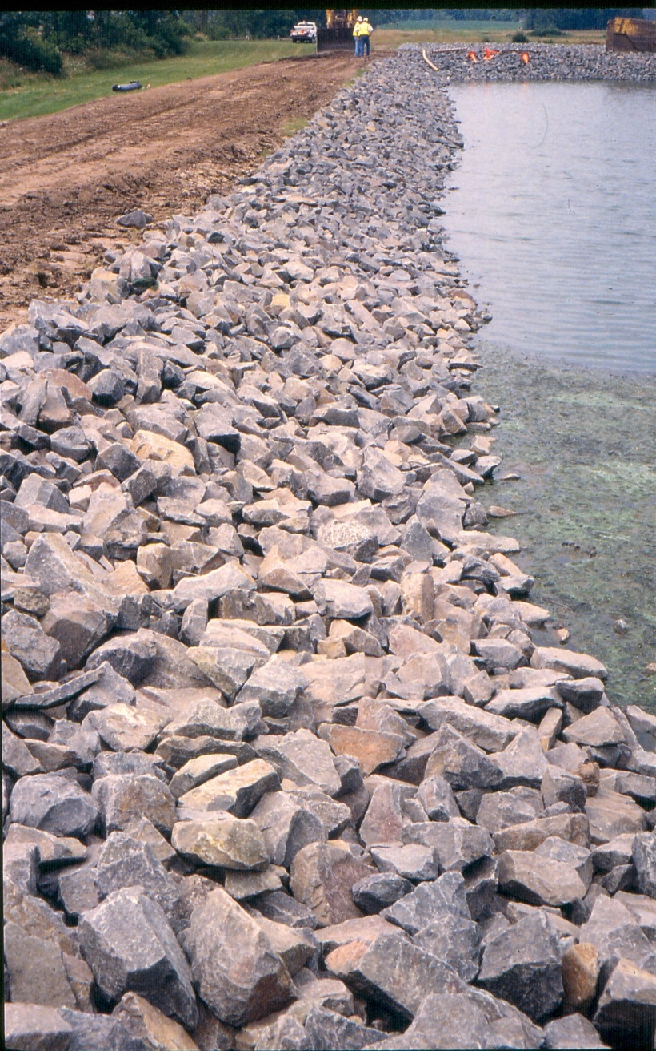
Erosion Control
Durable, Properly Sized and CLEAN Rip Rap is Very Important

Slide 55
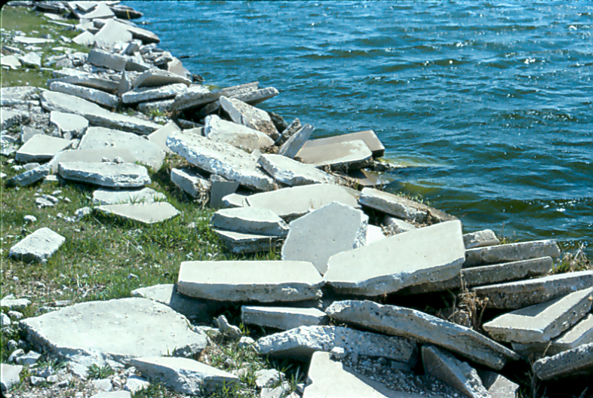
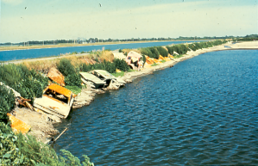
Erosion Control
Old Sidewalks, Bricks, and Cars are NOT Recommended

Slide 56
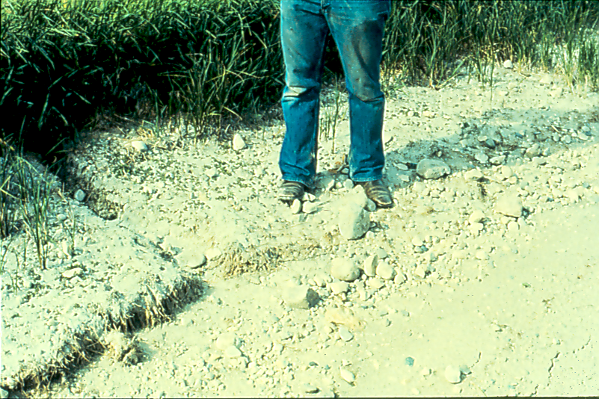
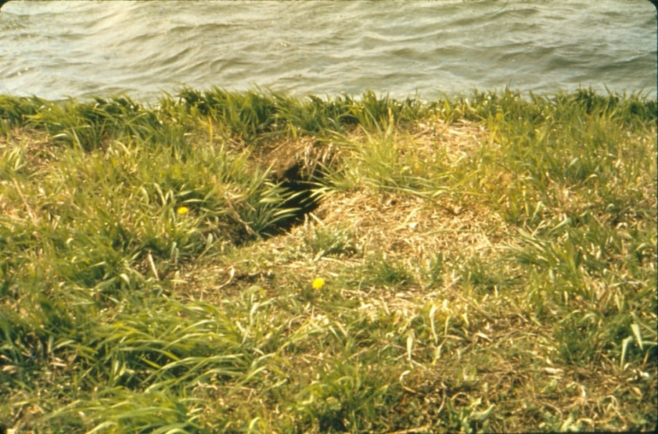
Rodent Control
Frequent, Careful Inspection of Dikes is Required
Muskrats, Gophers, Groundhogs
Trapping or ???

Slide 57
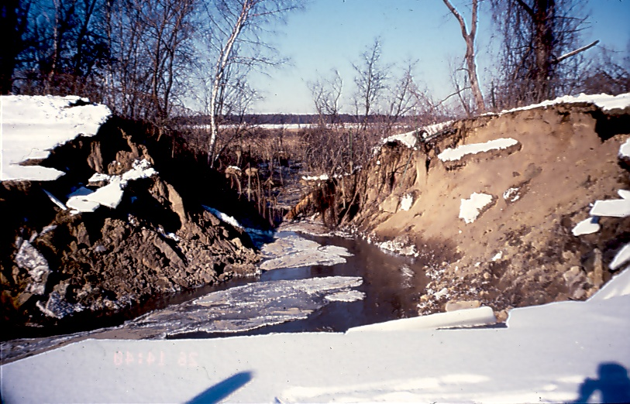
Rodent Control
If Not Addressed, Rodents can Cause Big Problems, including Dike Failure

Slide 58

Floating Mats
Very Common in the Late Summer
Blue-Green Algae
Filamentous Algae
Duckweed
Sludge ?

Slide 59
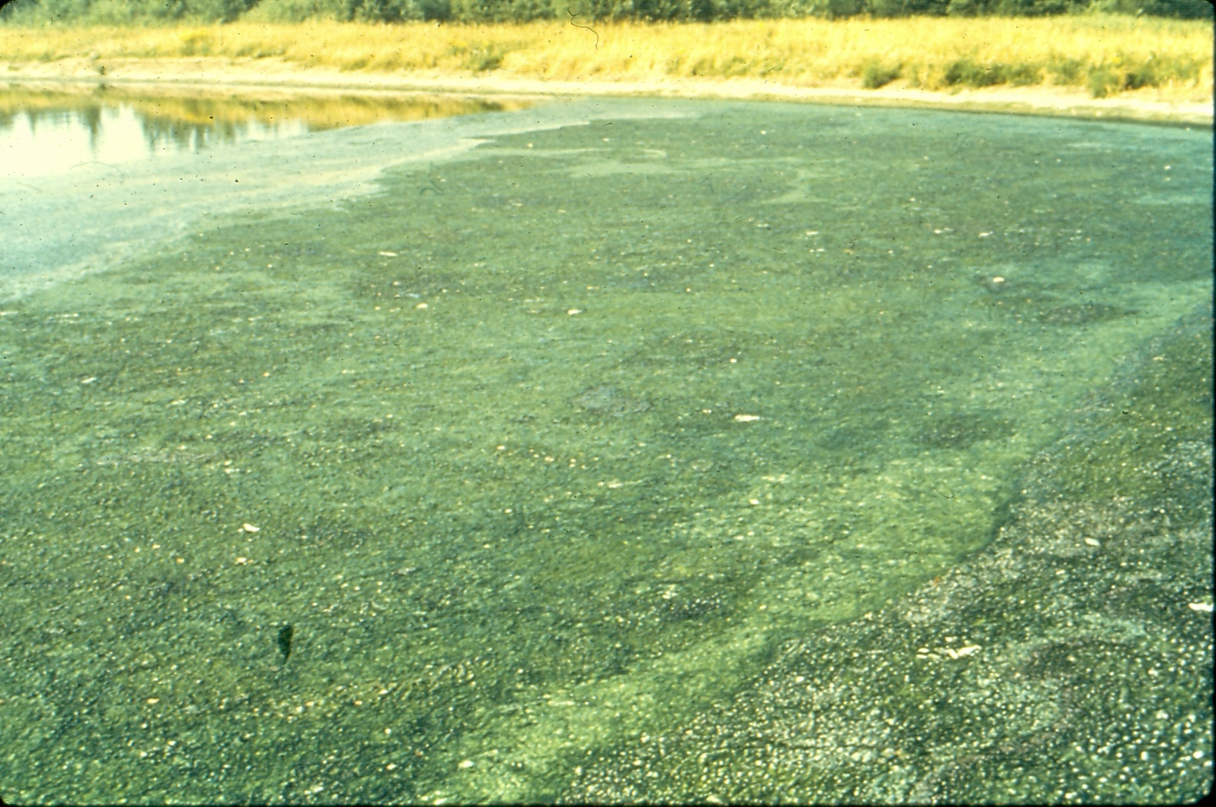
Floating Mats

Slide 60
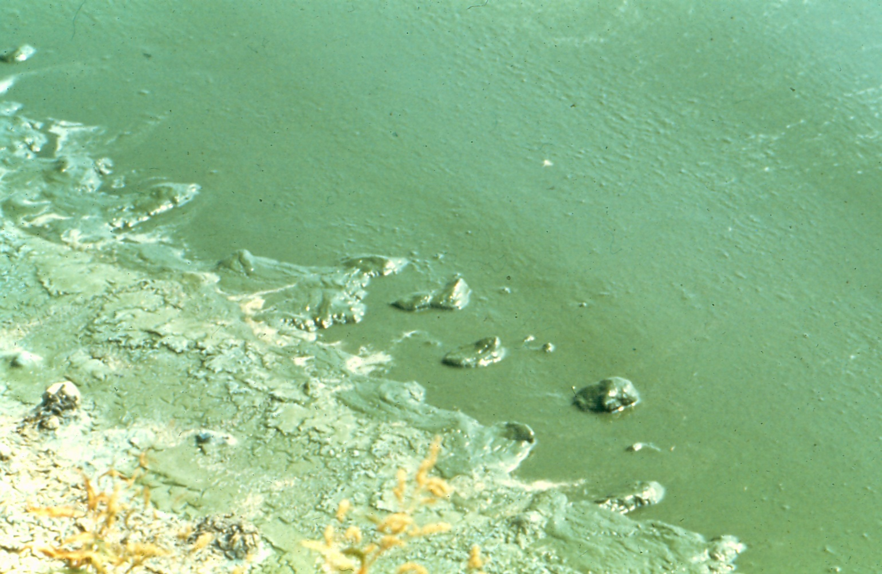
Blue-Green Algae

Slide 61
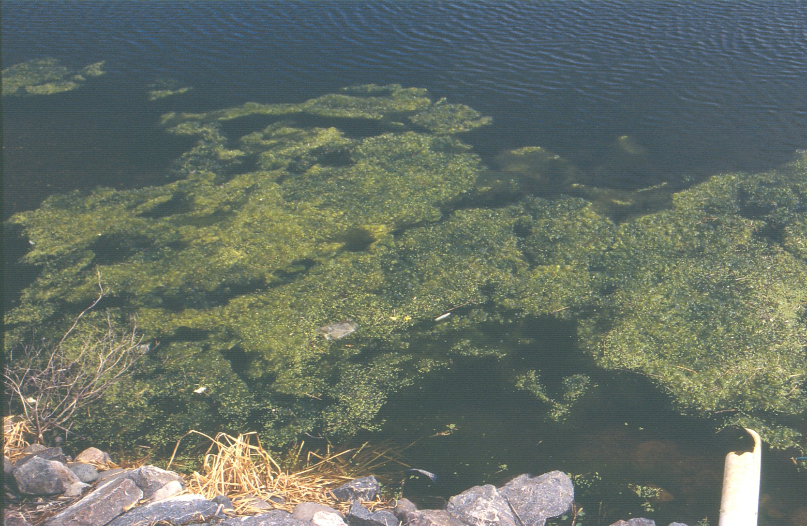
Filamentous Algae

Slide 62
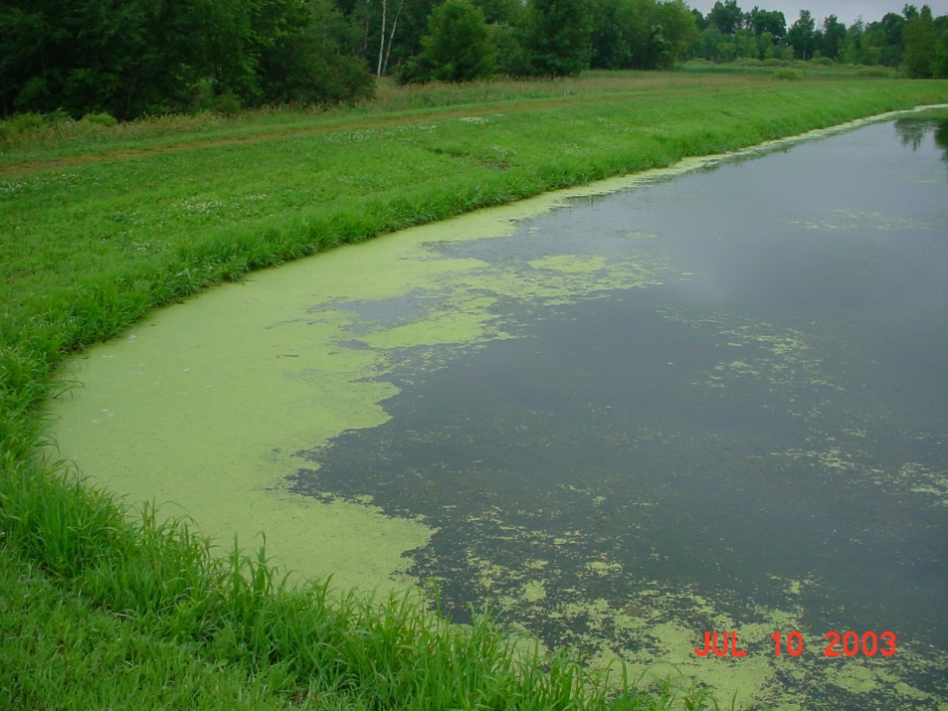
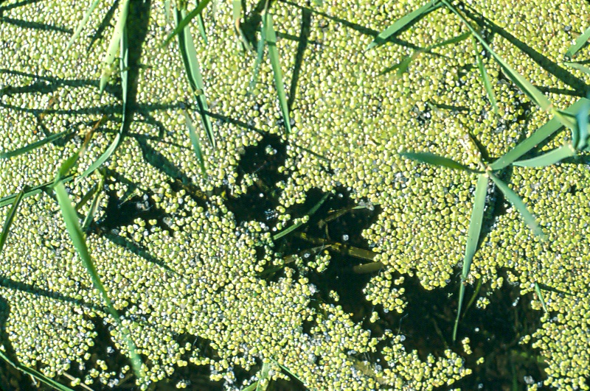
Duckweed

Slide 63
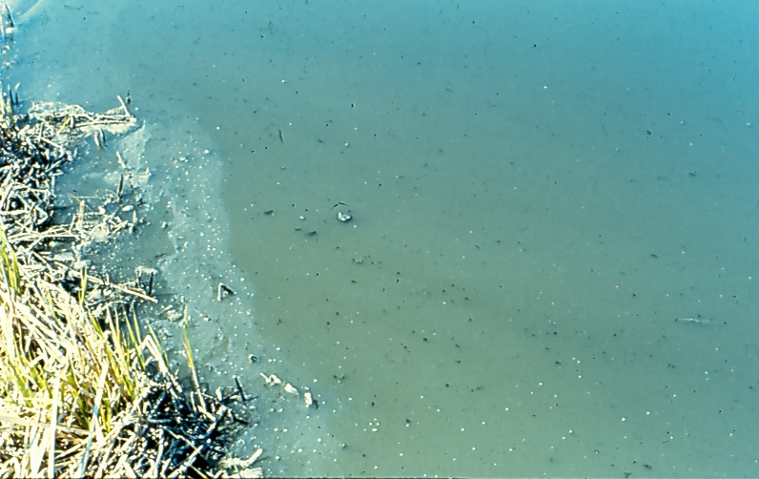
Sludge

Slide 64
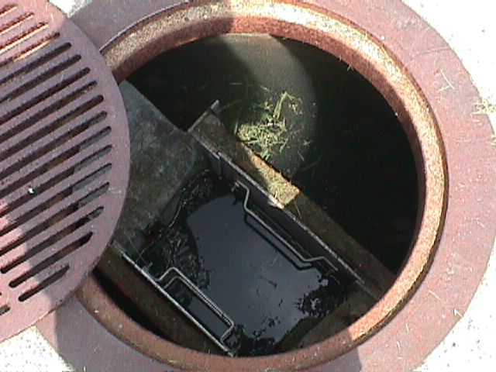
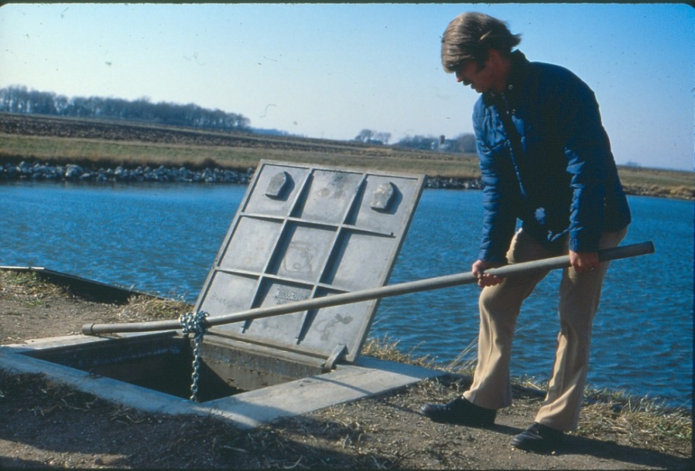
Control Structures
Corrosion
Ventilation
Leakage
  Slide gate
  Valves
  Control structure

Slide 65
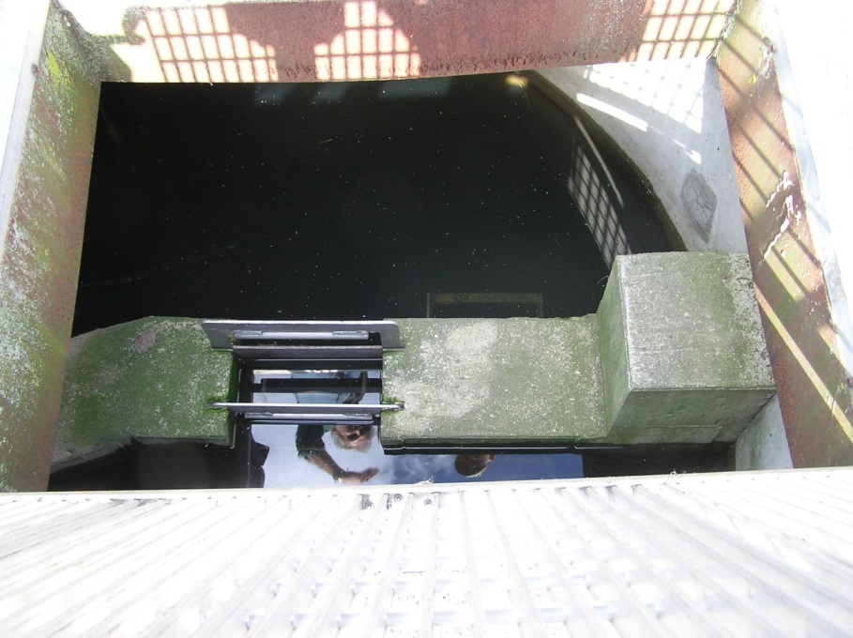
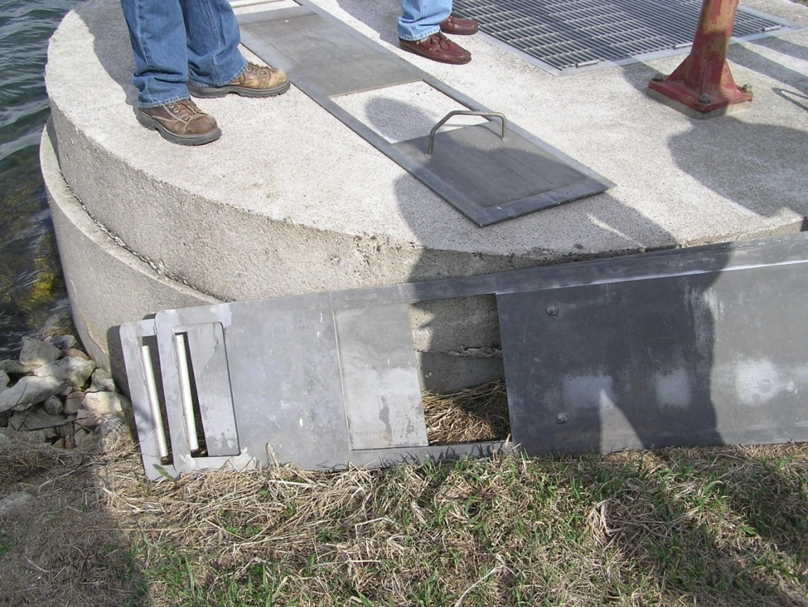
Slide Gates

Slide 66
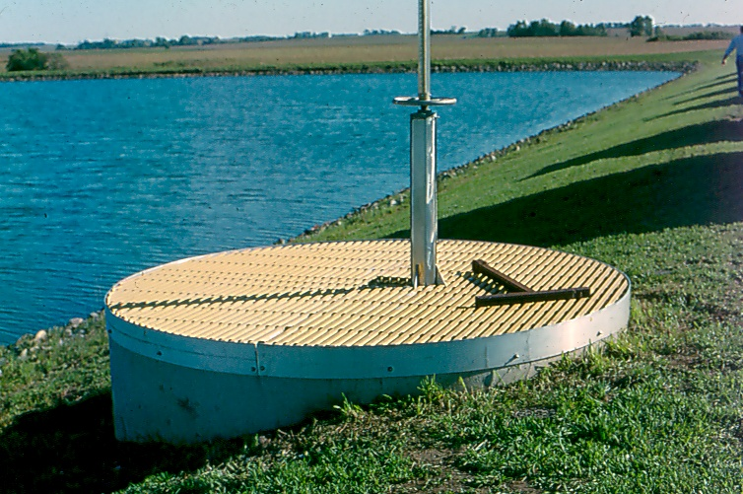
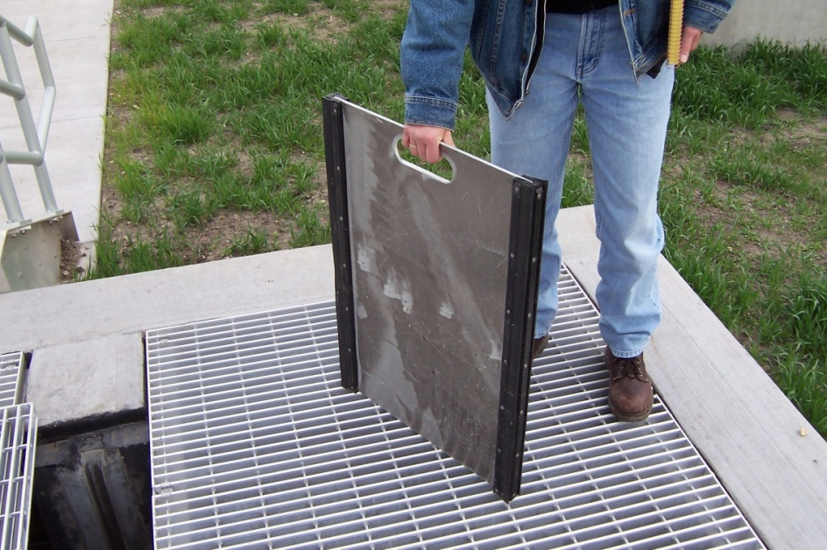
Valves and Slide Gates
Slide Gate
Valve

Slide 67
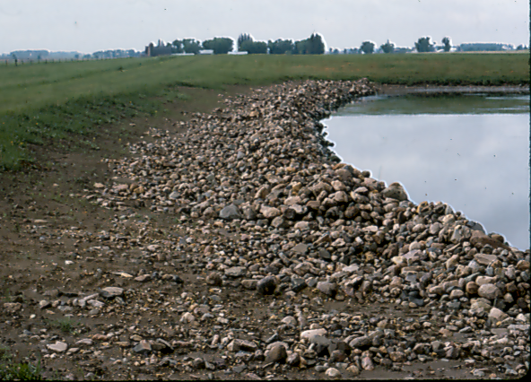
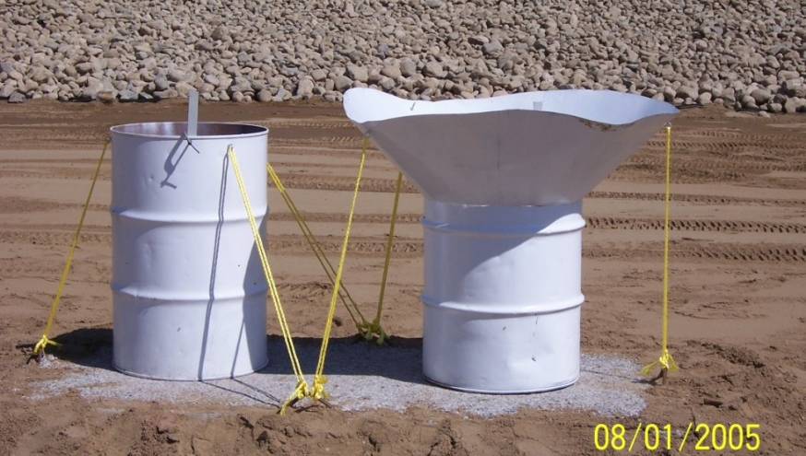
Seepage
Clay, Synthetic liner
Does system meet seepage
criteria
Desktop water balance
Water balance needed?

Slide 68


Roads, Signs, Gates, and Fences

Slide 69
Troubleshooting

Slide 70
Pond Colors
Dark green – Normal Primary Pond
Light green – Normal Secondary Pond
Dark Pea Soup – Primary Pond – Summer
Black or Grey – Normal after ice-out; overloaded if in summer
Black/Green – Blue green algae
Red streaks/pink – Daphnia under stress

Slide 71
Pond Issues
Organic Loading
  22 pounds per acre per day primary ponds -design
Adequate Hydraulic Capacity
  Storage for at least 180 days with 3 ft of freeboard
Improper Operations
  Flow through vs. Fill and draw
  Riser pipe on discharge lines

Slide 72

Outlet Piping

Slide 73
Odor
Common and unavoidable in spring
If odor lasts longer than 2 weeks, ponds may be overloaded
Split loading between two primary ponds
Sludge accumulation may be an issue
Hydrogen peroxide or Nitrate salts – expensive due to volume to be treated

Slide 74



Questions?
Susan Hazelett
Susan.Hazelett@ApexEngGroup.com
701.224.3101

