Slide 1
Wastewater Treatment Systems in North Dakota
Presented by:
Location:
Date:

Slide 4
Outline
Factors in Selection of Unit Processes
Wastewater Stabilization Ponds
Mechanical Treatment Plants
Package Treatment Plants

Slide 5
Factors in Selection of Unit Processes
Personnel Requirements
Operating and Maintenance Requirements
Reliability
Complexity
Compatibility
Adaptability
Economic life-cycle analysis
Land Availability

Slide 6
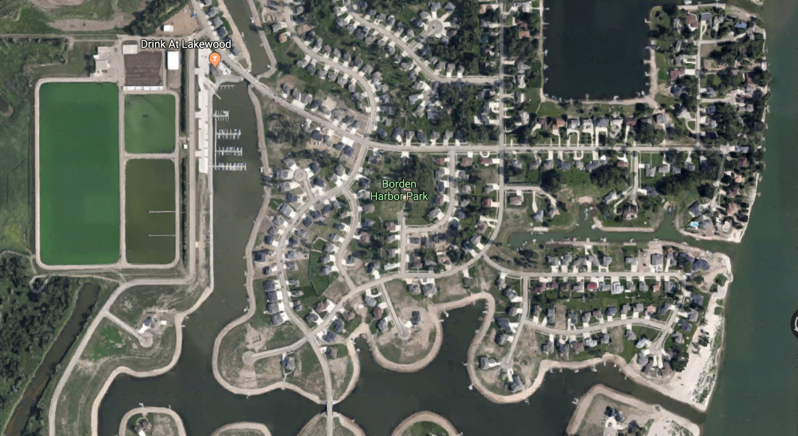
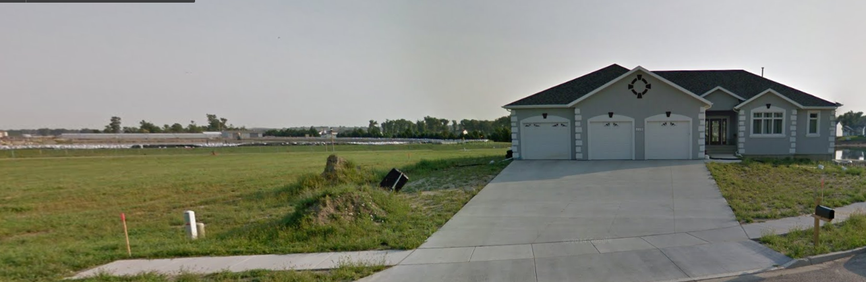
Land Availability
Setback should be .25 miles.
Is the city responsible for the controlling the smell from the lagoon or does the home owner have the right to complain?
Wind direction should be considered when building a lagoon.

Slide 7
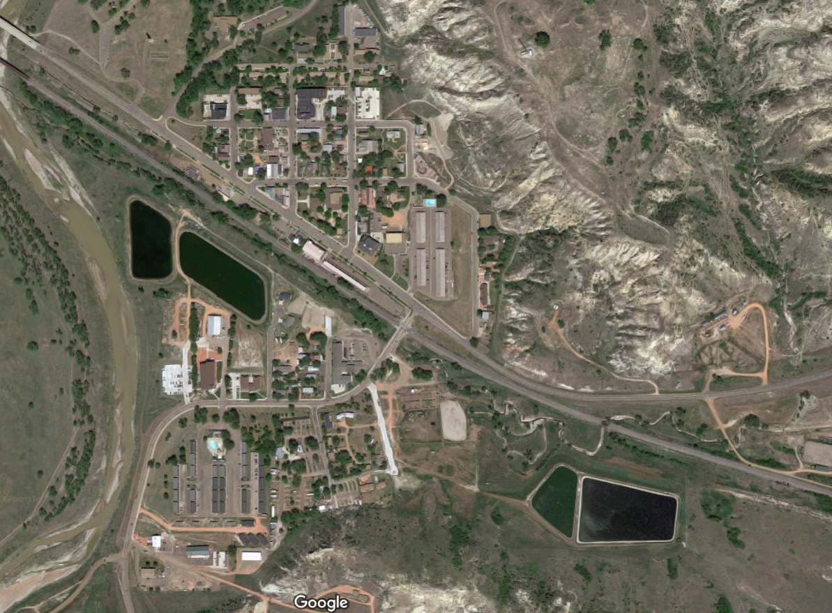
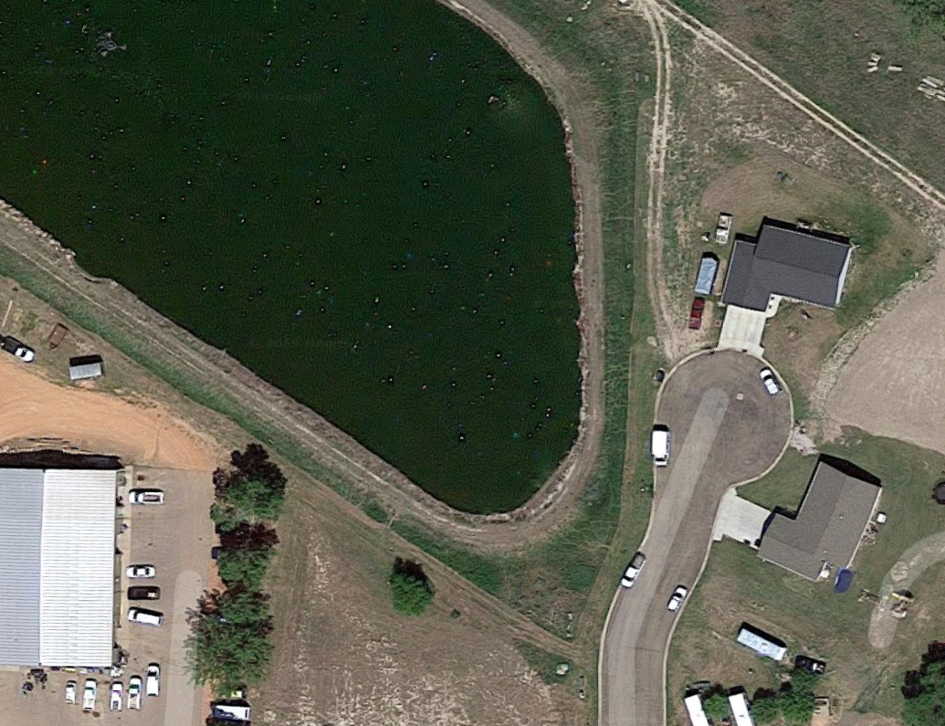

Slide 8
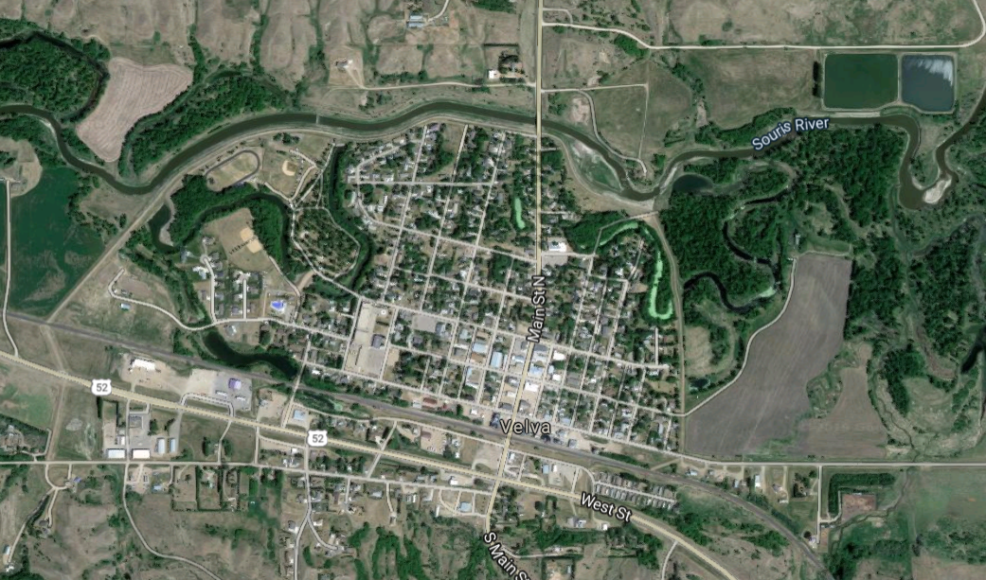
Wind Direction
Cenex

Slide 9
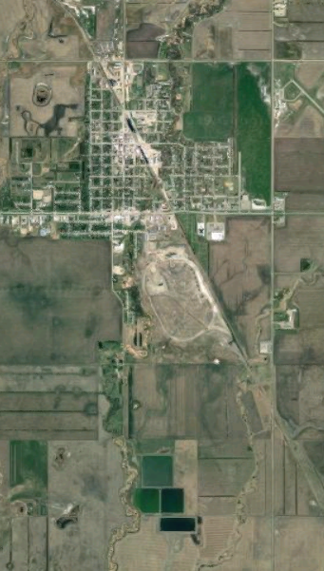
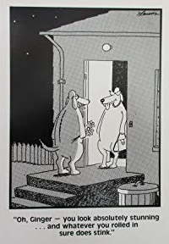
Distance 1.7 miles
However, there are days where spending millions on the location of a lagoon does not help.
Wind Direction

Slide 10
Wastewater Stabilization Ponds
The most common technique across the state (in the 90s percent).
Only one-fourth of municipals in the United States utilize a wastewater stabilization pond.
Design standards:
  Operating depth between 2 and 5 feet
  Minimum freeboard of 3 feet
  At least three cells designed for series operation
    There are 2 cells lagoons in North Dakota
Flexibility to allow cells to be bypassed is encouraged

Slide 11
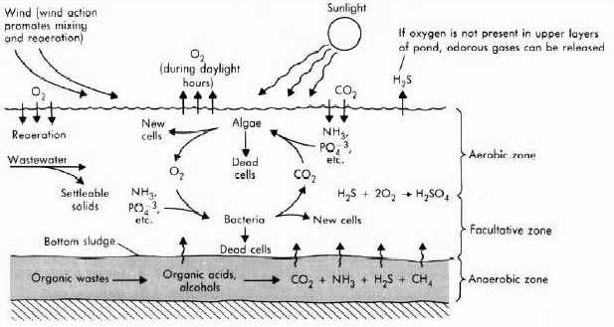
Source: Tchobanoglous and Schroeder 1987

Slide 12
Advantages
  Ease of operation
  No electrical energy
  Minimal maintenance required
  Handles flow and loading variations well
  Class 1A to Class II, or no need for a certified operator for a community with a population less than 500
Disadvantages
  Large land requirements
  Need to be located away from permanent residences
  Public perception/odors
  Limited treatment occurs during the winter

Slide 13
Mechanical Treatment Plants
Levels of Wastewater Treatment
Preliminary: removal of large solids like rags, sticks, grit, etc.
Primary: removal of suspended solids and organic matter by sedimentation.
Secondary: removal of biodegradable organic matter and suspended solids through oxidization by microorganisms.
Tertiary: removal of suspended solids (usually by filters), disinfection, nutrient removal.

Slide 14
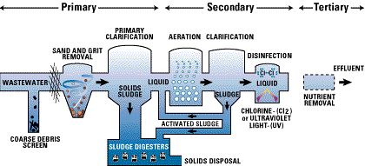

Slide 15
A variety of unit processes are available for all levels of treatment and can be tailored to the needs of the community.
Need to meet Ten States Standards
Advantages: able to effectively treat wastewater flows from larger communities.
Disadvantages: higher level of operator certification required, electrical energy requirements, complexity, higher capital costs, higher operation and maintenance costs.

Slide 16
Categories of Secondary Treatment
Suspended growth/activated sludge: microorganisms and organic matter are suspended in wastewater
  Aerated basins
  Oxidation ditches
  Sequencing batch reactors
Attached growth, media is used to provide a surface for microorganisms to grow and consume organic matter
  Trickling filters
  Rotating biological contactors

Slide 17
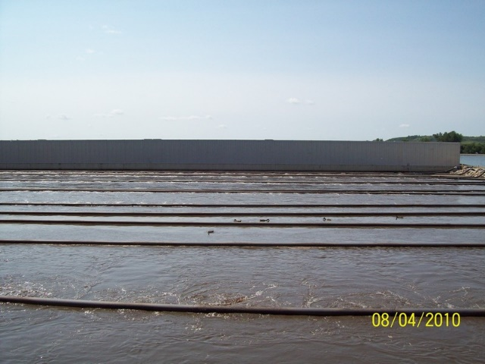
Aerated Basins
Activated sludge process
Used by Grand Forks and Mandan
May not require primary treatment
Mandan

Slide 18
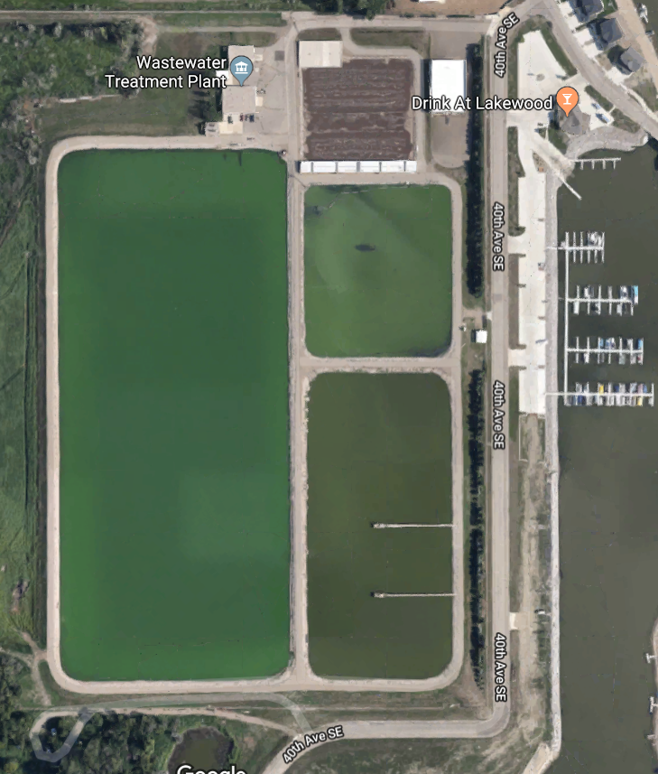
Mandan

Slide 19
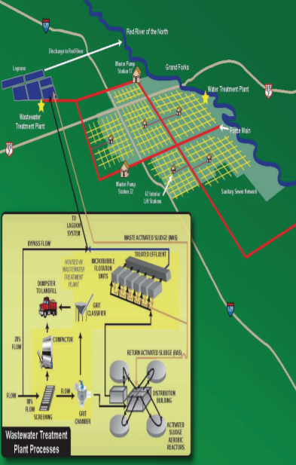
http://www.grandforksgov.com/home/showdocument?id=710
There are schematics online for the design of the wastewater treatment facility.

Slide 20
Oxidation Ditches
Activated sludge process
Used by: Williston, Watford City
Reactors are commonly designed in a “racetrack” configuration
Aerators mix and aerate the wastewater

Slide 21
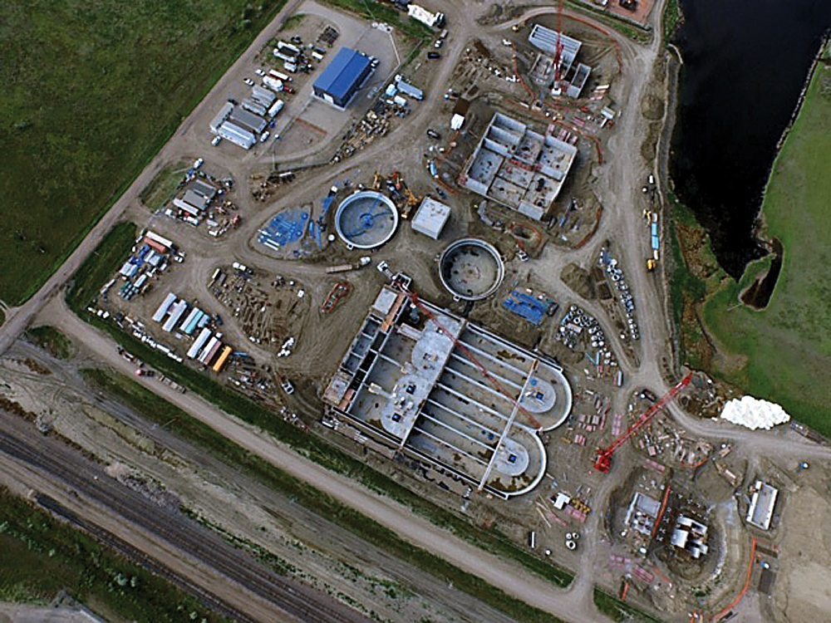
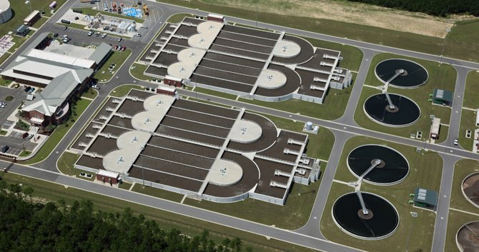
Williston
http://www.westech-inc.com/en-usa/products/oxidation-ditch-oxystream

Slide 22
Advantages: reliable, economical for small plants, high quality effluent is possible, capable of treating shock loads, adaptable to nutrient removal.
Disadvantages: poorer BOD and TSS removal (80-90%), sensitivity to lower temperatures, odor production.

Slide 23
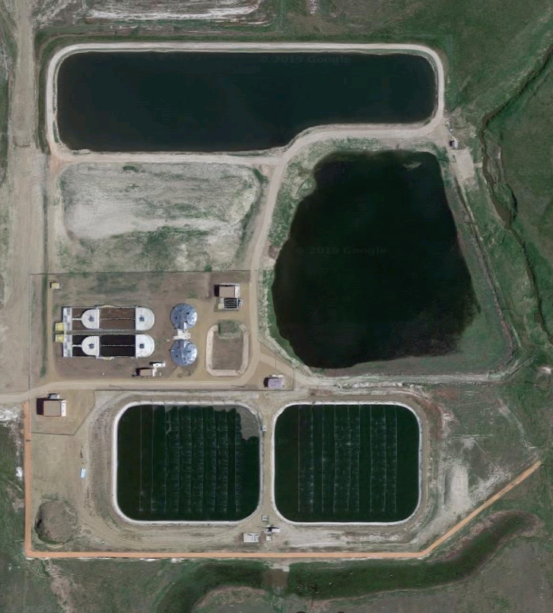
Watford City

Slide 24
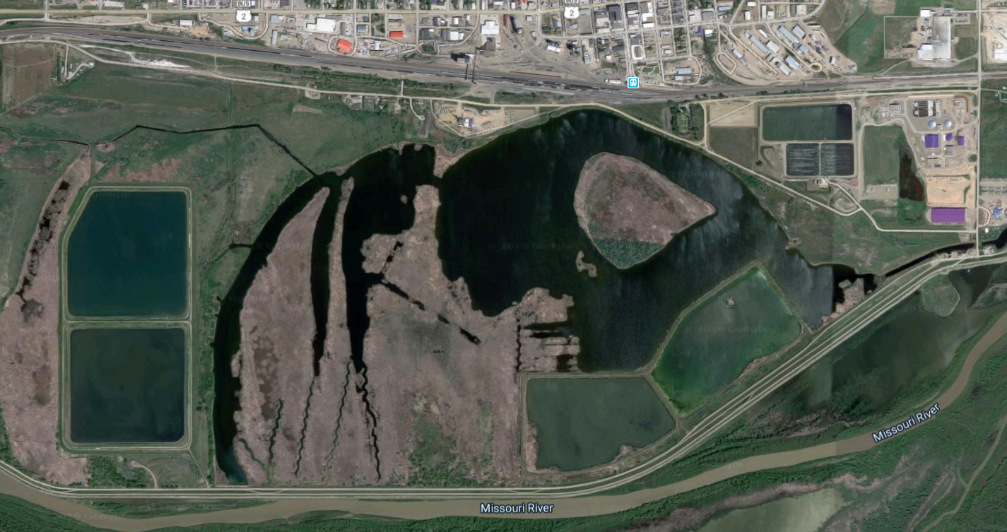
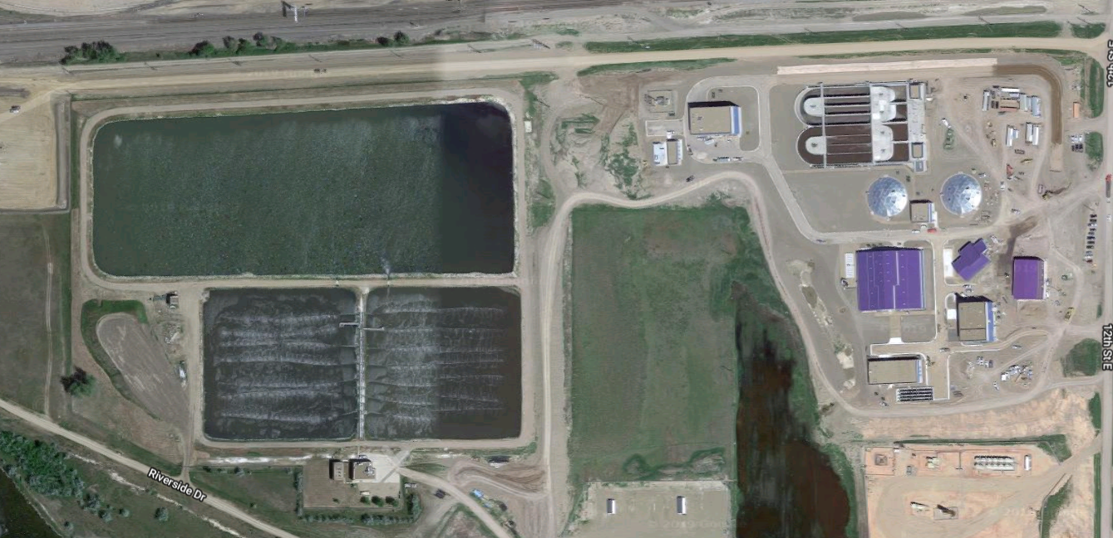
Williston

Slide 25
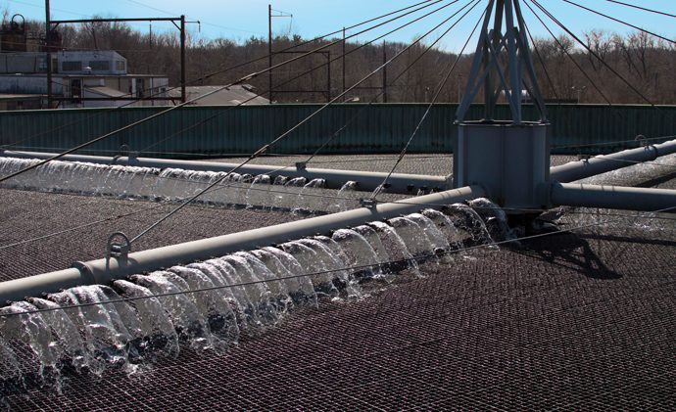
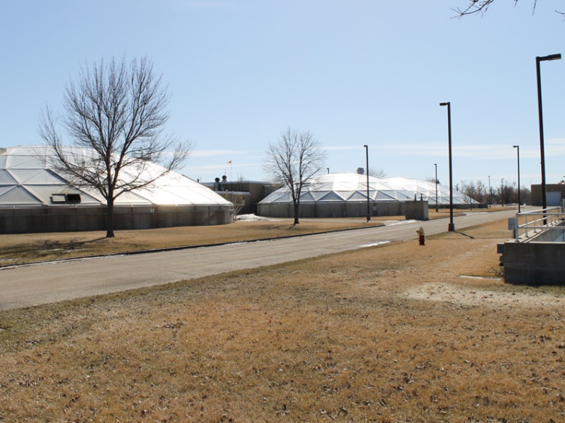
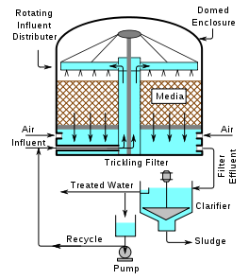
Trickling Filters
Attached growth process
Used by Fargo and Bismarck
https://www.brentwoodindustries.com/water-wastewater-products/trickling-filter/
Bismarck

Slide 26
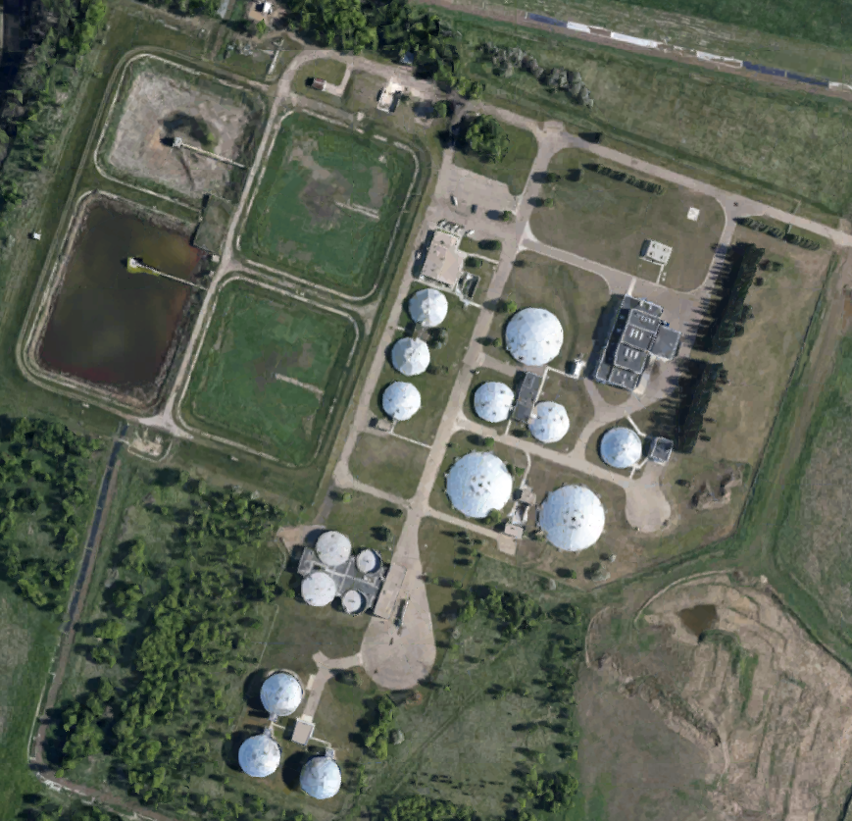
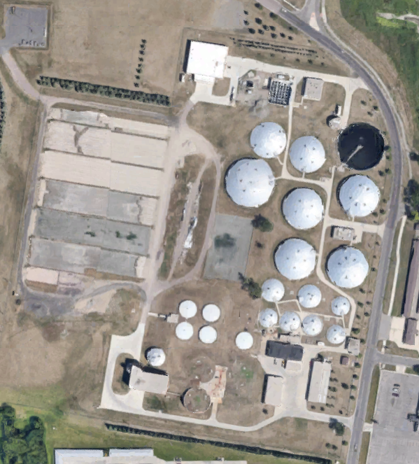
Bismarck
Fargo
Majority of the mechanical operations are roofed.

Slide 27
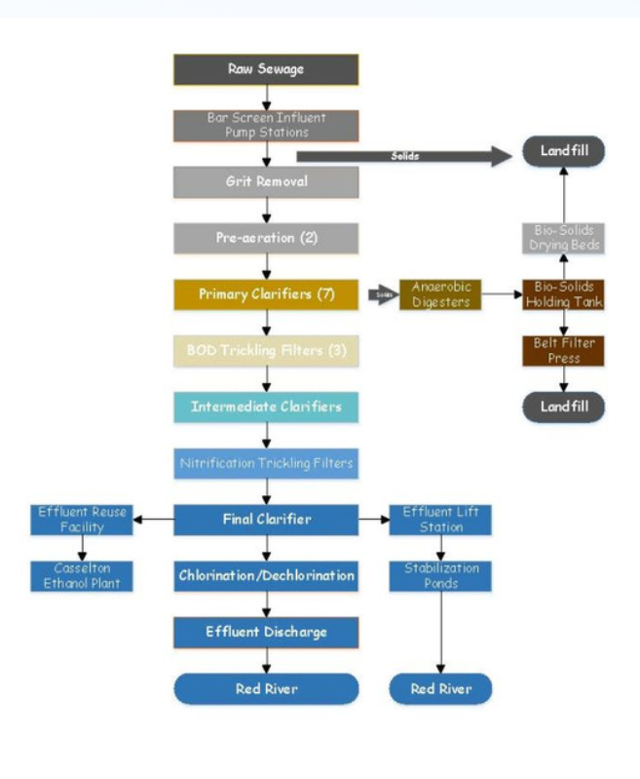
Fargo

Slide 28
Compare to the activated sludge process:
Advantages: less energy required, simpler operation, less equipment maintenance.
Disadvantages: poorer BOD and TSS removal (80-90%); sensitivity to lower temperatures, odor production

Slide 29
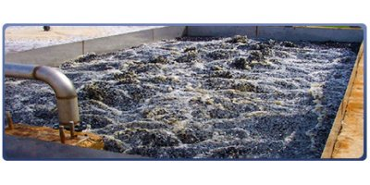
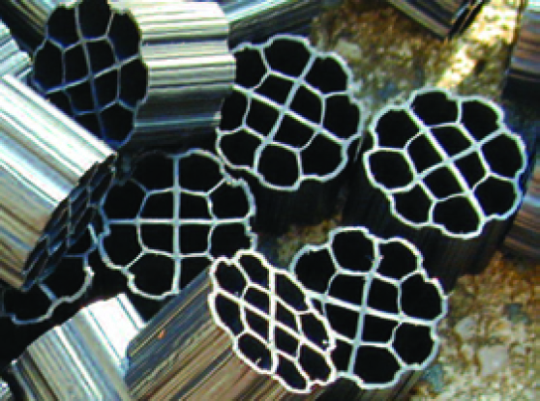
Integrated Fixed-Film Activated Sludge
Used by Dickinson.
Hybrid of activated sludge and attached growth processes.
Media are mixed into suspension in a tank where they provide a surface for biofilm to attach.

Slide 30
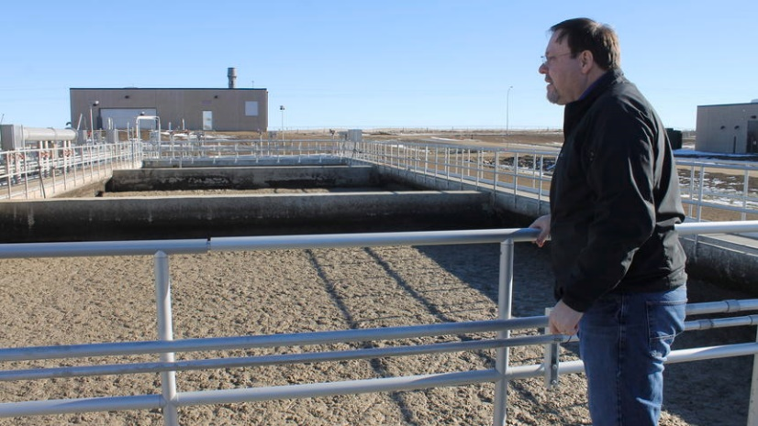
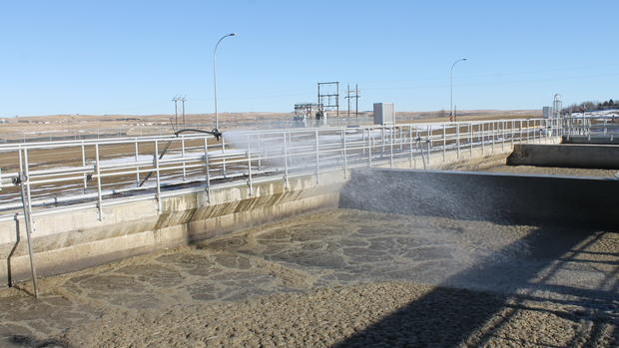
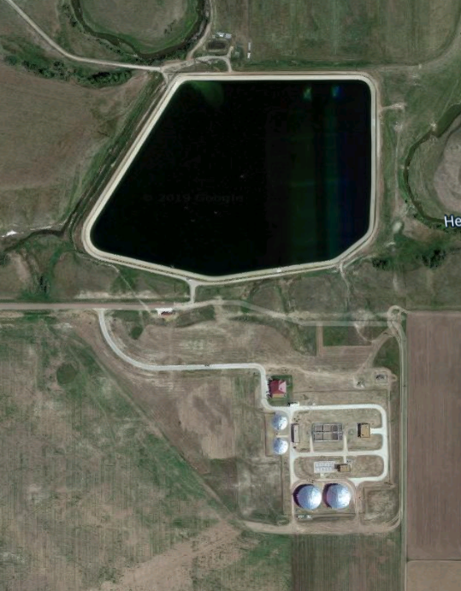
https://www.thedickinsonpress.com/business/3669112-new-era-water-reclamation-dickinson-facility-built-serve-oil-patch
https://www.google.com/search?q=dickinson+nd+wastewater+integrated+fixed+film+activated+sludge&source=lnms&tbm=isch&sa=X&ved=0ahUKEwi78pqQga3iAhXBna0KHYEBDLQQ_AUIDigB&biw=1536&bih=754#imgrc=9iDZq4b3jSIlXM:
Dickinson

Slide 31
Package Treatment Plants
Becoming more common, especially in the western part of the state or private developments.
Treatment flows range from 2,000 gpd to 500,000 gpd.
Use many of the same processes as a full-size mechanical treatment plant.
Despite being pre-engineered, the plans must still be stamped by a Professional Engineer licensed in the state of ND.
Manufacturer shall provide letter with submittal certifying the treatment level with the proposed installation.

Slide 32
Two options for effluent discharge:
  Effluent storage pond
  Drain field
Effluent storage pond: must provide 180 days of storage, but can be up to 12 feet deep with 3 feet of freeboard for a total of 15 feet; otherwise must comply with Chapter 90.
Drain field: must conform to North Dakota Plumbing Code for Private Sewage Disposal Systems, no reduction in drain field size is allowed for treated effluent.

Slide 33
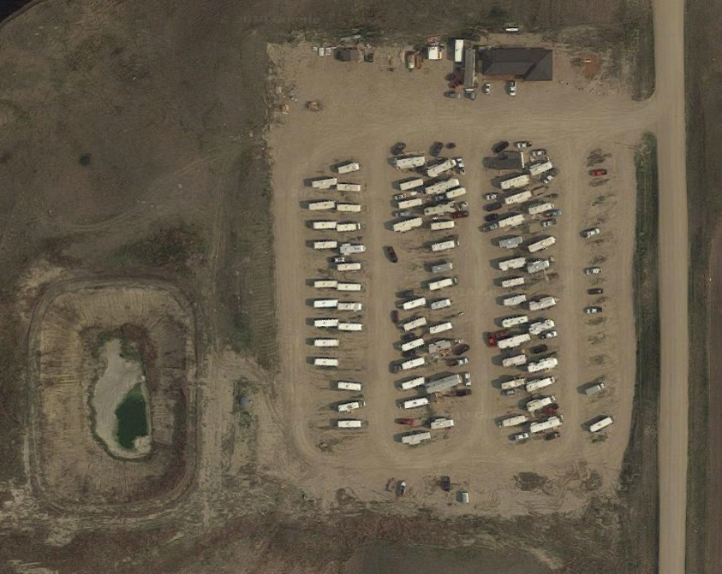
But Why?
No possible connection to an existing sewer line
Produce too much waste for a septic tank.
Does not produce enough waste for a lagoon

Slide 34
Advantages
  Smaller footprint
  Treatment to stricter standards is possible
  Pre-engineered, pre-manufactured
  Ease of installation
Disadvantages
  Electrical energy requirements
  May need supplementary flow equalization and disinfection
  Need provisions for disposal of biosolids.
  Higher level of operator certification required.
  Maintenance and replacing parts

Slide 35
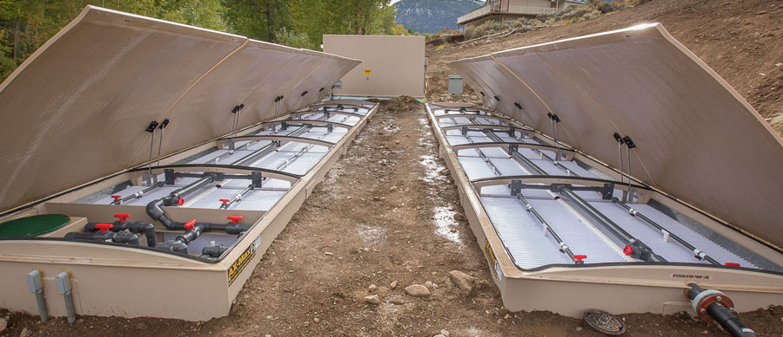
Orenco AdvanTex
Utilizes a recirculating packed bed filter.
Used by: City of Alexander, River’s Edge Addition (near Horace), Egan Crest Camp, JMAC Resources

Slide 36
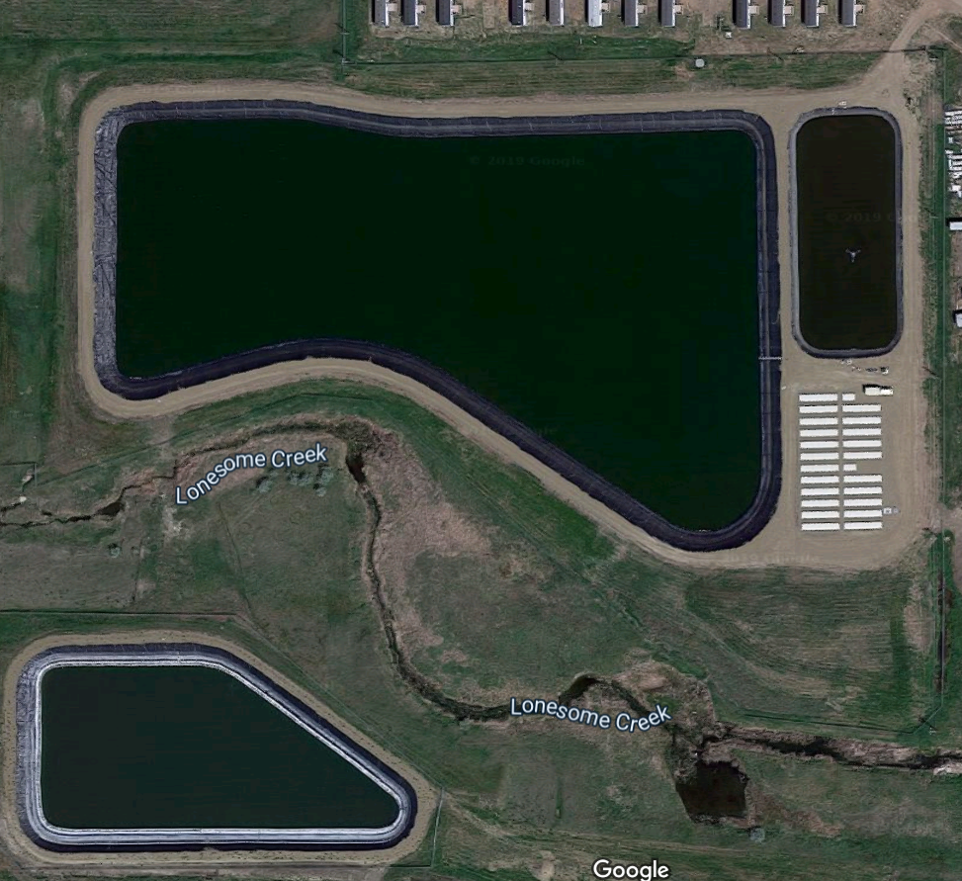
Alexander

Slide 37
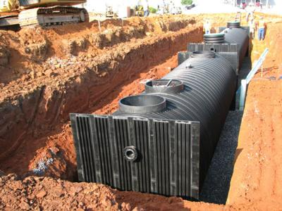
Contech Magellan
Utilizes a primary clarifier, flow equalization, moving bed biofilm reactor (MBBR), and secondary clarifier
Used by: Misty Waters, The Ranch Subdivision, Epping Ranch

Slide 38
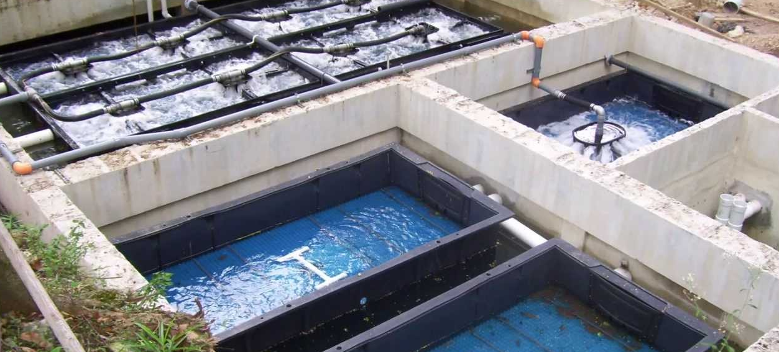
Bio-Microbics MyFAST
Integrated Fixed-Film Activated Sludge
Used by: Dakota Sewer Disposal, Enviro Waste Solutions, Bakken Water Exchange

Slide 39
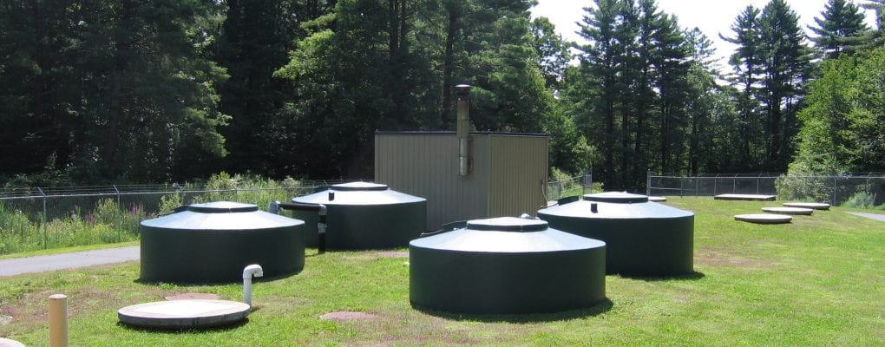
AquaPoint Bioclere
Utilizes a modified trickling filter over a clarifier.
Used by Burning Hills Amphitheater in Medora

Slide 40
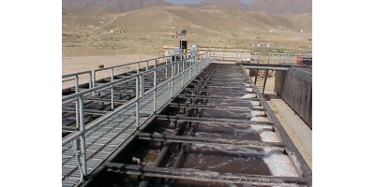
Pollution Control Systems, Inc,
Utilizes extended aeration.
Used by: Sweet Crude Travel Center

Slide 41
Questions

