Slide 1


RECORD KEEPING
Spring 2021
Gregg Stewart
North Dakota Department of Environmental Quality
701-328-6621
gstewart@nd.gov

Slide 2
WHY KEEP RECORDS?
Required by law
Track routine maintenance
Track treatment problems/optimize treatment

Slide 3
Provide basis for annual reports
Help control the quality of the water being discharged
Provide a basis for possible financial aid

Slide 4
Protect yourself/system from unnecessary litigation/unjust claims
- i.e. odor problems, sewer backups, permit violations, work related accidents, etc.

Slide 5
WHERE TO KEEP RECORDS?
Two separate locations is ideal
- Operator has one copy
- City auditor (or other designated city official has the other copy)
NOTE: Monitoring records must be kept on file for at least 3 years

Slide 6
EXAMPLES OF RECORDS THAT SHOULD BE KEPT
Date, place and time of any samples collected
Individual who took the sample(s)
Date(s) analyses were performed

Slide 7
Individual who performed analysis and method used
Results of analyses (pH, BOD, total suspended solids, fecal coliforms, ammonia, chlorine, metals, whole effluent toxicity, hydrogen sulfide, oil/grease, dissolved oxygen)

Slide 8
Preventive maintenance records (for each piece of equipment)
Preventive maintenance schedule (i.e., when valves are exercised)
Service report cards

Slide 9
Spare parts inventory
List of where spare parts can be purchased
Operation and maintenance manuals

Slide 10
Specifications on equipment from suppliers
Equipment inventory
Lift station pump hours (must keep hour meter readings/kilowatt hour usage)

Slide 11
North Dakota Pollutant Discharge Elimination System (NDPDES) permit
Discharge approvals
-also when discharge started and ended

Slide 12
How flow is determined while discharging (no more than 6 inches per day in order to minimize release of bottom solids)
Discharge Monitor Report (DMR) forms
  Include amount of water discharged within 10%
  Submitted to Dept. of Environmental Quality every 6 months

Slide 13
Operation manuals/manufacturers literature
Design Engineers Report and Specifications
Budgets/maintenance costs

Slide 14
Do your wastewater ponds hold water or are they seeping?
Or is your discharge pipe leaking?

Slide 15
When was the last time you checked your discharge pipe? (must be screened or have a flapper valve)
If it is leaking, must test if water is wastewater or groundwater

Slide 16
Sample must be collected and analyzed for: fecal coliform, BOD, TSS, pH, nutrient scan, and general chemistry
If it is wastewater, valve must be repaired or replaced

Slide 17
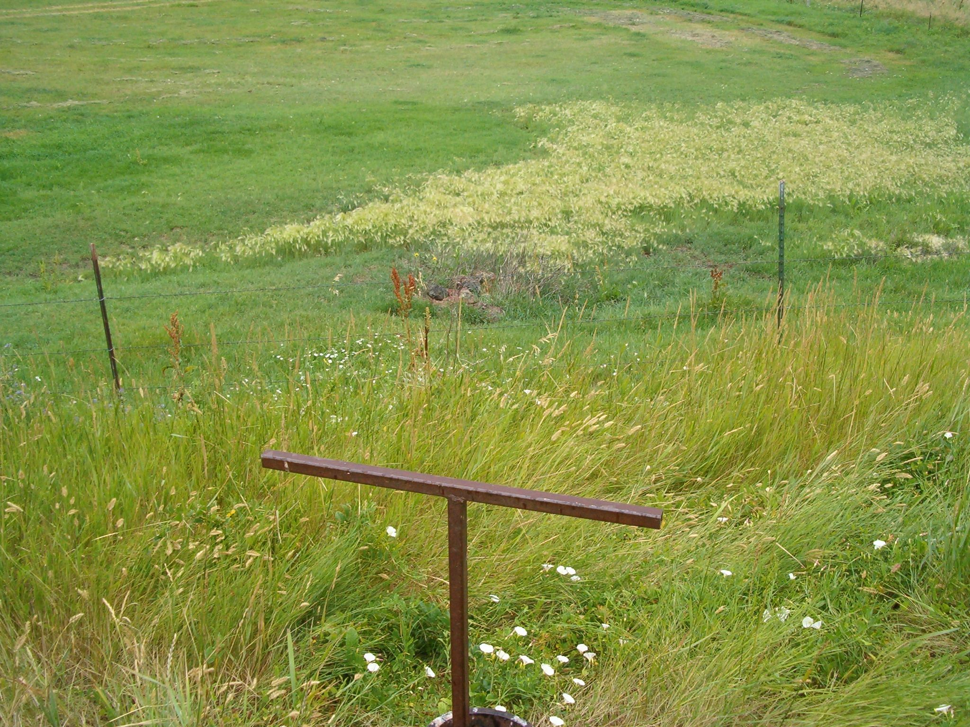

Slide 18
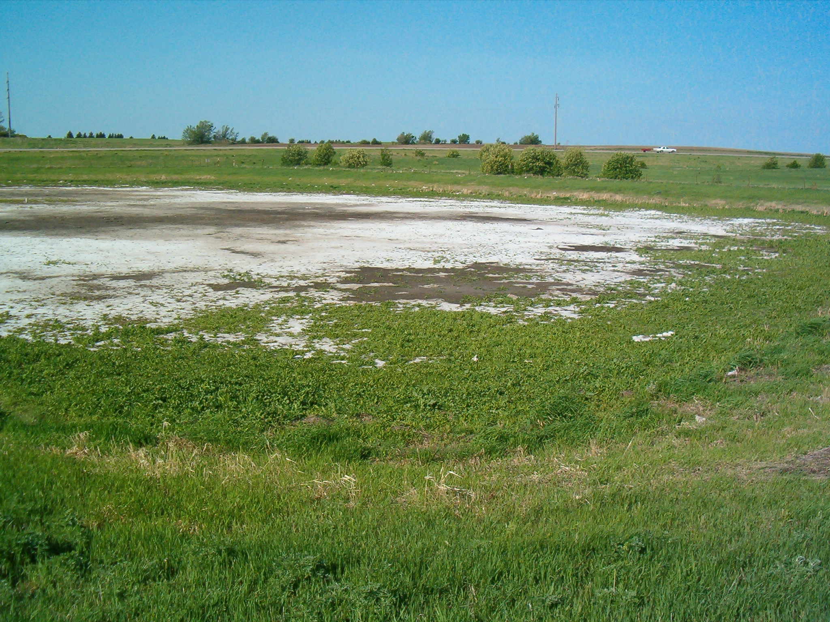

Slide 19
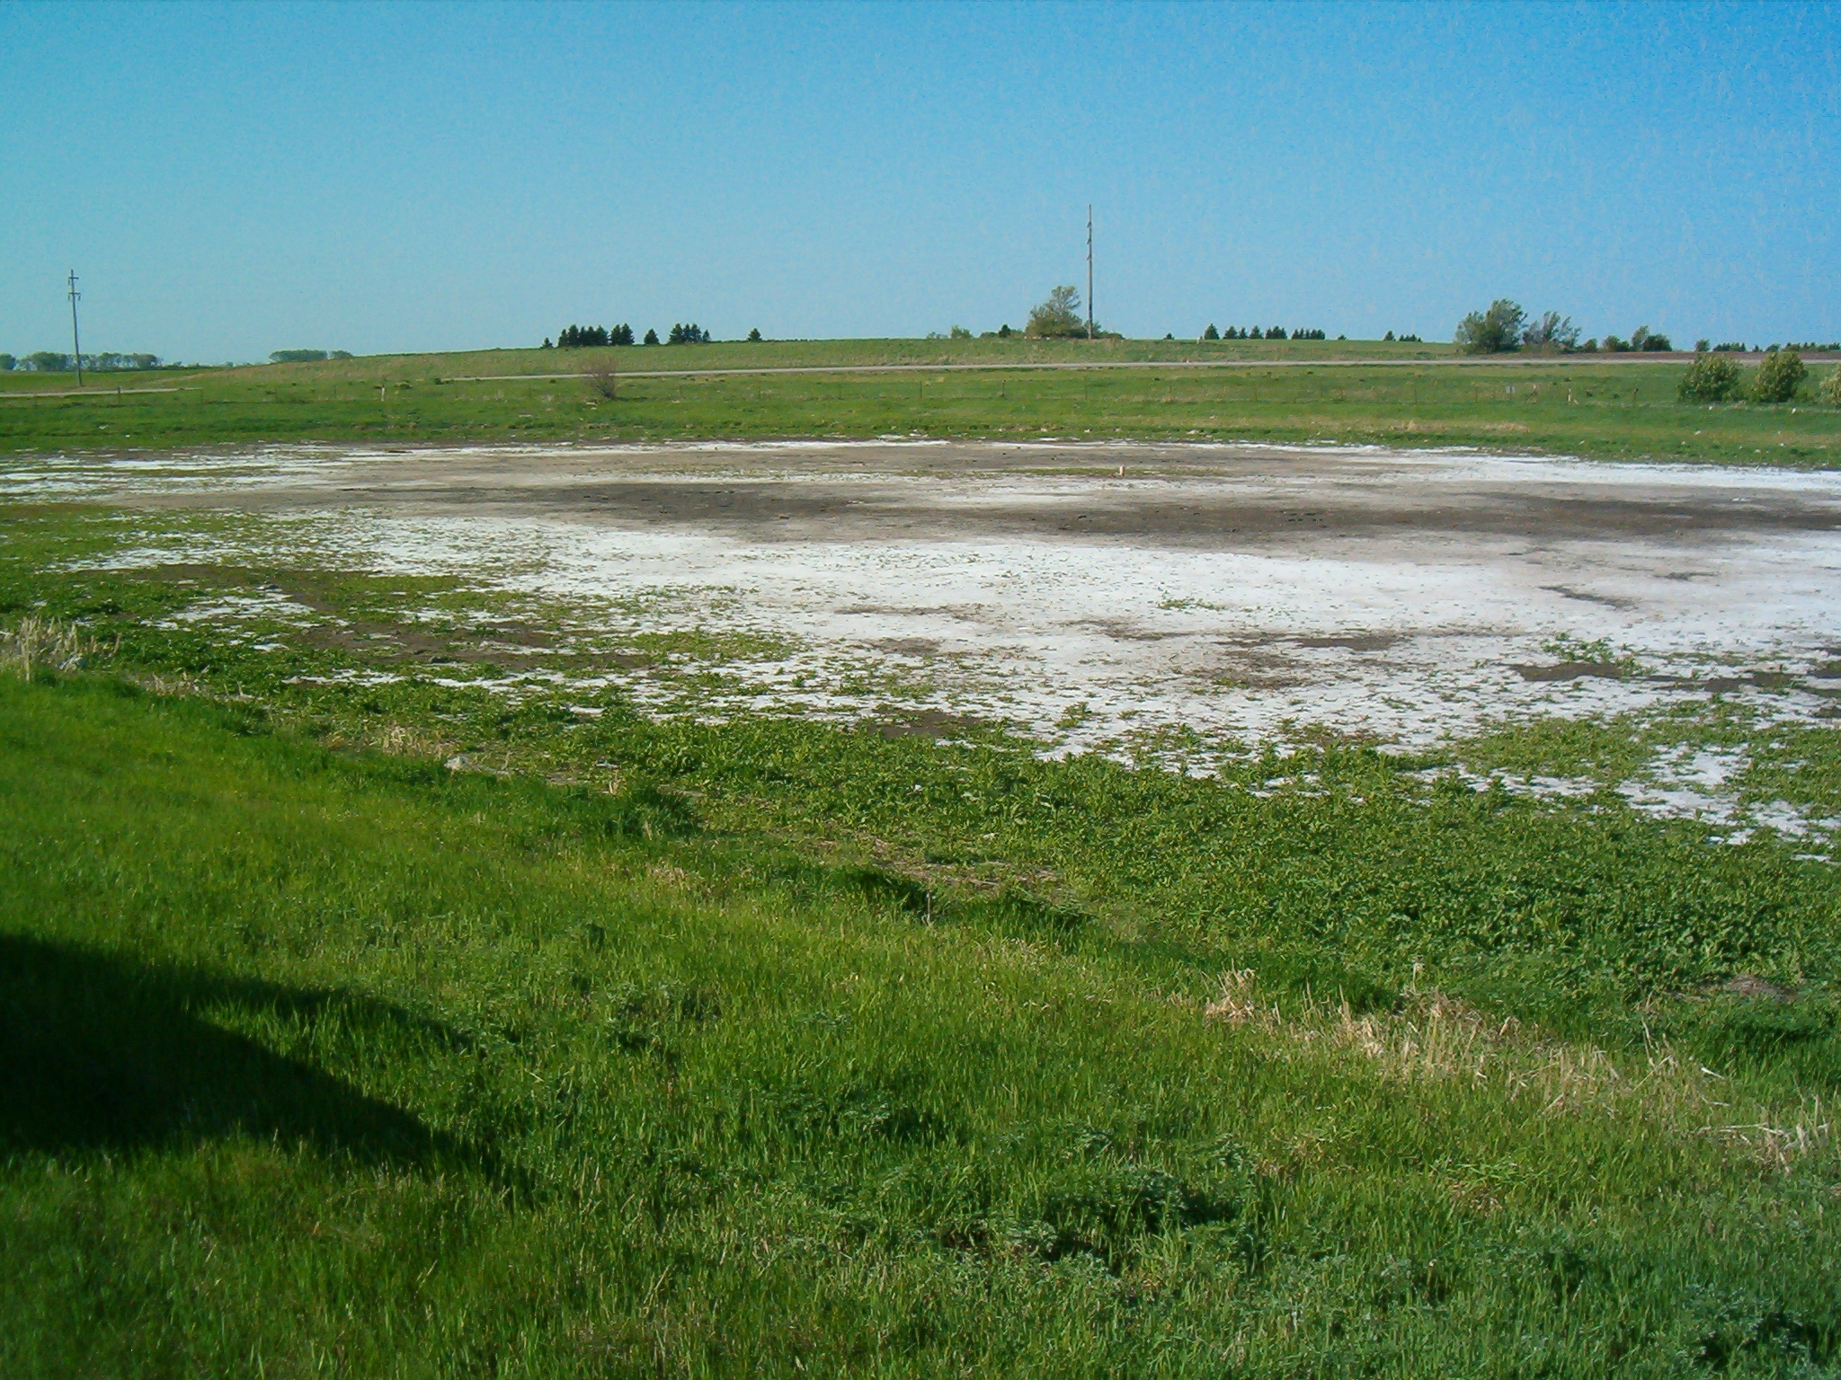

Slide 20
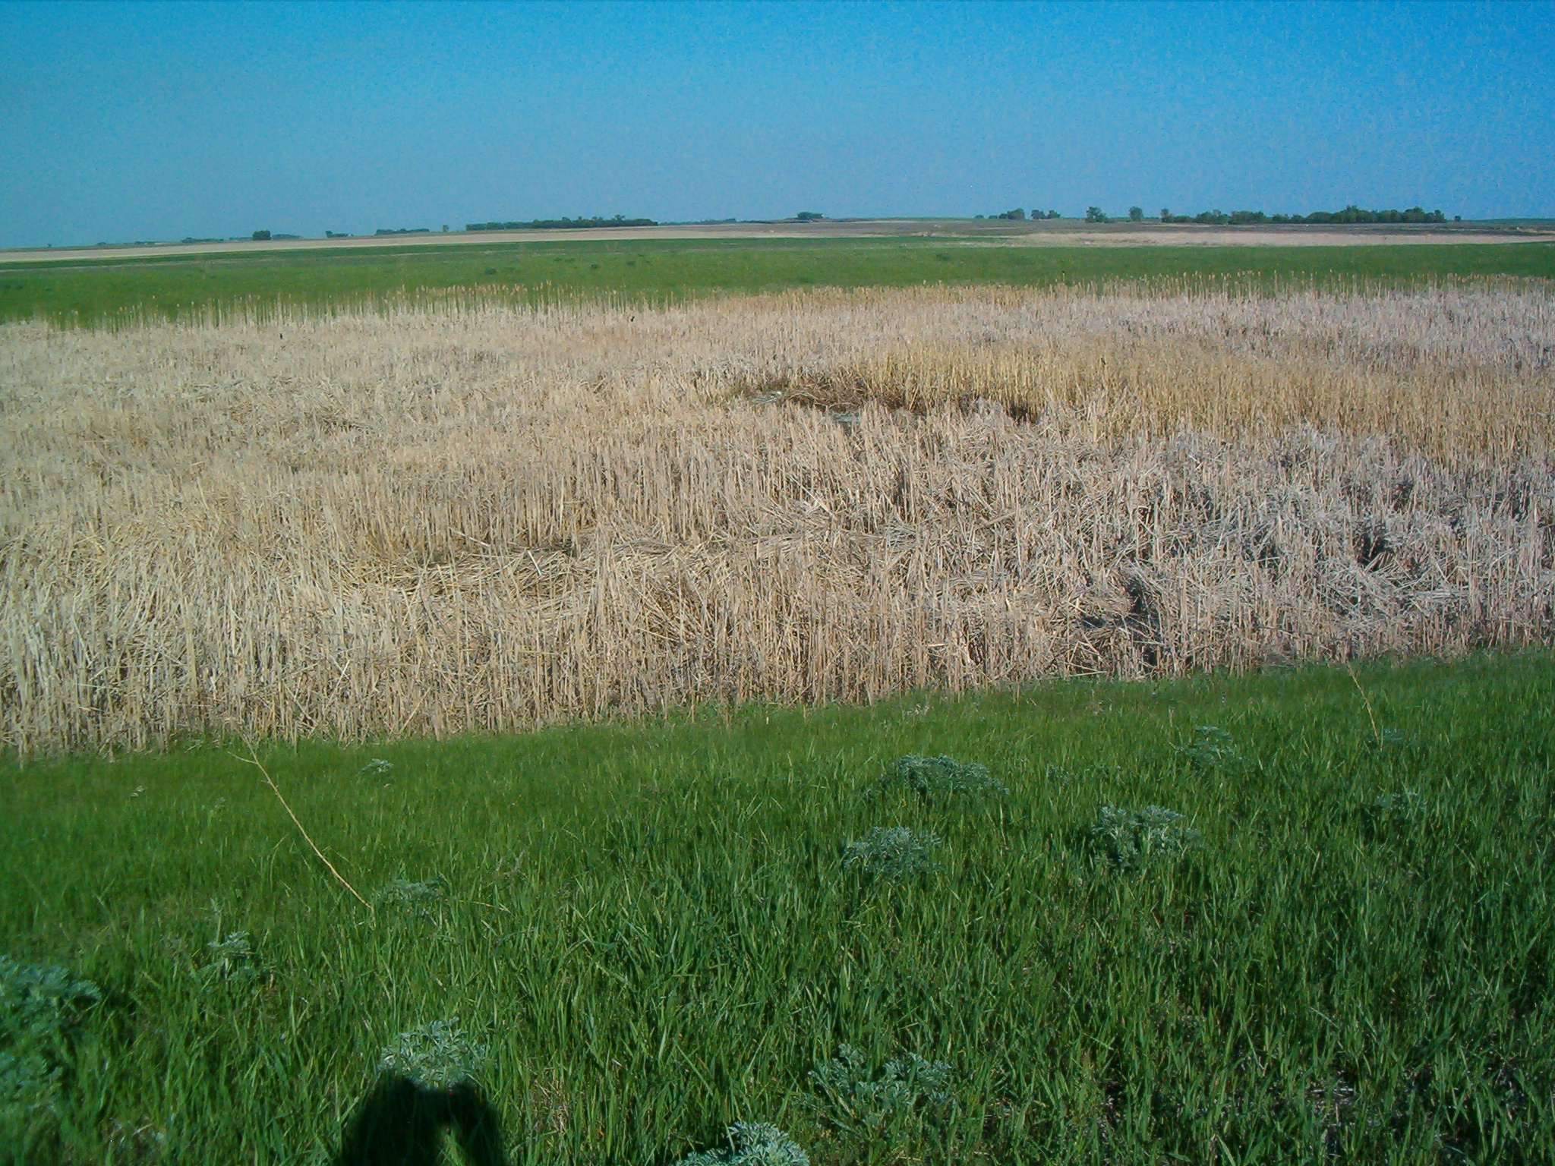

Slide 21
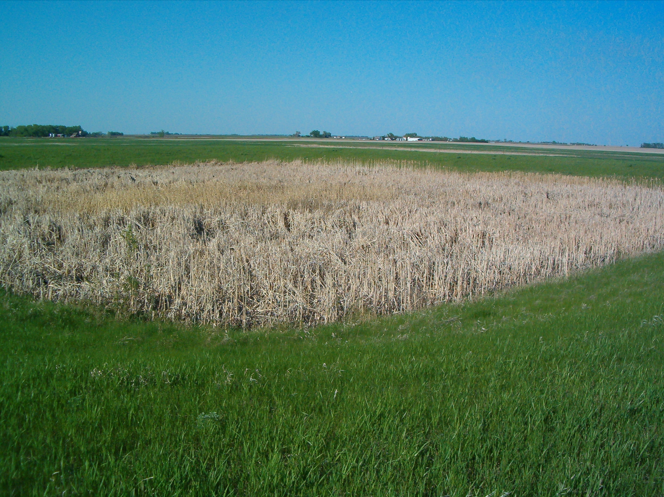

Slide 22
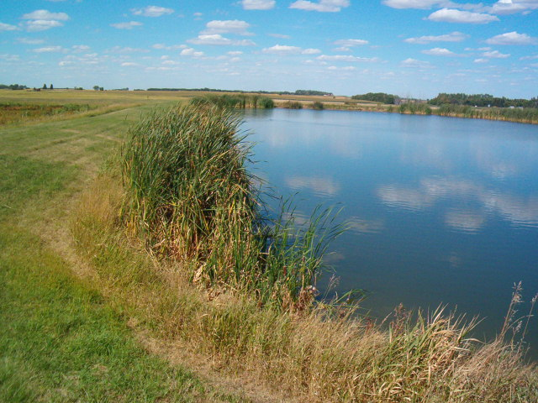

Slide 23
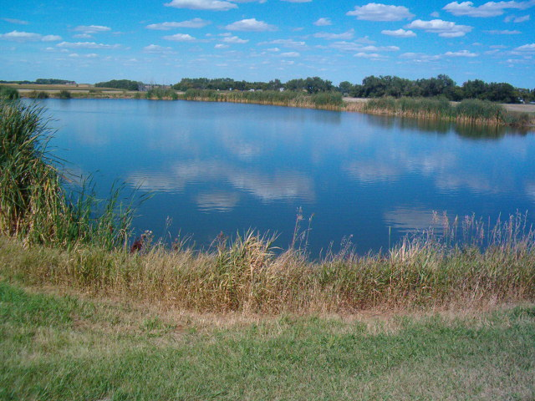

Slide 24
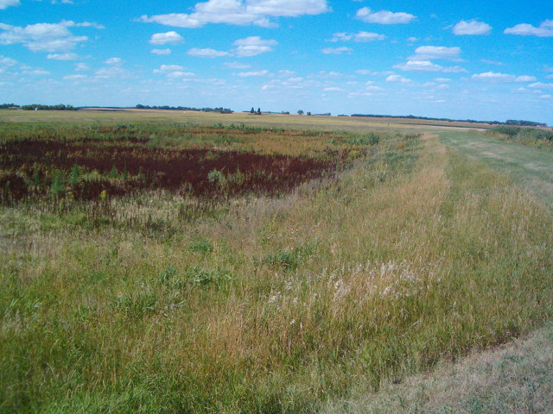

Slide 25
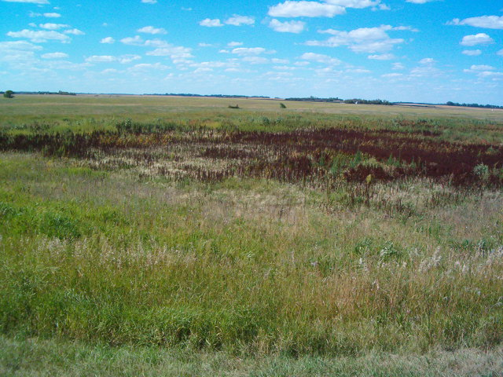

Slide 26
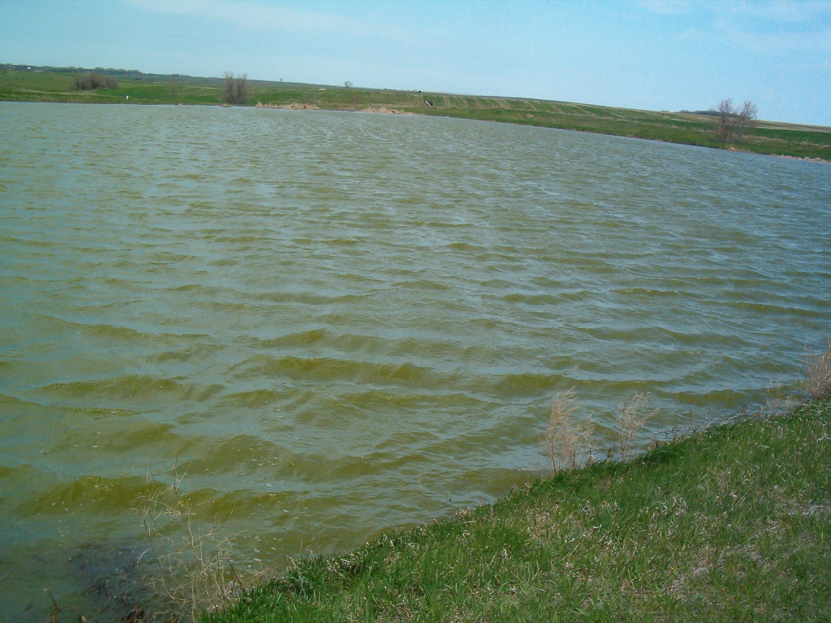

Slide 27
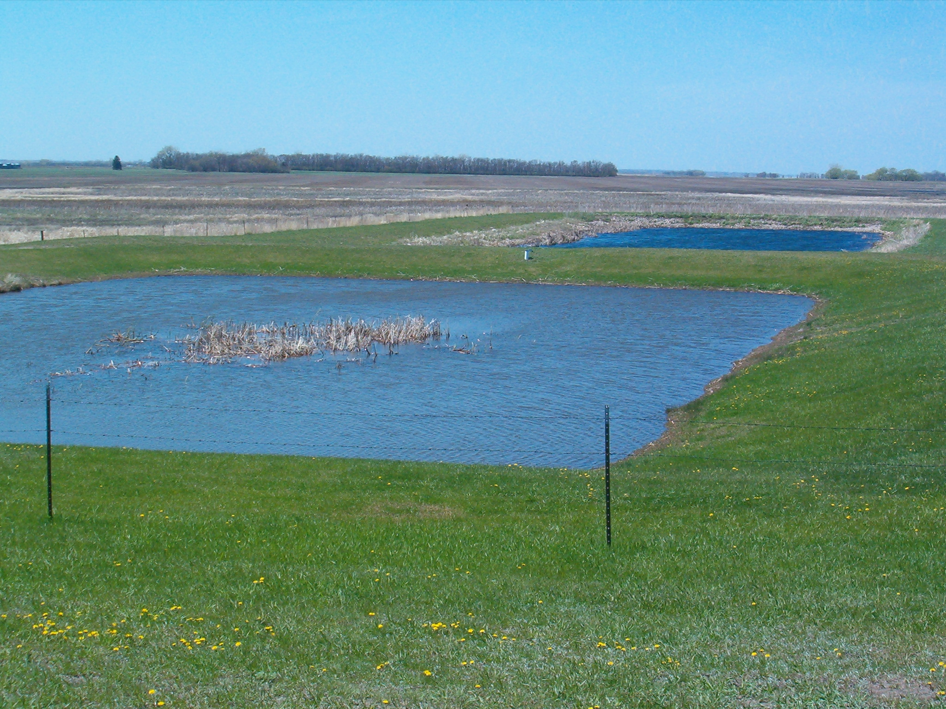

Slide 28
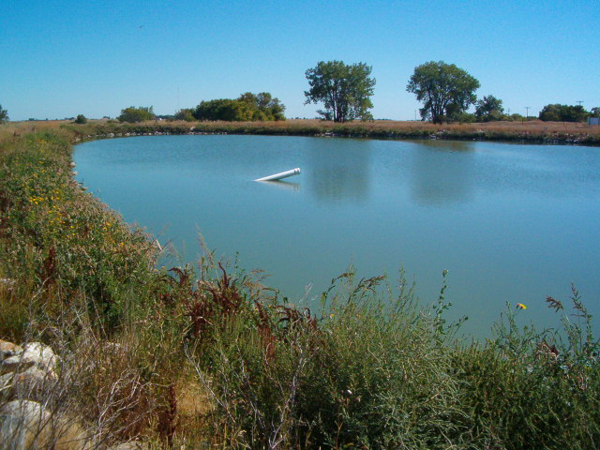

Slide 29
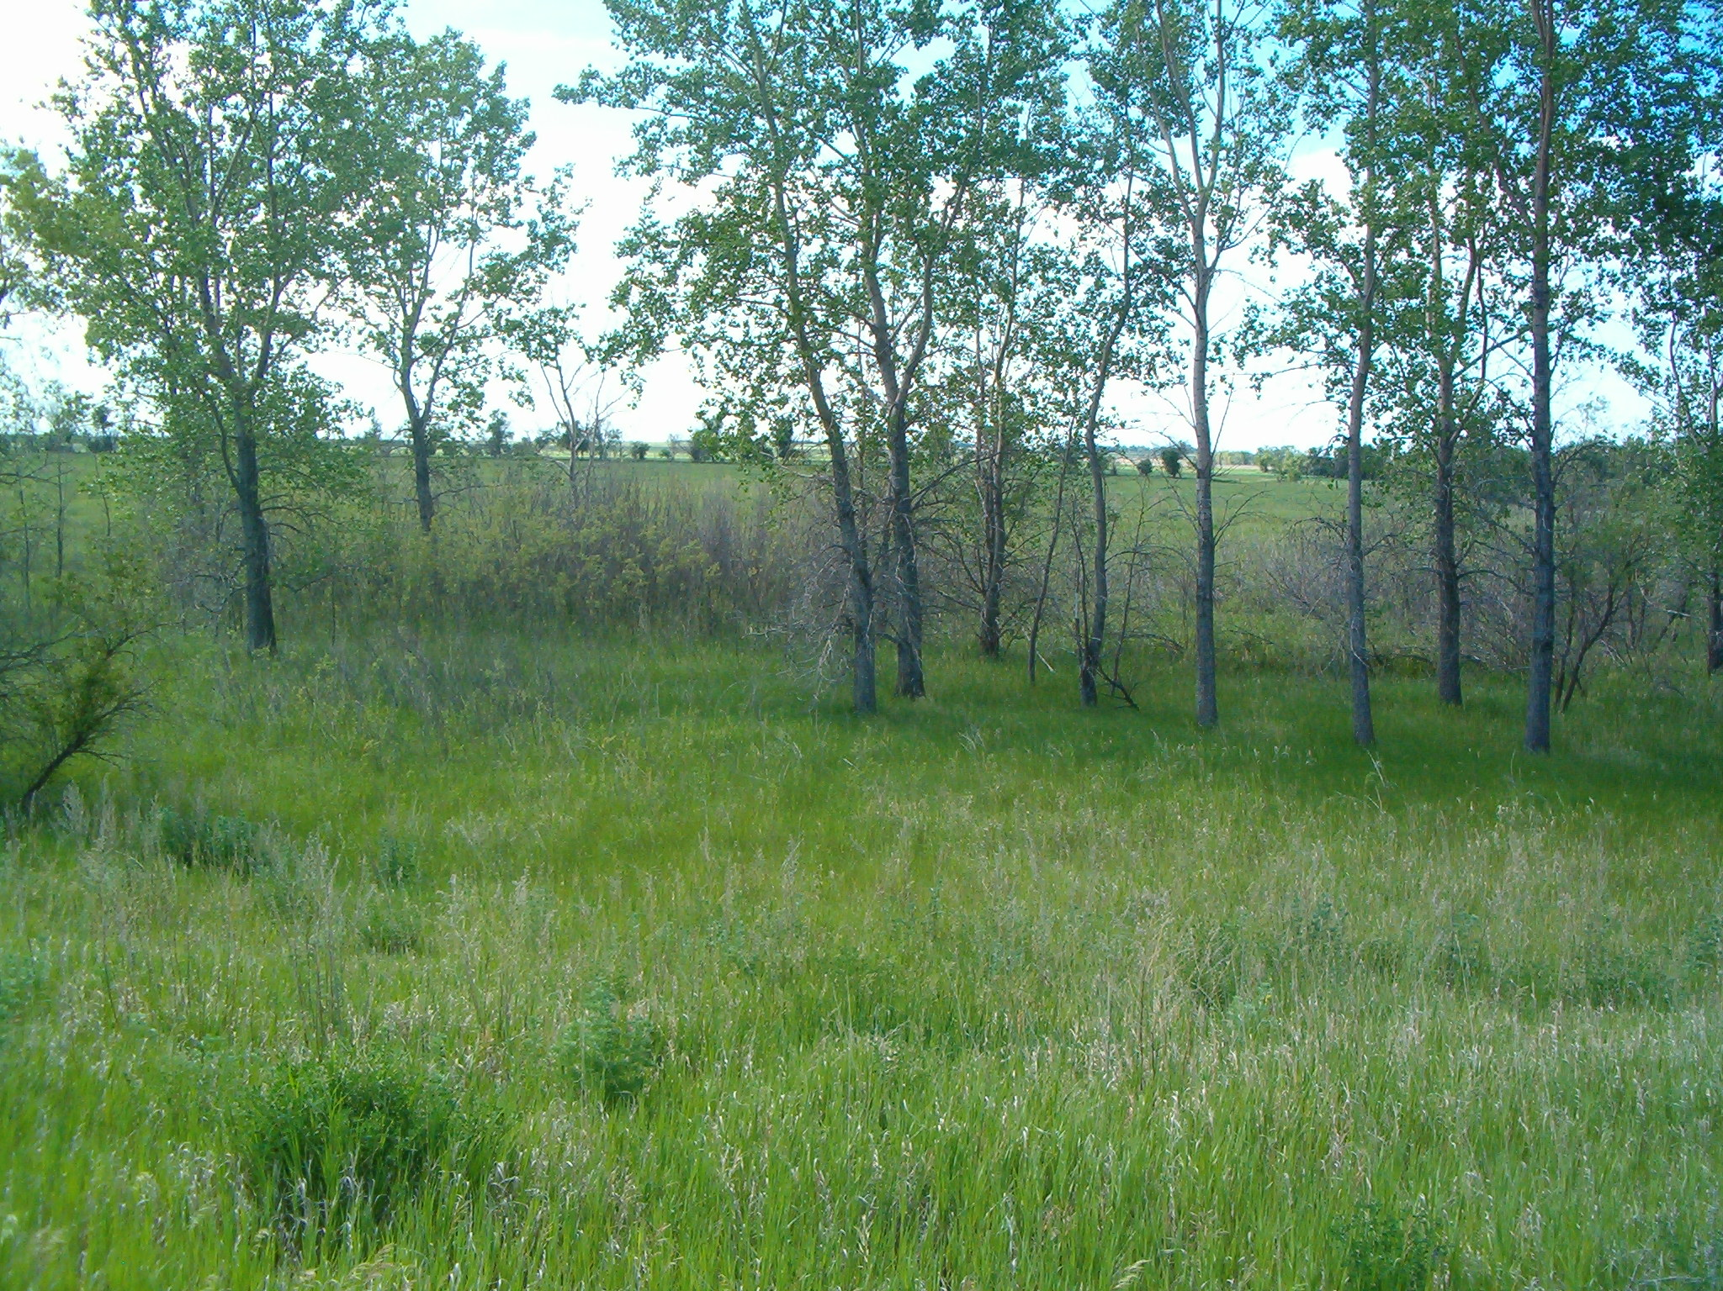

Slide 30
QUESTIONS?
1. Keeping adequate records is required by law. (T or F)
2. Monitoring records should be kept on file for at least ____ years.

Slide 31
3. Keeping good records may protect a system from unjust litigation. (T or F)
4. Wastewater systems should keep track of when a discharge from a pond ______
and ______.

Slide 32
5. When discharging a pond, the pond should be lowered no more than _________ per day.

